Slide 1
FREIA Laboratory for Accelerator and Instrumentation Development
Presentation at the
1st FCC Nordic Day 22 March 2021
Detailed publication now available at https://arxiv.org/abs/2103.05265

Slide 2
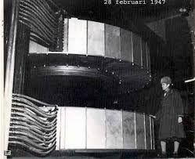
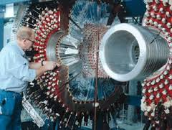
Uppsala university has been developing
accelerators since the 1950s
In the 1950s: Construction in Uppsala of the first synchrocylclotron (SC) as the then highest energy accelerator in Europe with its energy 185 MeV, followed 2 years later by Uppsala provding essential contributions to the build-up of CERNs first accelerator, the 600 MeV synchrocylclotron.
In the 1970s and 1980s the Uppsala synchro-cylcotron was converted to a sector-focussing cyclotron followed by the design and build-up of 1.5 GeV proton storage ring CELCIUS and the WASA detector which were operated during the 1990s. Considerable support from the Swedisch Research Council VR at that time.

Slide 3
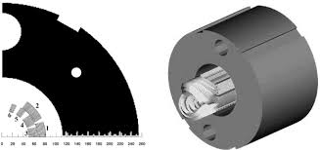
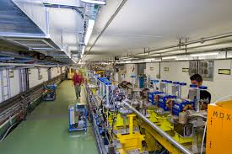
In 1994-1996 participation at CERN in the design, fabrication and test of the first 1 m prototype MFISC superconducting magnet for the 1300 superconducting dipoles for LHC. VR-support ca 2 Mkr.
Since 1995 till now participation in the CLIC prototype tests at CERN, in the 1990’s with design and test of Beam Position Monitors in the CLIC Test Facility 2 and from 2005 till 2016 with design, build-up and tests of the Two-Beam Test-Stand in the CLIC Test Facility 3 CTF3, now continued with DC spark vacuum break-down studies at CERN and in FREIA. VR support ca 12 Mkr.
MFISC
CLIC Test Facility CTF3

Slide 4
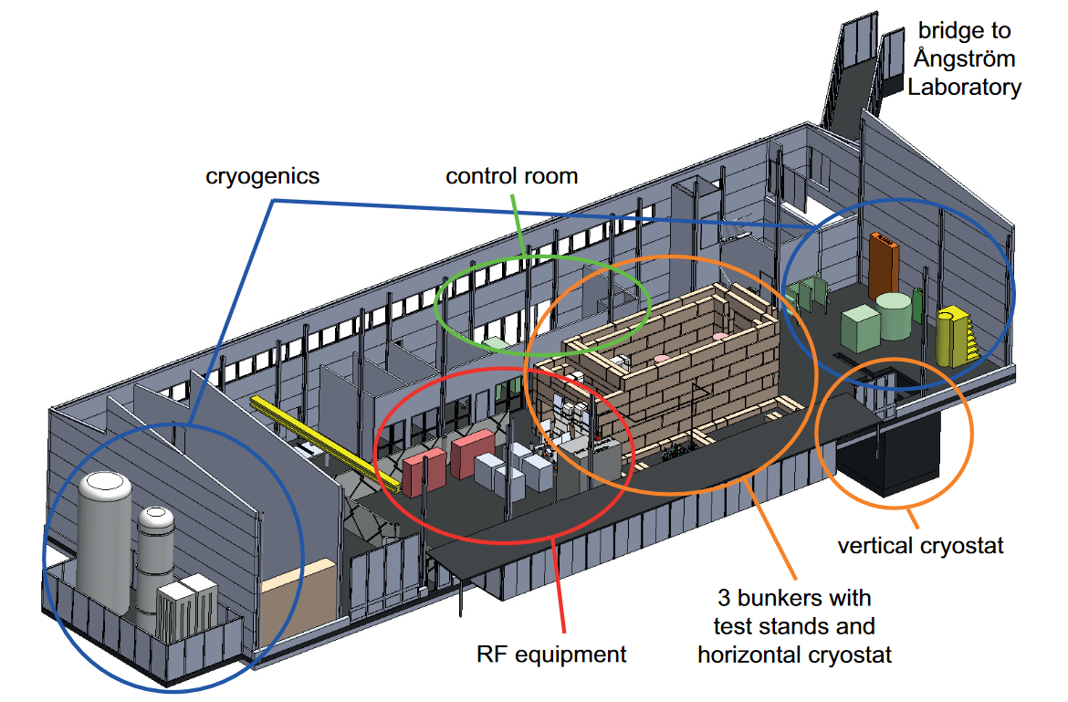

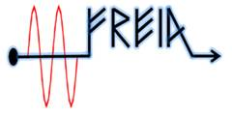
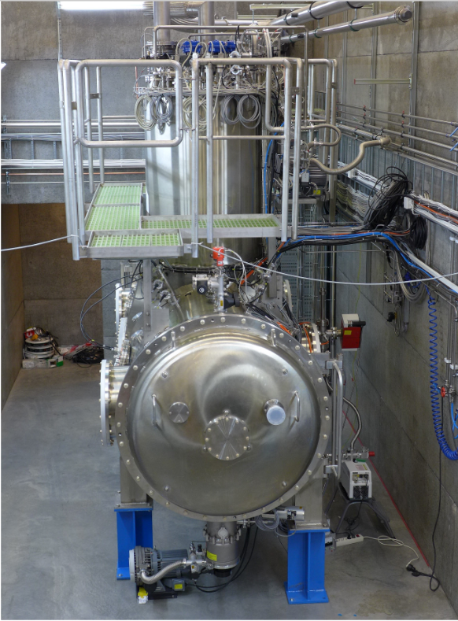
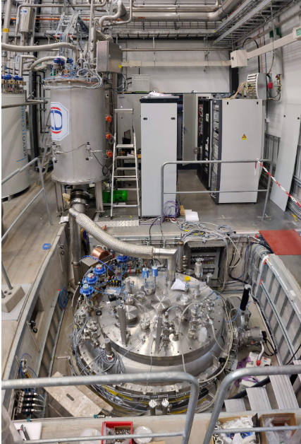
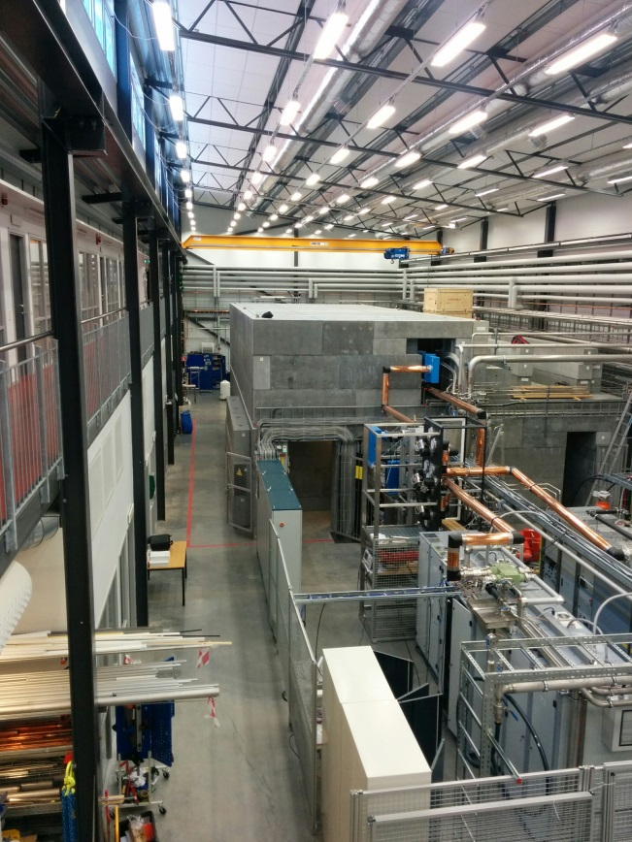
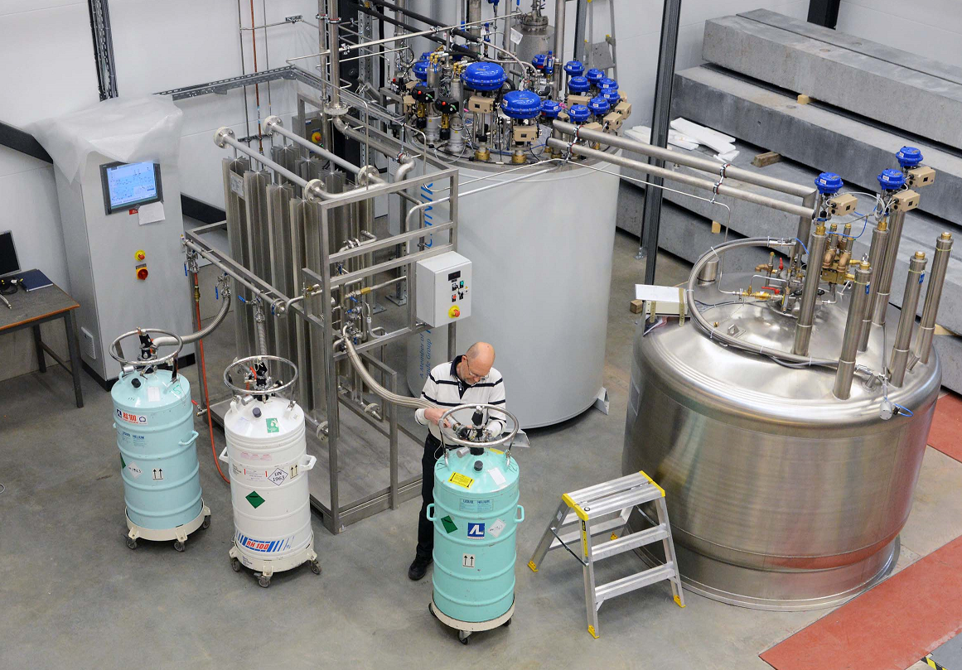
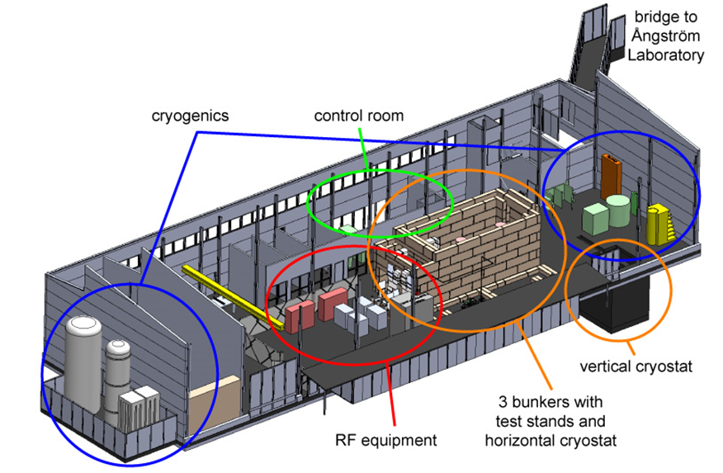
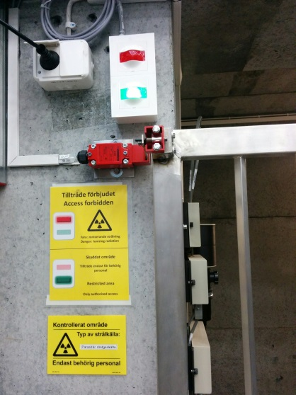
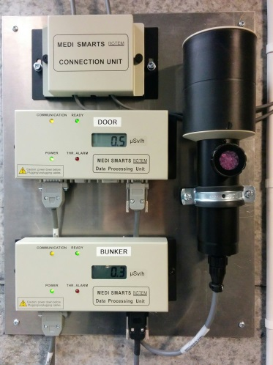
FREIA Laborator created in 2011
Major high-tech infrastructure for accelerator and instrumentation development and tests, including a high capacity liquid Helium source, a horizontal and a vertical cryostat, high power radiofrequency power generators, test bunkers and fast process control systems.
The nearby Ångström mechnical workshop with its highly qualified workshop personnel and large set-up of modern CAD-CAM workshop machines is a significant asset for FREIA.
The FREIA laboratory will continuously develop and complement its infrastructure when collaborations on new projects will be added to the current activities.
FREIA stands for "Facility for Research Instrumentation and Accelerator Development". The FREIA Laboratory was established in 2011 within the department of Physics and Astronomy at Uppsala University, to develop and test new particle accelerator and detector instrumentation. Freia is located at the Ångström Laboratory campus and was inaugurated in 2013.
FREIA Laboratory lay-out
Cryo Plant
Horisontal Cryostat
HNOSS
Vertical Cryostat
GESEMI
The Hall
1000 m² large, 10 m high. Has a 6.3-ton movable crane and other mechanical equipment, office space for ~15 people, small workshops for mechanics and electronics and 50 m² control room.
Cryogen Distribution
The cryogenic facility produces and distributes liquid helium and provides liquid nitrogen to the test cryostats in the FREIA Laboratory
In addition it provides these cryogens to all other research departments at the University.
Bunkers
Three concrete bunkers for equipment producing ionizing radiation.
1 bunker, 10.4 m x 4.0 m x 4.8 m high, with cryostat
2 bunkers, dimension 4.0 m x 2.8 m x 2.4 m high
Monitoring systems for ionizing radiation and oxygen deficiency
Helium Liquefier
Helium liquefier 140 l/h at 1.15 bar.
Liquid helium storage dewar 2’000 l.
Liquid nitrogen storage dewar 20’000 l at 3 bar.
High pressure helium gas storage, 11 m³ at 200 bar.
High pressure helium gas recovery compressor station, 75 m³/h at 200 bar.
Impure helium recovery gas storage balloon 100 m³.
Helium gas sub-atmospheric pumping system, 3 g/s at 10 mbar
Radiation Safety
Interlock system prevents entry into the experimental bunker
Area monitoring detectors outside and inside the bunker
FREIA stands for "Facility for Research Instrumentation and Accelerator Development". The FREIA Laboratory was established in 2011 within the department of Physics and Astronomy at Uppsala University, to develop and test new particle accelerator and detector instrumentation. Freia is located at the Ångström Laboratory campus and was inaugurated in 2013.
Cryo Plant
The Hall
1000 m² large, 10 m high. Has a 6.3-ton movable crane and other mechanical equipment, office space for ~15 people, small workshops for mechanics and electronics and 50 m² control room.
Cryogen Distribution
The cryogenic facility produces and distributes liquid helium and provides liquid nitrogen to the test cryostats in the FREIA Laboratory
In addition it provides these cryogens to all other research departments at the University.
Bunkers
Three concrete bunkers for equipment producing ionizing radiation.
1 bunker, 10.4 m x 4.0 m x 4.8 m high, with cryostat
2 bunkers, dimension 4.0 m x 2.8 m x 2.4 m high
Monitoring systems for ionizing radiation and oxygen deficiency
Helium Liquefier
Helium liquefier 140 l/h at 1.15 bar.
Liquid helium storage dewar 2’000 l.
Liquid nitrogen storage dewar 20’000 l at 3 bar.
High pressure helium gas storage, 11 m³ at 200 bar.
High pressure helium gas recovery compressor station, 75 m³/h at 200 bar.
Impure helium recovery gas storage balloon 100 m³.
Helium gas sub-atmospheric pumping system, 3 g/s at 10 mbar
Radiation Safety
Interlock system prevents entry into the experimental bunker
Area monitoring detectors outside and inside the bunker

Slide 5
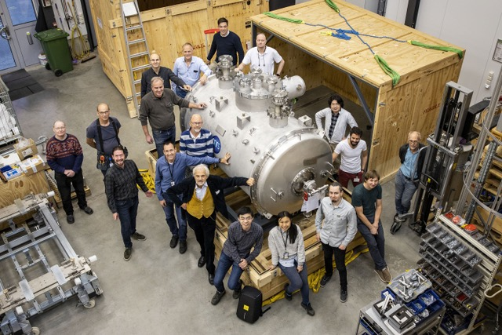
Personnel
Ca 30 staff, about half of which are researchers with a PhD and half engineers and technicians
New recruitments of mostly younger physicists and engineers have been made through wide international announcements, resulting in several recruitments from from China, Japan, Spain, Ukraine…
Arrival in November 2020 at FREIA of the first ESS accelerating module

Slide 6
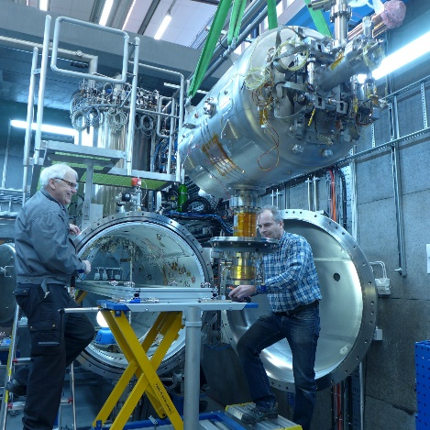
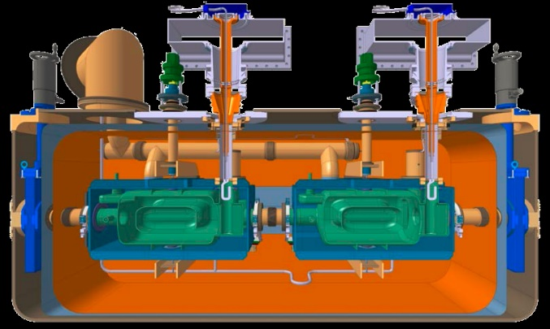
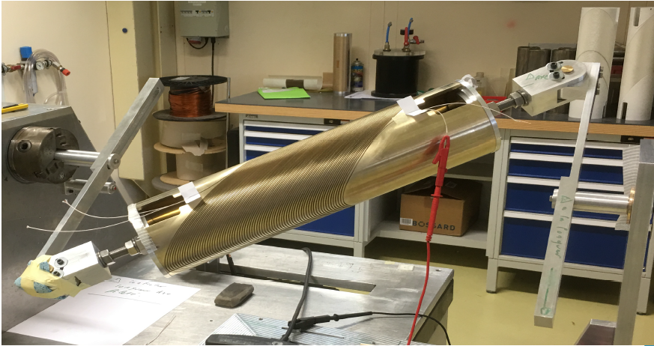
In 2009-2015 build-up of the FREIA Laboratory of developments and tests of ESS accelerator superconducting accelerating cavities, first tests of spoke cavity prototypes and subsequently of a prototype module at full power in 2016-2019, and in 2020-2022 acceptance tests of 13spoke-cavity series-production modules. So far two production ESS accelerator-modules have been tested in FREIA and a third module test is ongoing this week .
In 2020-2023 tests for the CERN LHC HighLumi upgrade of superconducting orbit-corrector dipoles under the first Swedish so-called K-contract with CERN.
We are currently in discussion of two more LHC High-Lumi related K-contacts with CERN: one involving Scanditronix Magnets AB for development of superconducting LHC corrector dipoles and the other involving RFR Solutions AB for production of superconducting cable connection boxes.

Slide 7
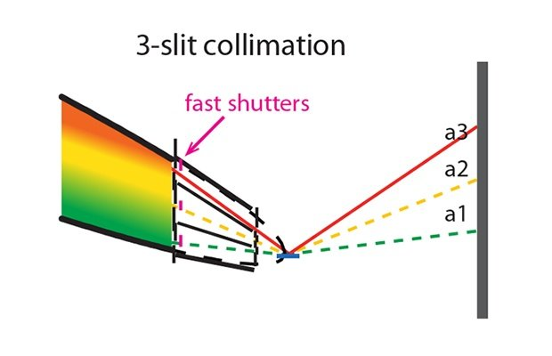
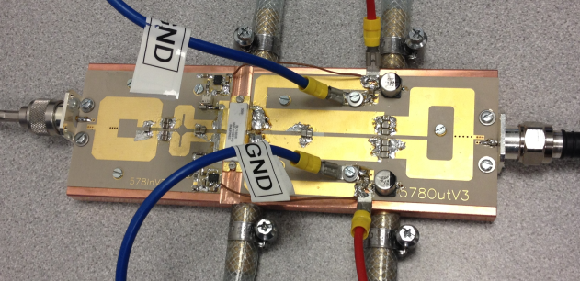
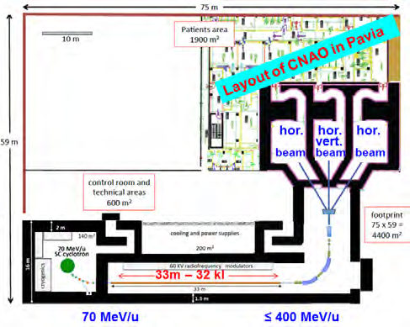
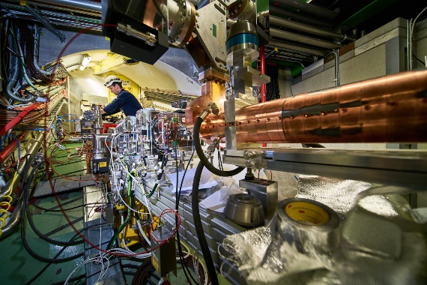
Other ongoing or planned FREIA development projects
Ultrafast compact coherent X-ray source based on superconducting (SC) accelerator technology
Doubling of the linac power and compression of the proton pulse for the ESS Neutrino Super-Beam (ESSnuSB) project
High-power transistors and radio-frequency(RF) combiners for high power (400 kW) RF amplifiers for scientific and industrial accelerators
Fast ESS neutron instrument Reflectometer for Extended Interfacial Analysis
RF-systems for the electron accelerator to be used with the AWAKE proton driven plasma accelerator at CERN
Superconducting Magnets for Light Ion Hadron Therapy as part of EU projects I.FAST and HITRIplua EU that have just started

Slide 8
FREIA and FCC
The FREIA Laboratory has built up equipment and experience for the currently ongoing superconducting magnet and cavity development-and-test projects for CERN and ESS, that will be of direct use in the prototyping and build-up phase of the FCC project.
The lab is currently quite busy with the developments and tests for ESS and HL-LHC, but is open for discussions with the FCC management of possible development-and-test projects, like e.g. one on SMES, for the FCC on the longer term.

