Slide 1
CCT Superconducting Magnets
03 MAR 2021
Kévin Pepitone

Slide 2
Outline
CCT magnet old simulations tools
MATLAB (Analytic)
CST
CCT magnet new simulations tools
Comsol
Protect CCT
SC wire

Slide 3
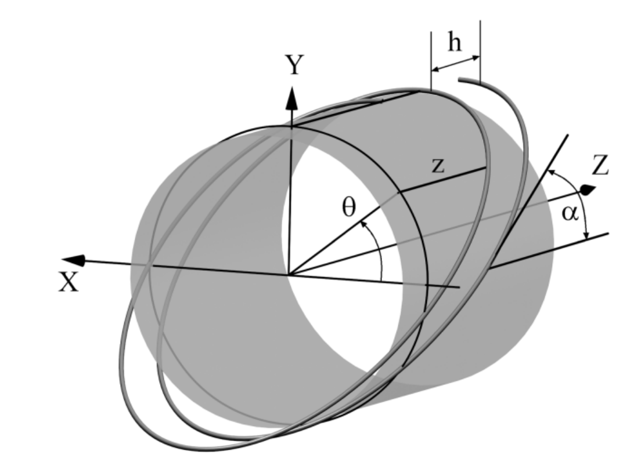
CCT parameterds
A tool developed by Loic Quéval can be used to pre-design a CCT magnet. This MATLAB script analytically and numerical calculates the magnetic field generated by a modulated double helical coil (double helix coil, canted-cosine-theta coil).
Parameter | Value | Unit | Description
$$α$$ | 30 | deg | Title angle
$$R_{i}$$ | 35 | mm | Inner radius
$$R­_{o}$$ | 53 | mm | Outer radius
$$nt$$ | 161 (=500/pitch) |  | Number of turns
$$Ω$$ | 3.1 | mm | Pitch
$$n$$ | 2x5 |  | Number of strands
$$I$$ | 350 (=7*50) | A | Current
θ is the azimuthal angle around the cylinder
L. Quéval, R. Gottkehaskamp, "Analytical field calculation of modulated double helical coils," IEEE Trans. Appl. Supercond, vol. 25, no. 6, p. 4901307, 2015.

Slide 4
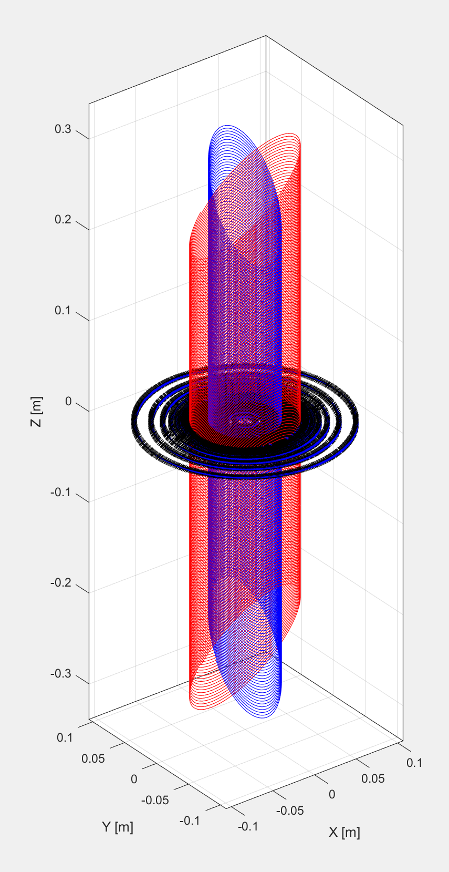
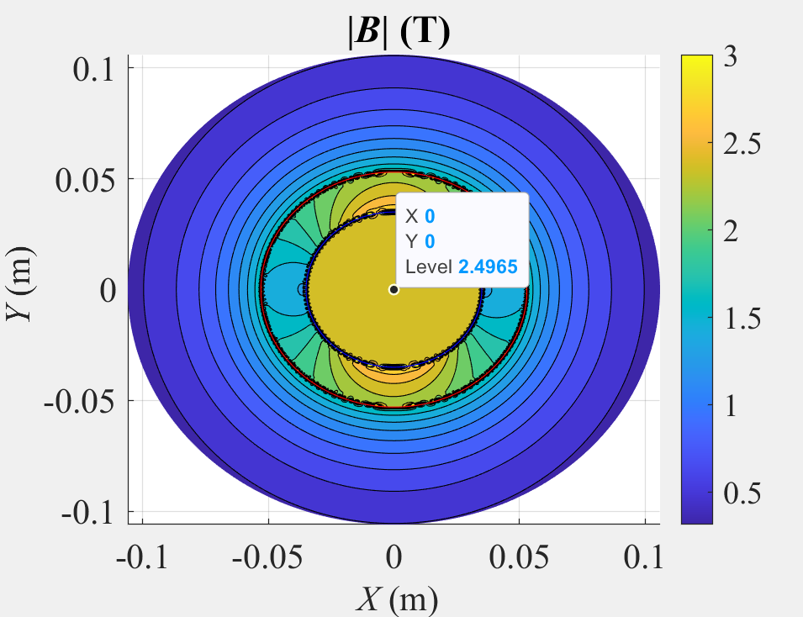
Simulation: Numerical model in 1D and 2D MATLAB
After calculations of the Biot-Savart law we obtain can numerically calculate the CCT magnet in 1D and 2D. 1D results are given at 45° and 2D results have a discretization of 1°.
See here for more details
https://indico.uu.se/event/834/

Slide 5
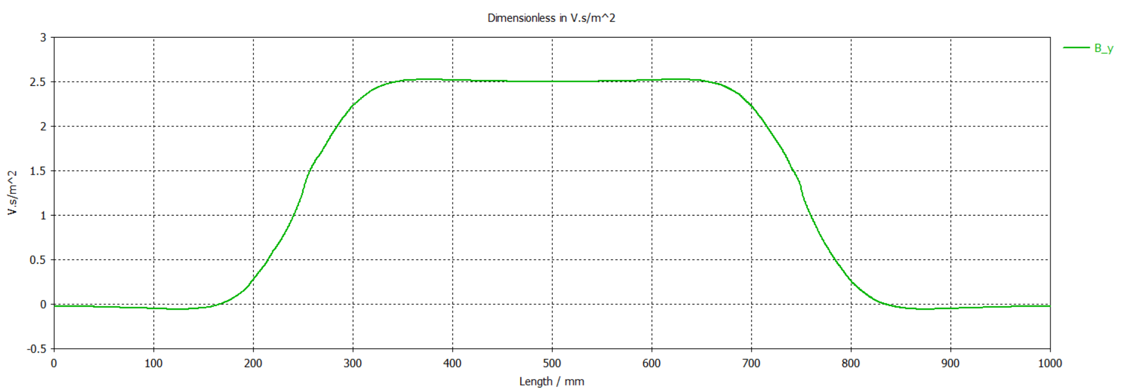
Simulation: 3D with CST
See here for more details
https://indico.uu.se/event/834/

Slide 6
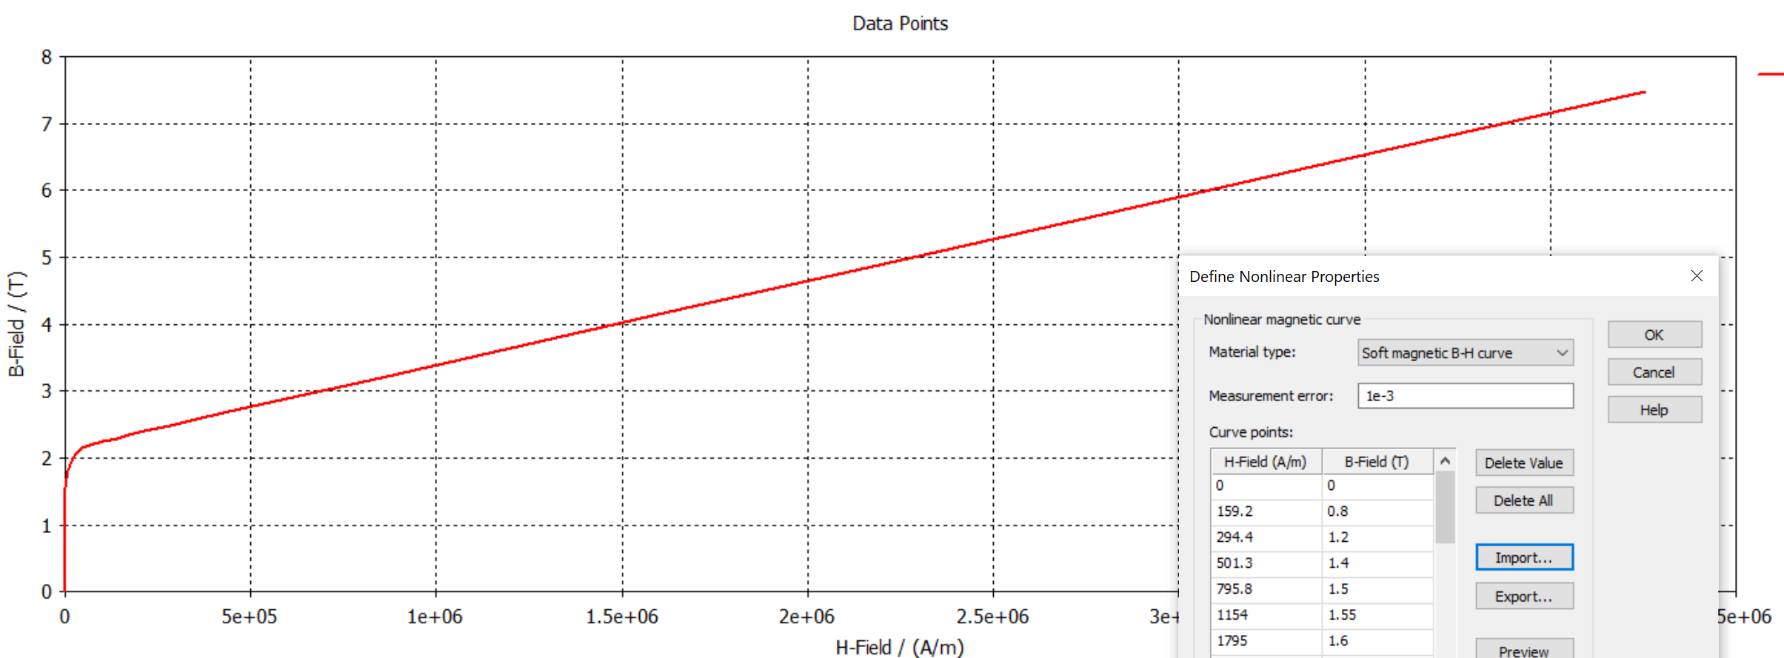
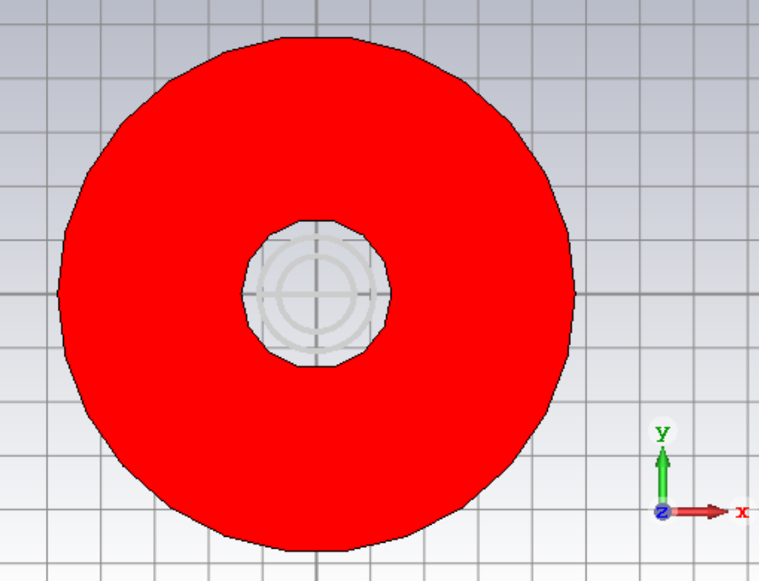
Simulations: 3D CST with yoke

Slide 7
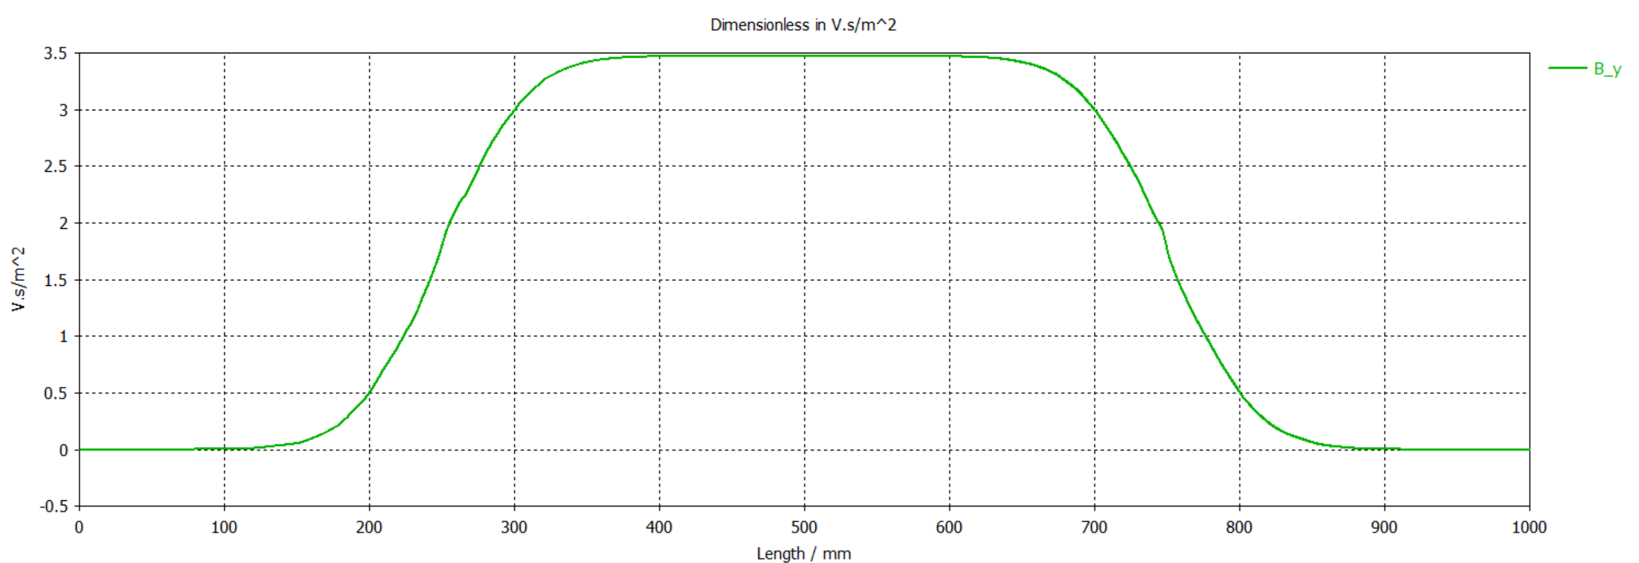
Simulations: 3D CST with yoke
1.75 T/m

Slide 8
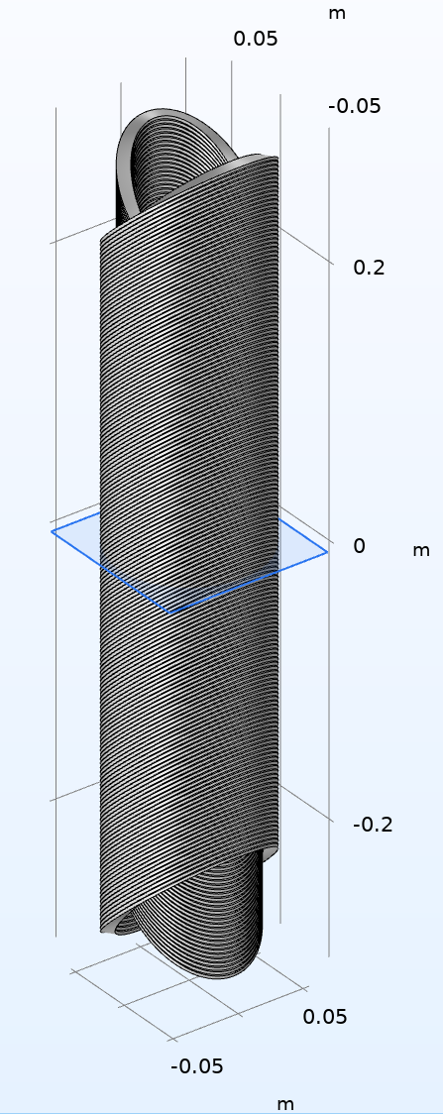
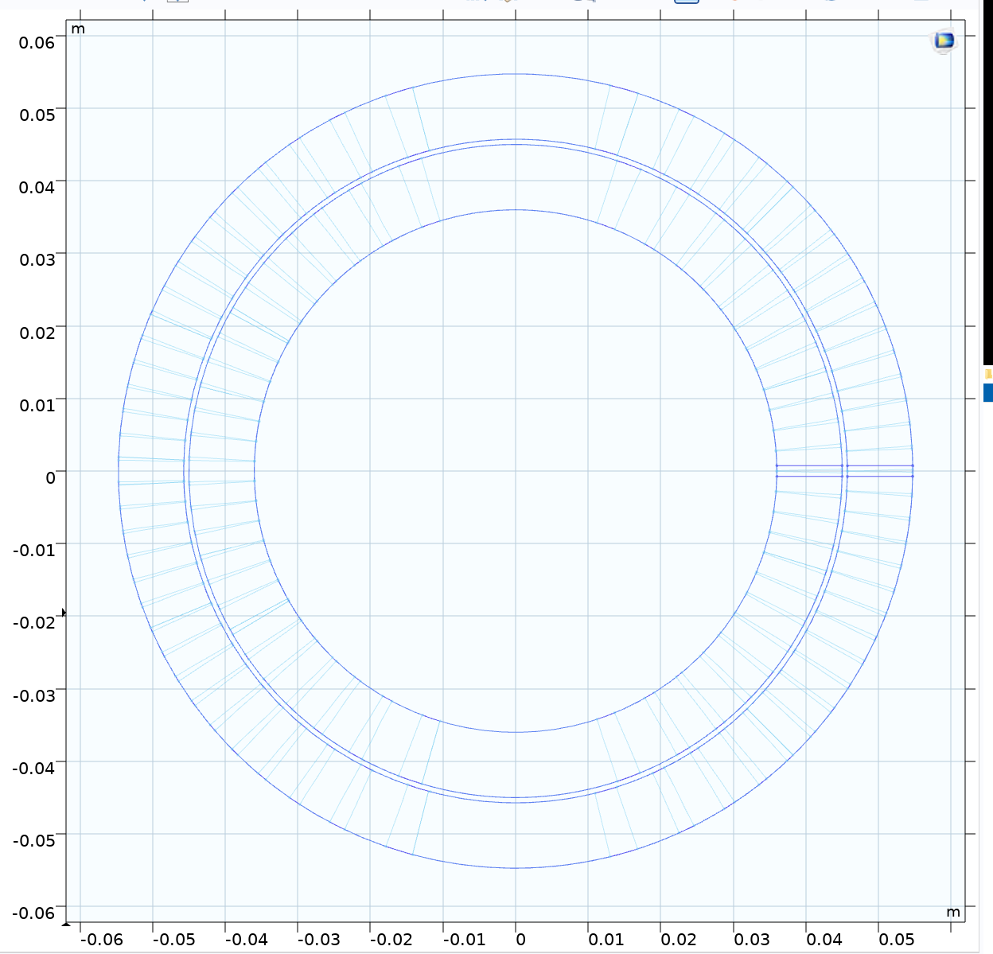
Comsol
The CCT model is developed by Martin Istvan Noval (CERN TE-ABT-SE) https://indico.cern.ch/event/727555/contributions/3436414/

Slide 9
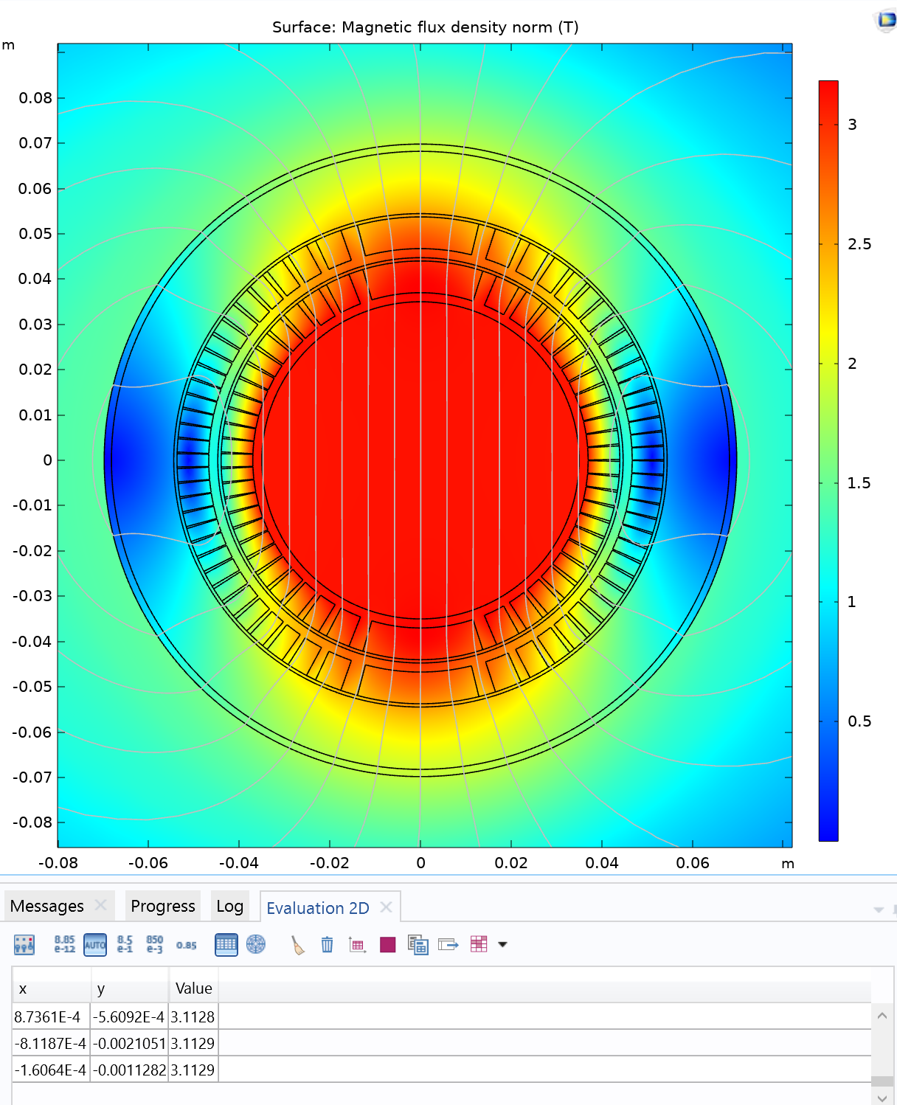
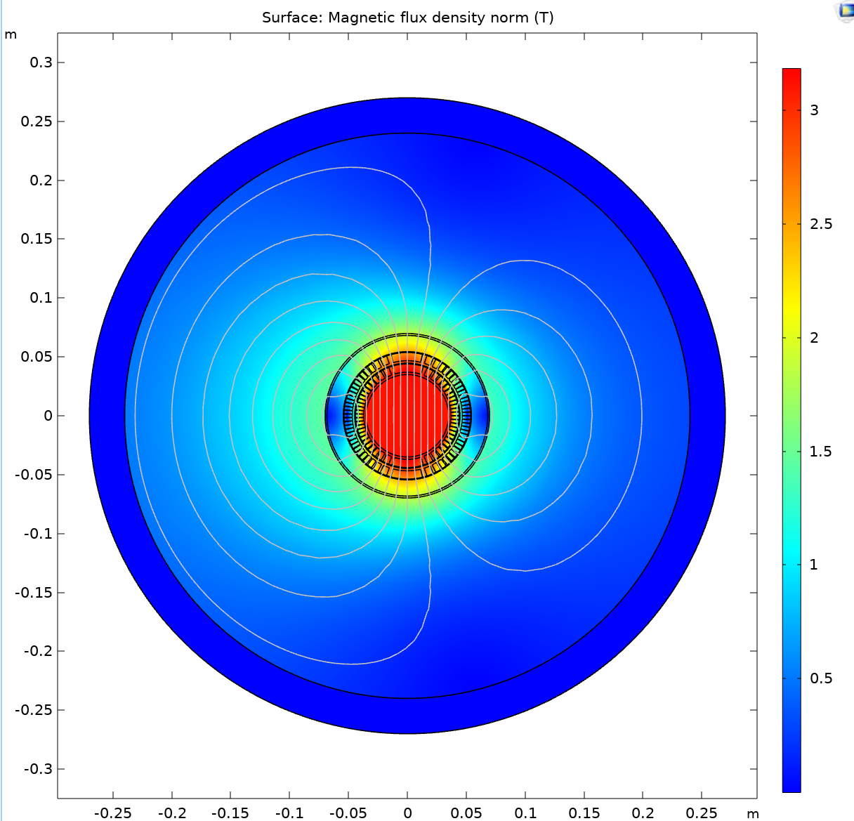
Comsol Results

Slide 10
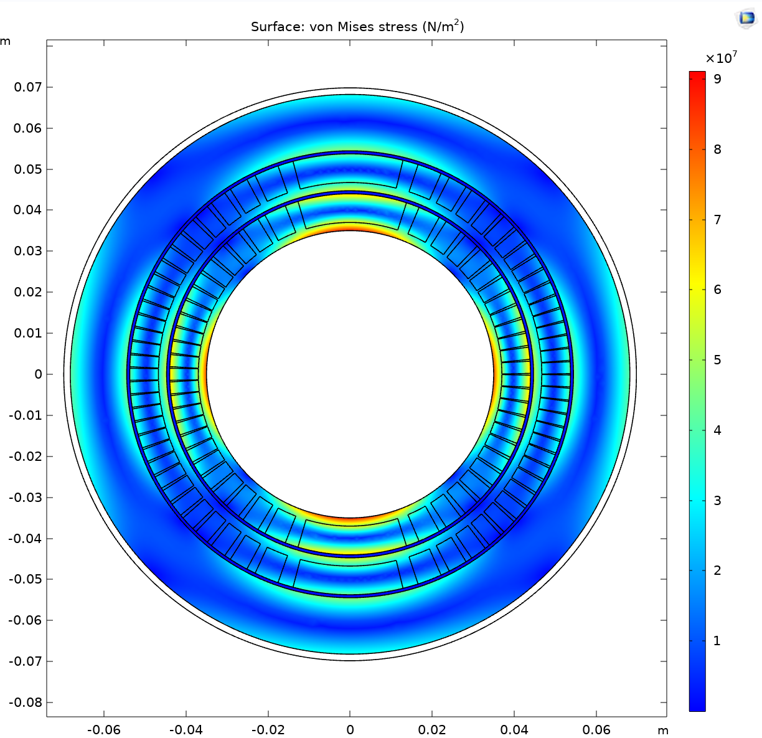
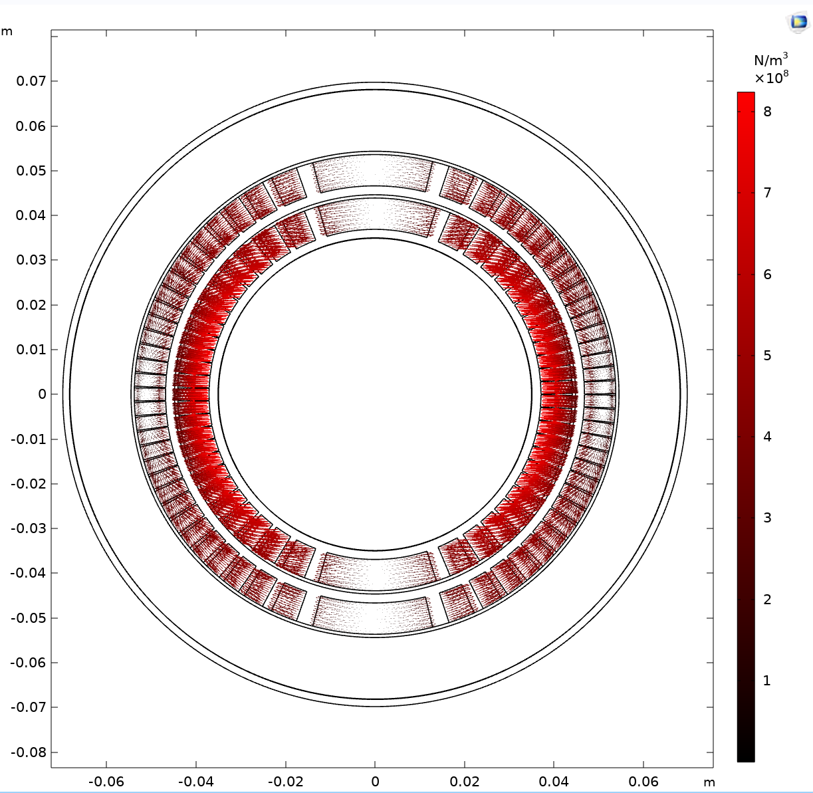
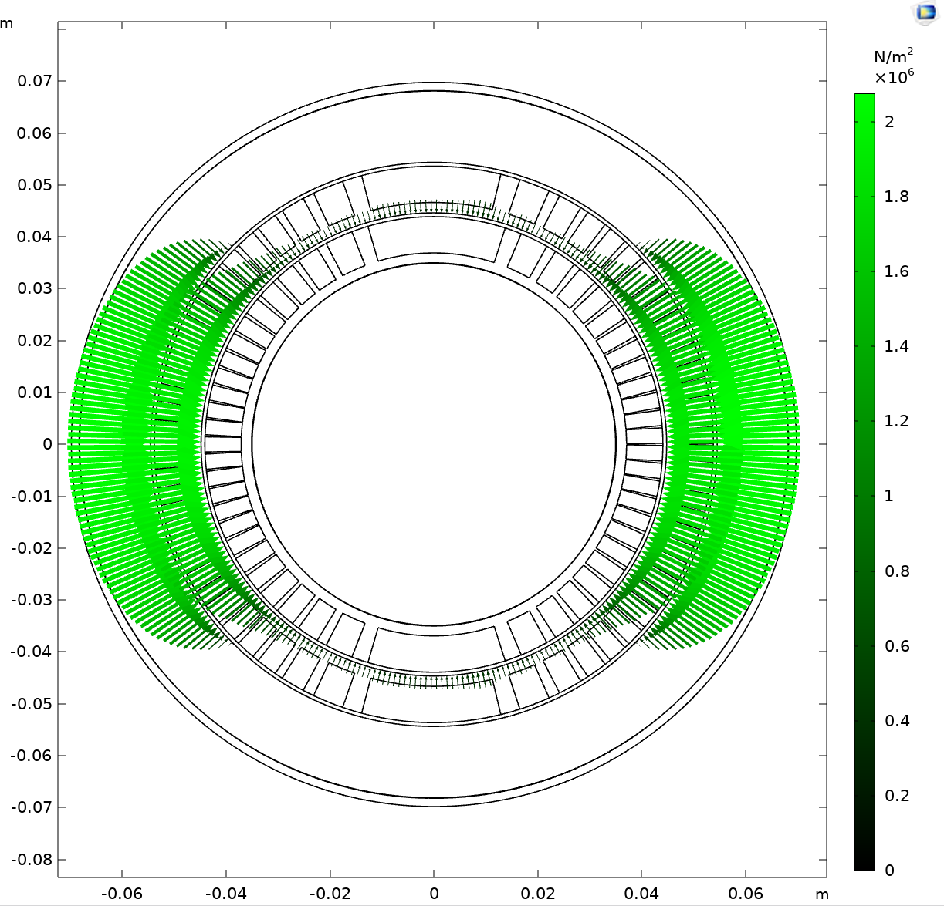
Comsol Results
Stress
Load
Contact

Slide 11
CCT wire
Rope of 7 SC cables
CuSc ratio 1.35:1 (Copper fraction is 0.5744)
Total length: nbStrands x nbTurns x 2Pi x sqrt(Rin^2+(Rin x SIN(30 deg)^2)/2) + nbStrands x x nbTurns x 2Pi x sqrt(Rout^2+(Rout x SIN(30 deg)^2)/2)
Total length is 9870 m for 161 turns and 7 wires in the rope

Slide 12
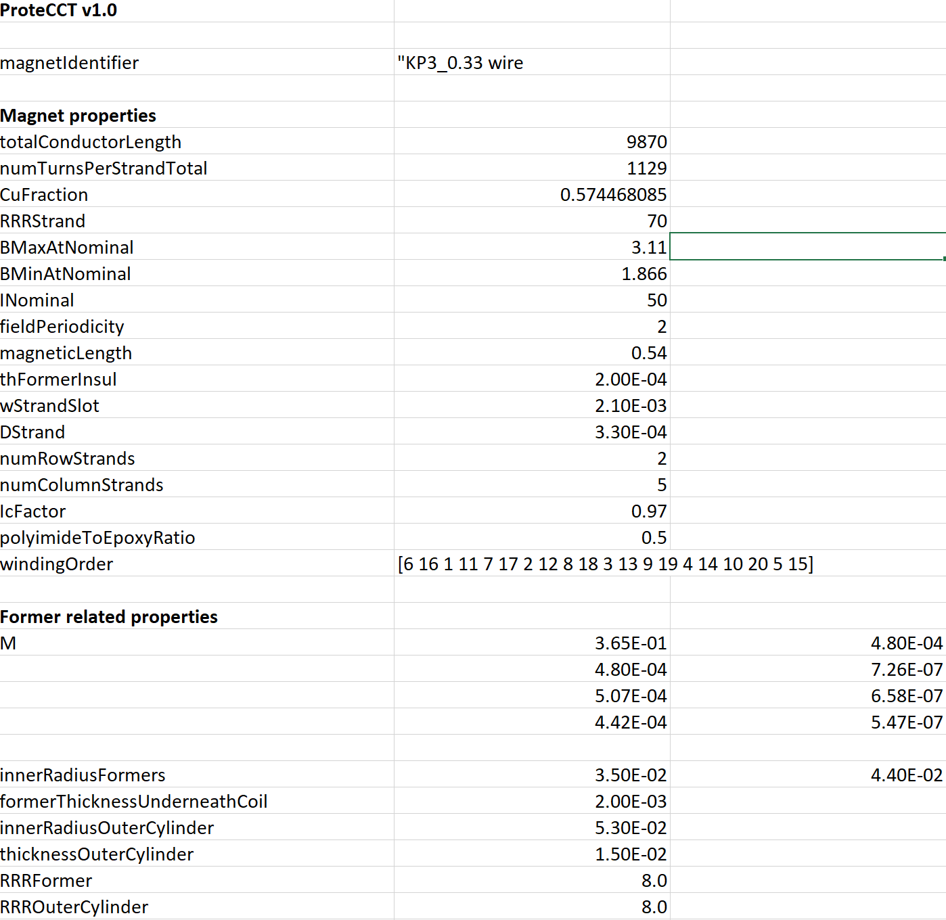
Protect CCT
Protect CCT is developed by Matthias Mentink
At CERN (TE-MPE-PE)

Slide 13
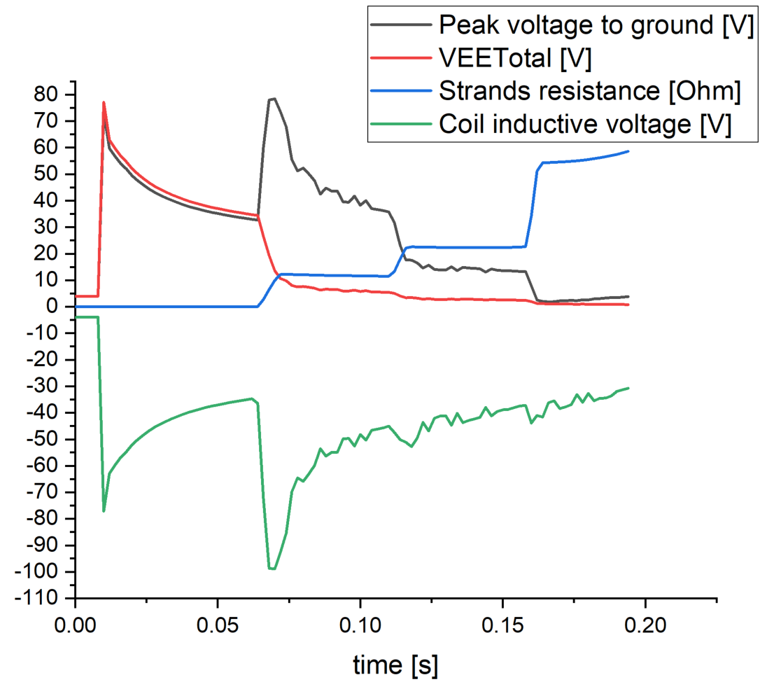
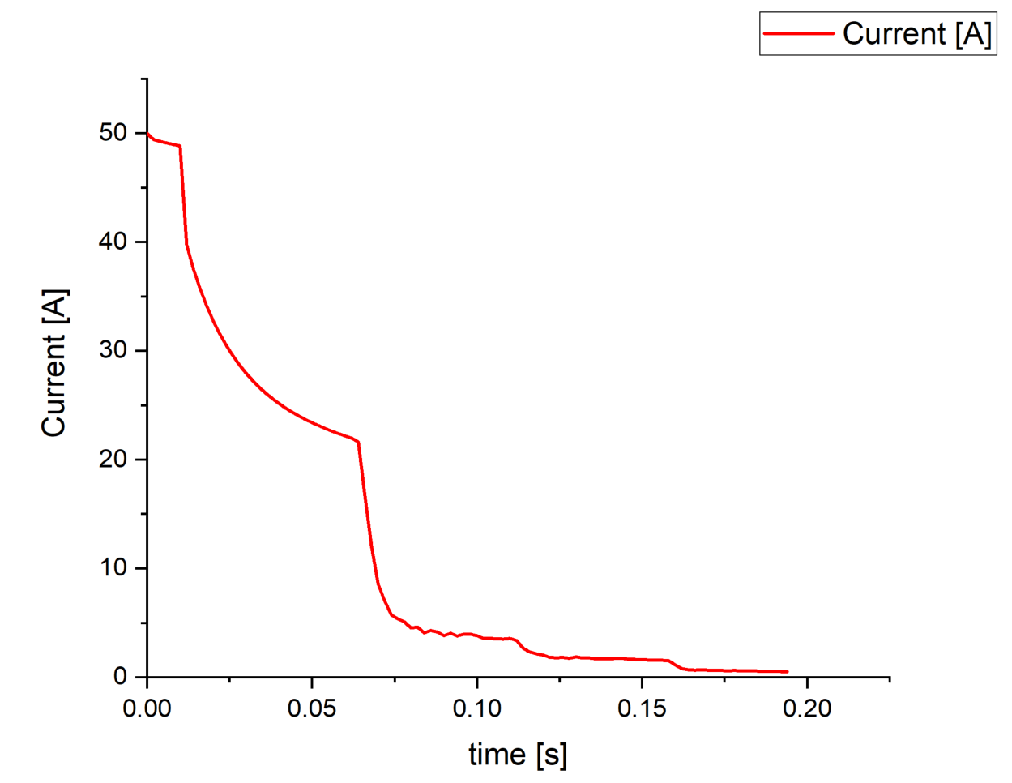
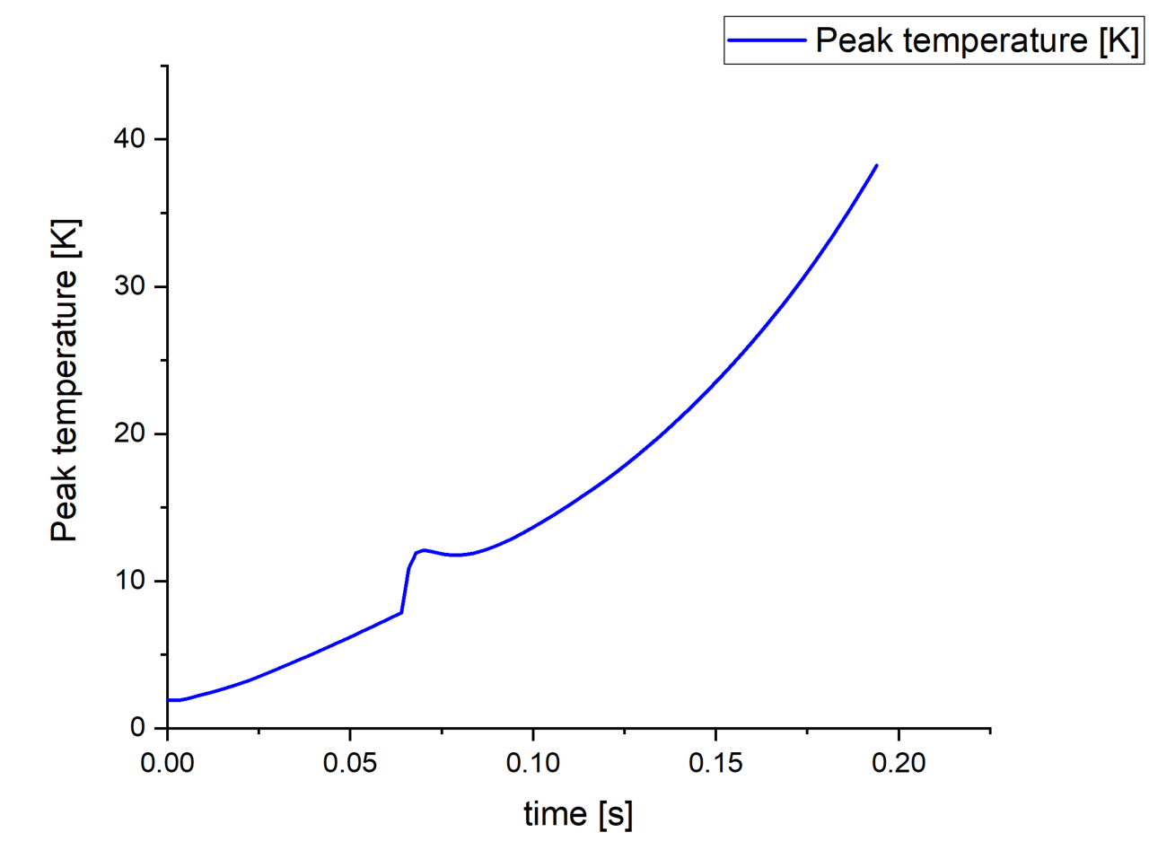
Protect CCT results

Slide 14
Future
Improve simulations
Include wire properties (composition of the rope)
Optimize the design

