Slide 1

CCT Superconducting Magnets
31 MAR 2021
Kévin Pepitone

Slide 2

Outline
COMSOL
Magnet Protection

Slide 3
Inputs
CCT magnet
Bfield= 2.8 T.m
Total length= 1100 mm
Inner former inner radius = 35 mm
Magnetic Length * Max field
Total coil length is around 1065-1070 mm

Slide 4
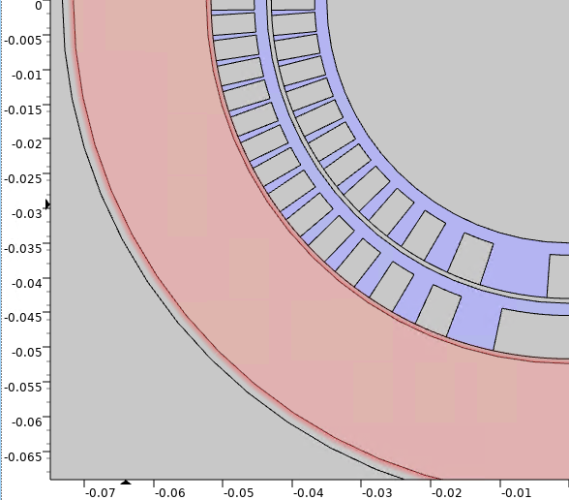
Jungle of numbers
Inner former inner radius = 35 mm
Channel = 5*1.25 x 2*1.25 = 6.25 x 2.5 mm2 ---------------- rope is 1.21 mm diameter
Rcoil 1 inner = Inner former inner radius + 1.75 mm = 36.75 mm
Rcoil 1 outer = Rcoil 1 inner + Tcoil (= 6.25) = 43 mm
Outer former inner radius = Rcoil 1 outer + T former gap (= 0.7) = 43.7 mm
Rcoil 2 inner = Outer former inner radius + 1.75 mm = 45.45 mm
Rcoil 2 outer = Rcoil 2 inner + Tcoil (= 6.25)= 51.7 mm
Rsupport inner = Rcoil 2 outer + T former gap (= 0.7) = 52.4 mm
Rsupport outer = Rsupport inner + Tsupport (= 19.15 mm) = 71.55 mm
Ryoke inner = Rsupport outer + Tyoke gap (= 1.6 mm) = 73.16 mm
Ryoke outer = 240 mm
Tilt = 30 deg

Slide 5
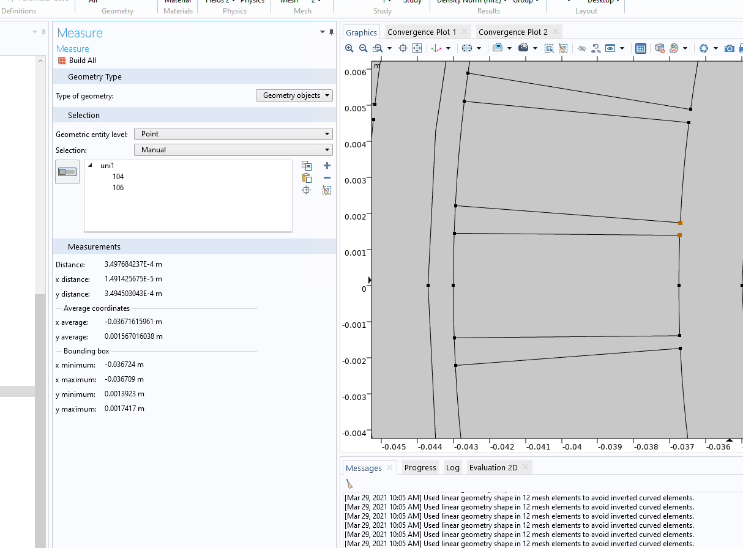
Definition of pitch and Bfield
With a pitch of 5.5 mm I have a gap of 3.5 mm in the mid plane inner coil
0.35 * cos (30 deg) = 0.303 mm
Based on this 166 turns corresponds to magnetic length of 913 mm and a total coil length of 1064 mm
-> Bfield = 2.8 T.m ; Magnetic length = 913 mm
We need a Max field of 3.066 T.

Slide 6
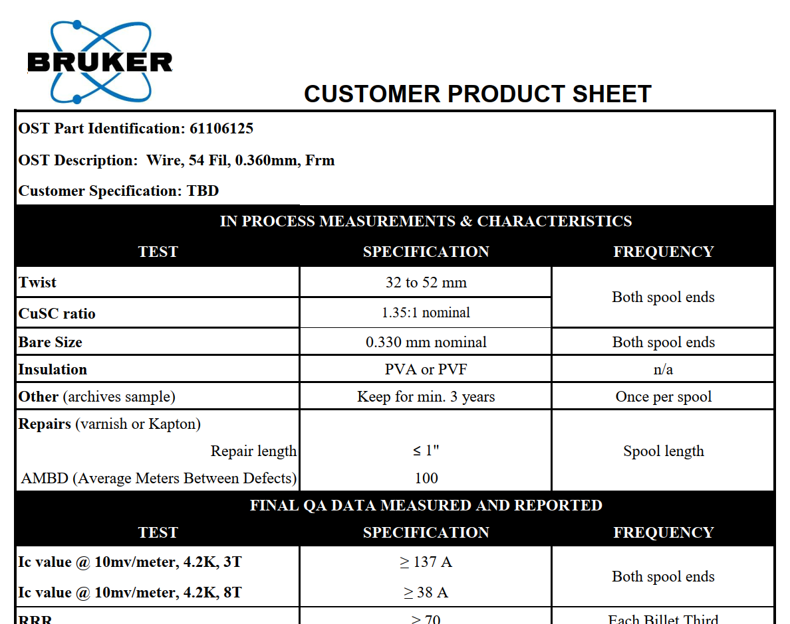
SC wire
60% of the short sample is 82.2 A
For a rope of 7 wires, it corresponds to 575.4 A

Slide 7
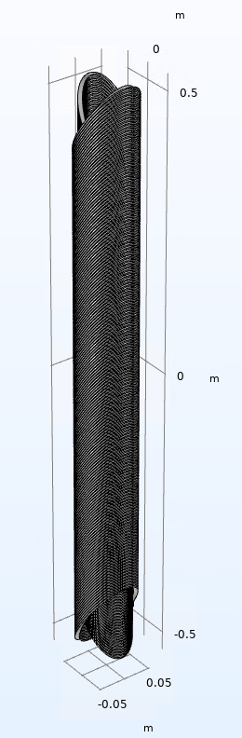
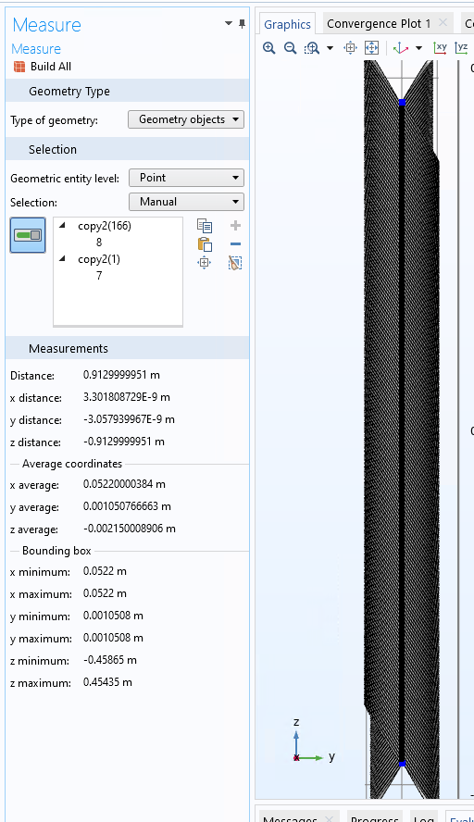
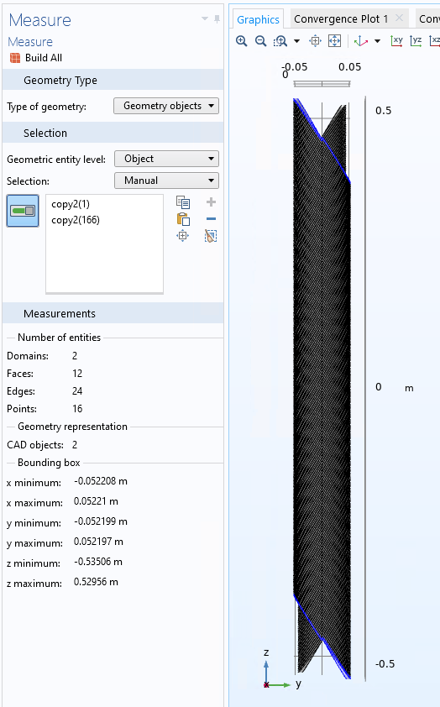
Let’s simulate this magnet ☺

Slide 8
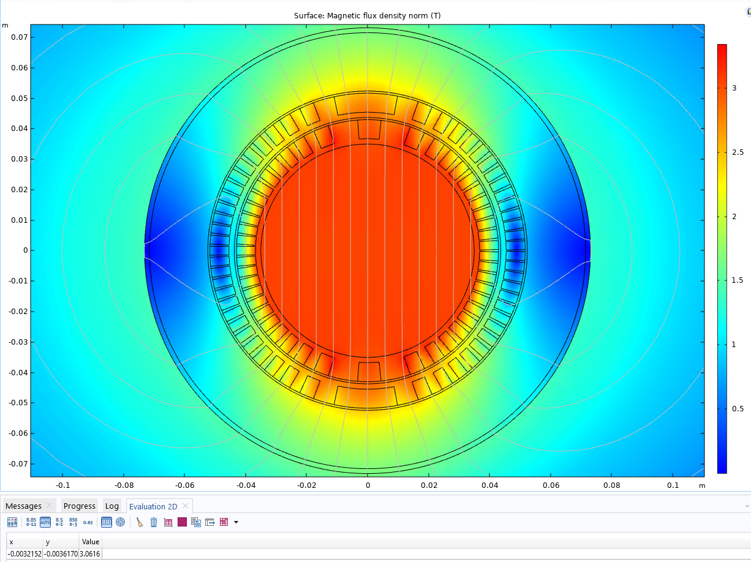
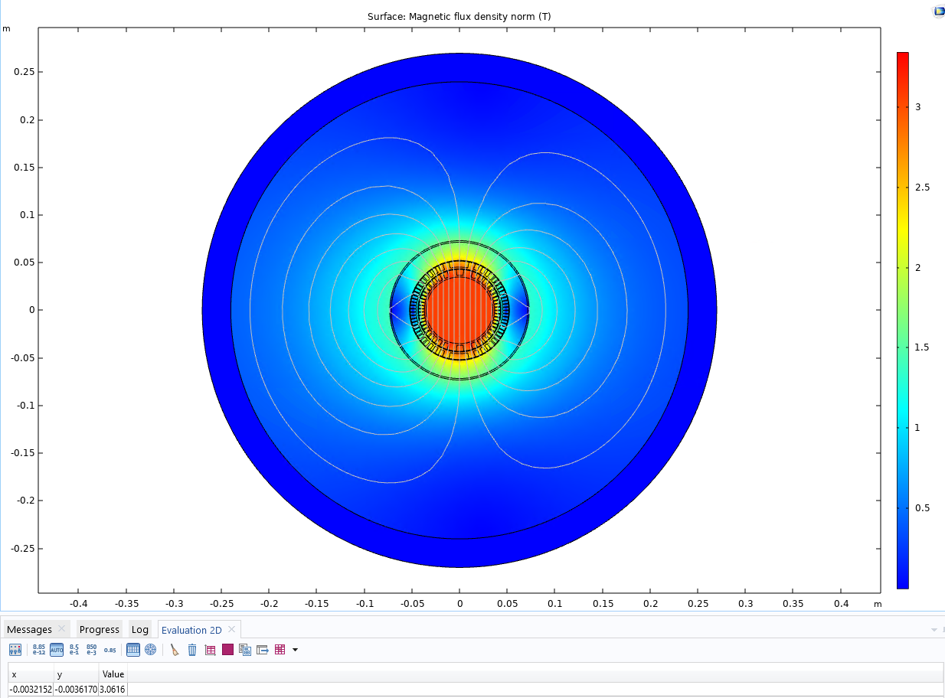
Results with COMSOL
After some iterations…
3.06 T
The COMSOL CCT model has been developed by Martin Istvan Noval (CERN TE-ABT-SE) https://indico.cern.ch/event/727555/contributions/3436414/

Slide 9
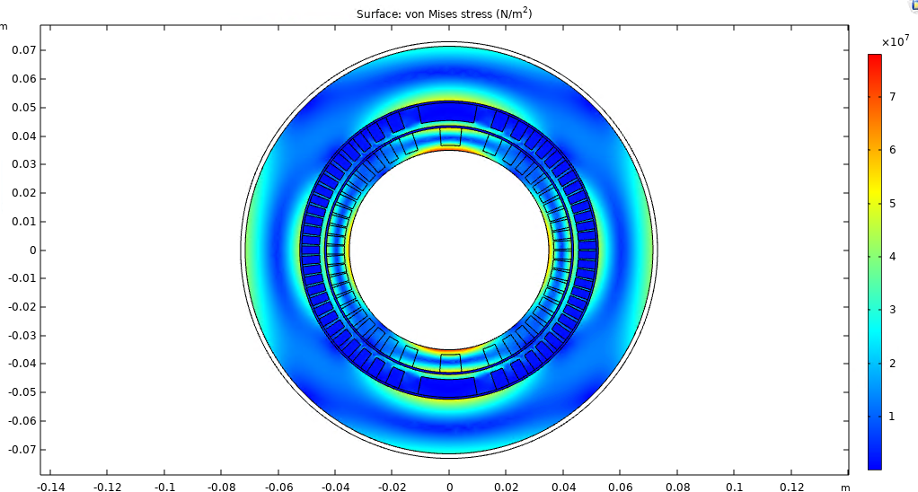
Stress

Slide 10
Conclusions COMSOL simulations
2D simulations done
Max field 3.06 T obtained for I = 7*79A (57.7% of the short sample)
Bfield is 2.8 T.m
Design ok, but ready for improvements

Slide 11
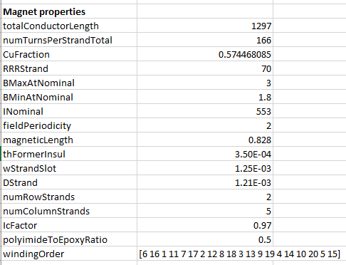
Magnet protection – HELP ME !!!
How to simulate this design ?
I know how to simulate this one !

Slide 12
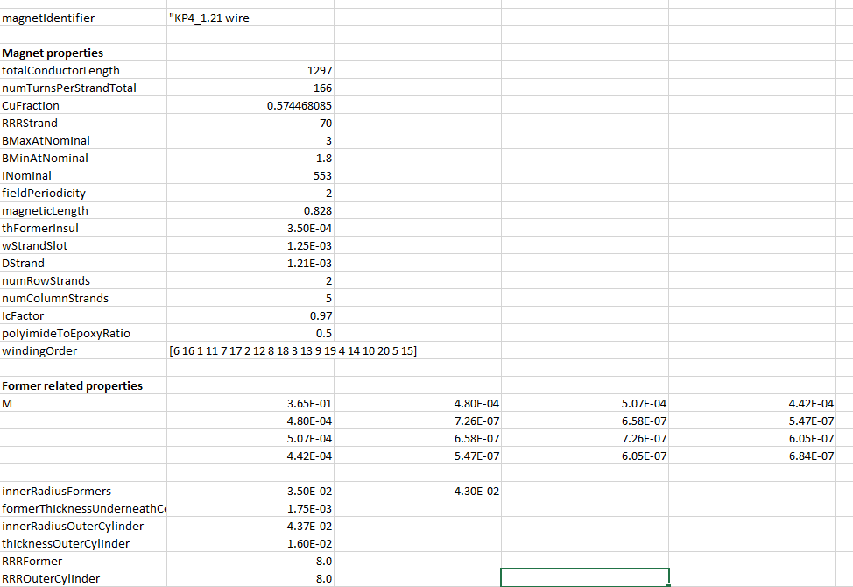
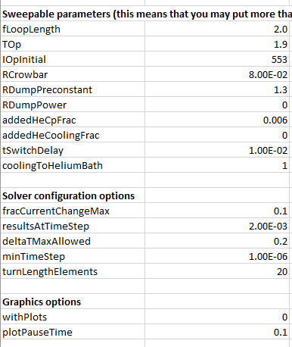
Input file

Slide 13
(Wrong) Results

Slide 14
Conclusions Protection simulations
?

