Slide 1
Projekt kalla magneter
Tillverkningsteknik
Roger Ruber
Uppsala, 7 April 2021

Slide 2

Nuvarande MCBC/MCBY Orbit Corrector
Parameters | MCBC | MCBY
Coil inner diameter | 56.4 mm | 70.4 mm
Magnetic length | 0.904 m | 0.899 m
Operating temperature | 1.9 K and 4.5 K | 1.9 K and 4.5 K
Nominal field (at 1.9/4.5 K) | 3.11/2.33 T | 3.00/2.5 T
Nominal current (at 1.9/4.5 K) | 100/74 A | 88/72 A
Peak field in coil (at 1.9/4.5 K) | 3.65/2.68 T | 3.60/2.96 T
Short sample current (at 1.9/4.2 K) | 172/127 A | 162/120 A
Stored energy (at 1.9 K) | 14.2 kJ | 13.6 kJ
Self-inductance | 2.84 H | 5.27 H
DC resistance (RT) | 375 Ω | 501 Ω
Overall length | 1100 mm | 1100 mm
Outer diameter of assembly | 452 mm | 475 mm
Magnet module mass | 203 kg | 193 kg
Total mass including the support structure | 1234 kg | 1247 kg
Superconductor type | Nb-Ti in Cu matrix | Nb-Ti in Cu matrix
SC wire dimension | 0.38 mm x 0.73 mm (+0.0/-0.01) | 0.38 mm x 0.73 mm (+0.0/-0.01)
Ribbon construction | 14 wire (glued) | 15 wire (glued)
Kombination
B₀ = 3.11 T
L_{magnetic} = 0.904 m
$\int{Bdl}$ = 2.81 Tm
aperture = 35.2 mm
I_{max} = 100 A

Slide 3
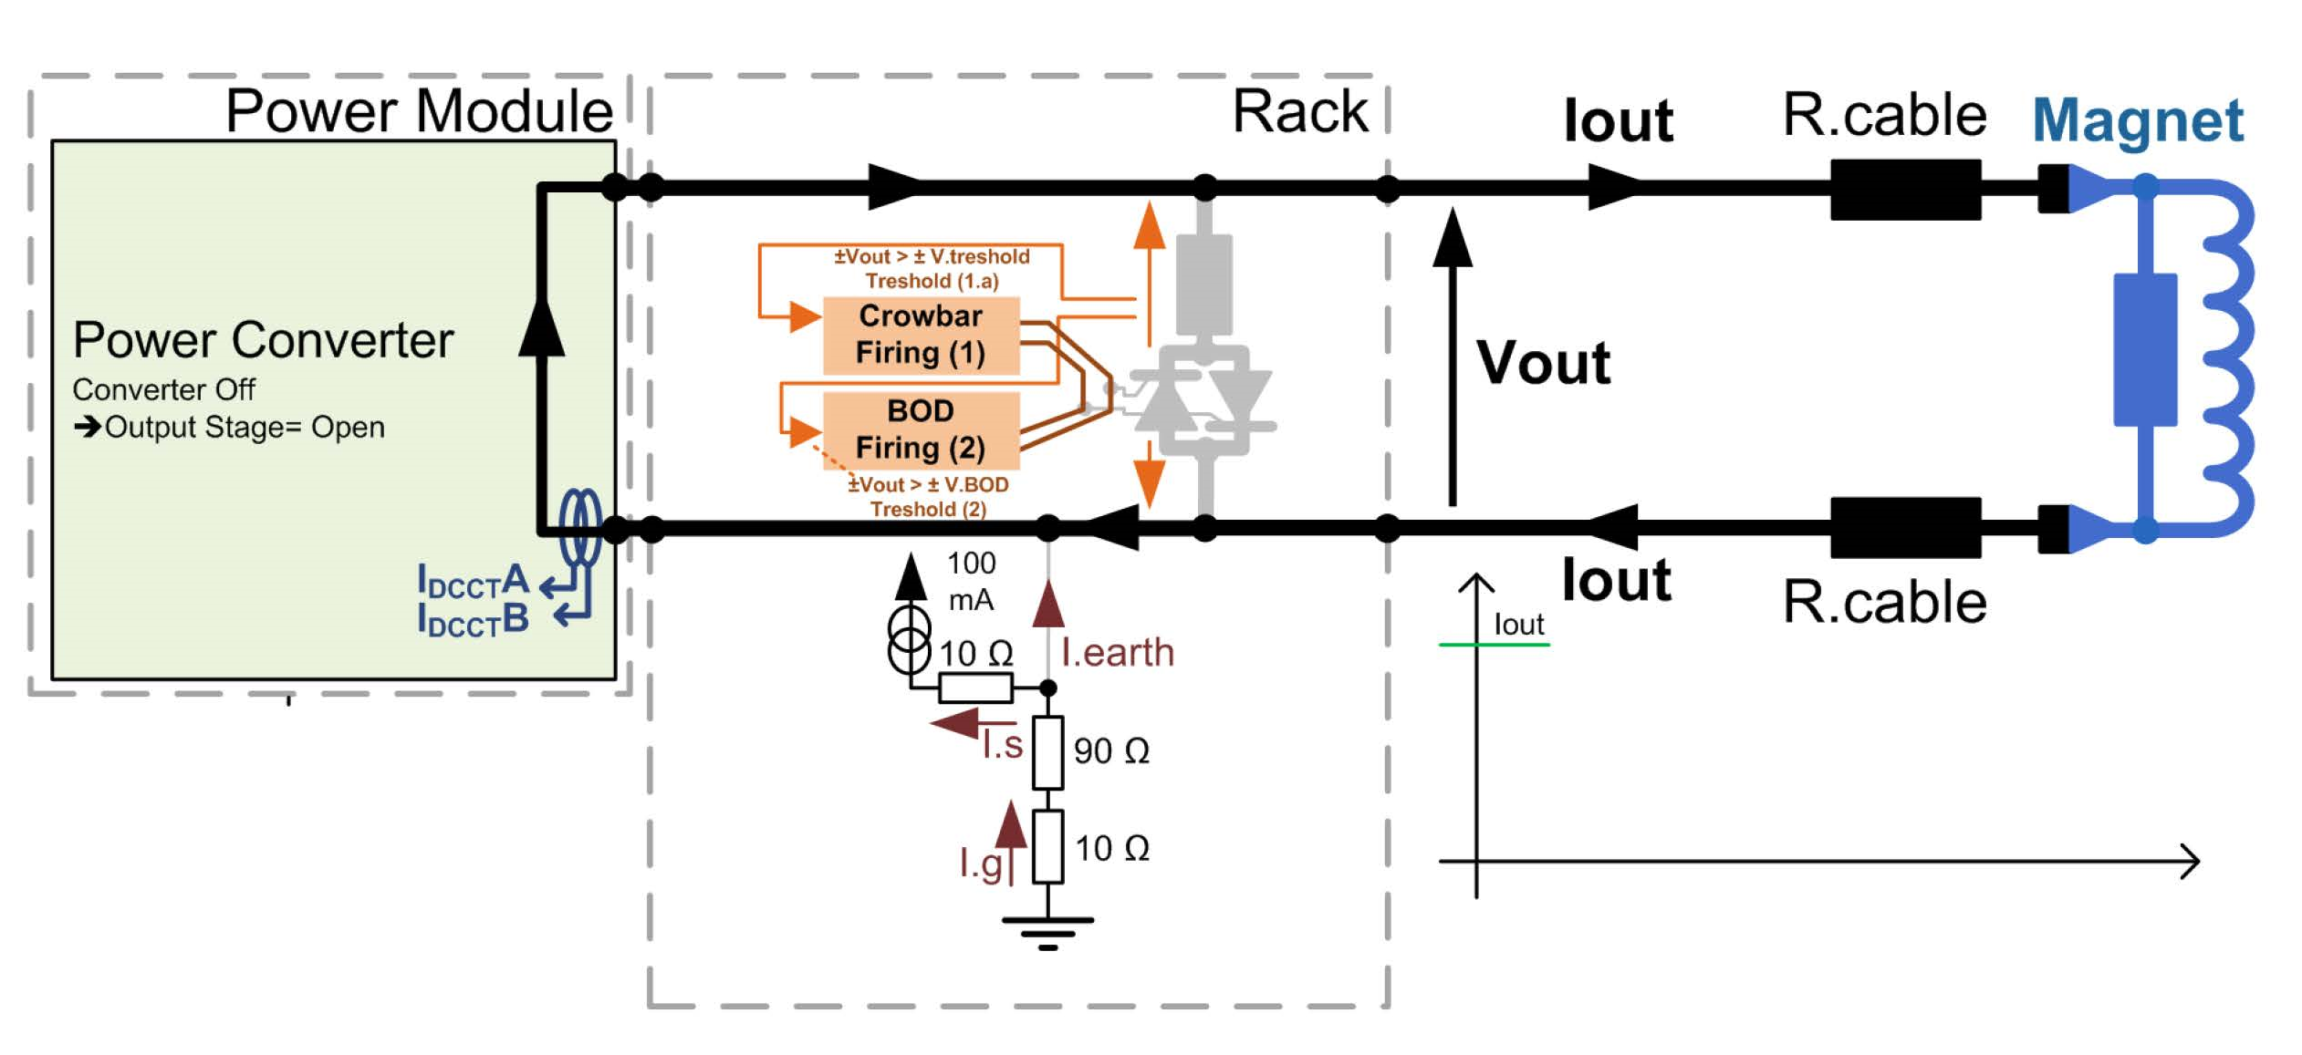
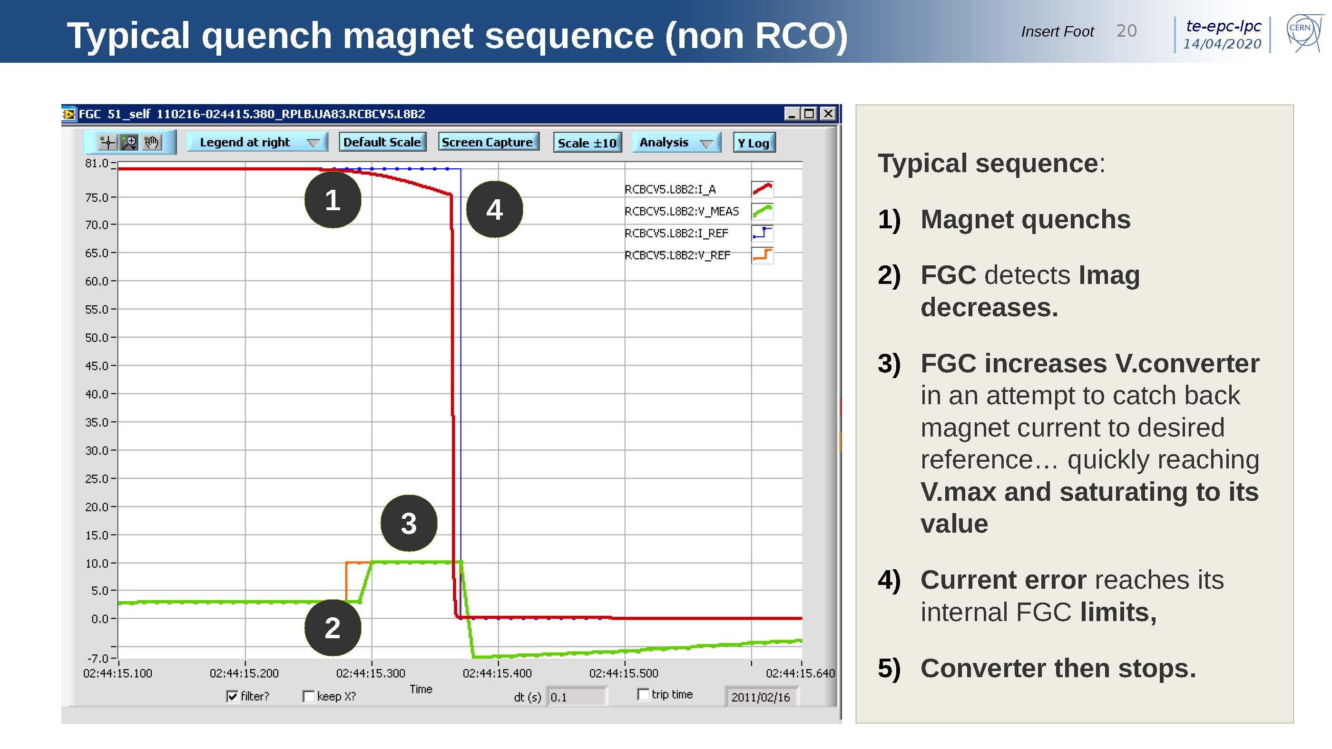
Elektrisk strömstyrka
Maximum ström
  begränsas av teknisk installation i LHC tunneln
  200 av denna typ av magnet
Power converter
  nuvarande ström circuit ±120 A, ± 10 V
    interlock för quench skydd:
      extern signal eller ström fel
    ingen energy extraction
  dokumentation
    http://sy-dep-epc-lpc.web.cern.ch/converters/lhc120a-10v/general.stm
    https://indico.cern.ch/event/904900/
Behöver passiv quench skydd
  diod och motstånd
  kall system, dvs inbyggd i magnetens kryostat
  att diskutera med CERN
FGC=function generator/controller

Slide 4
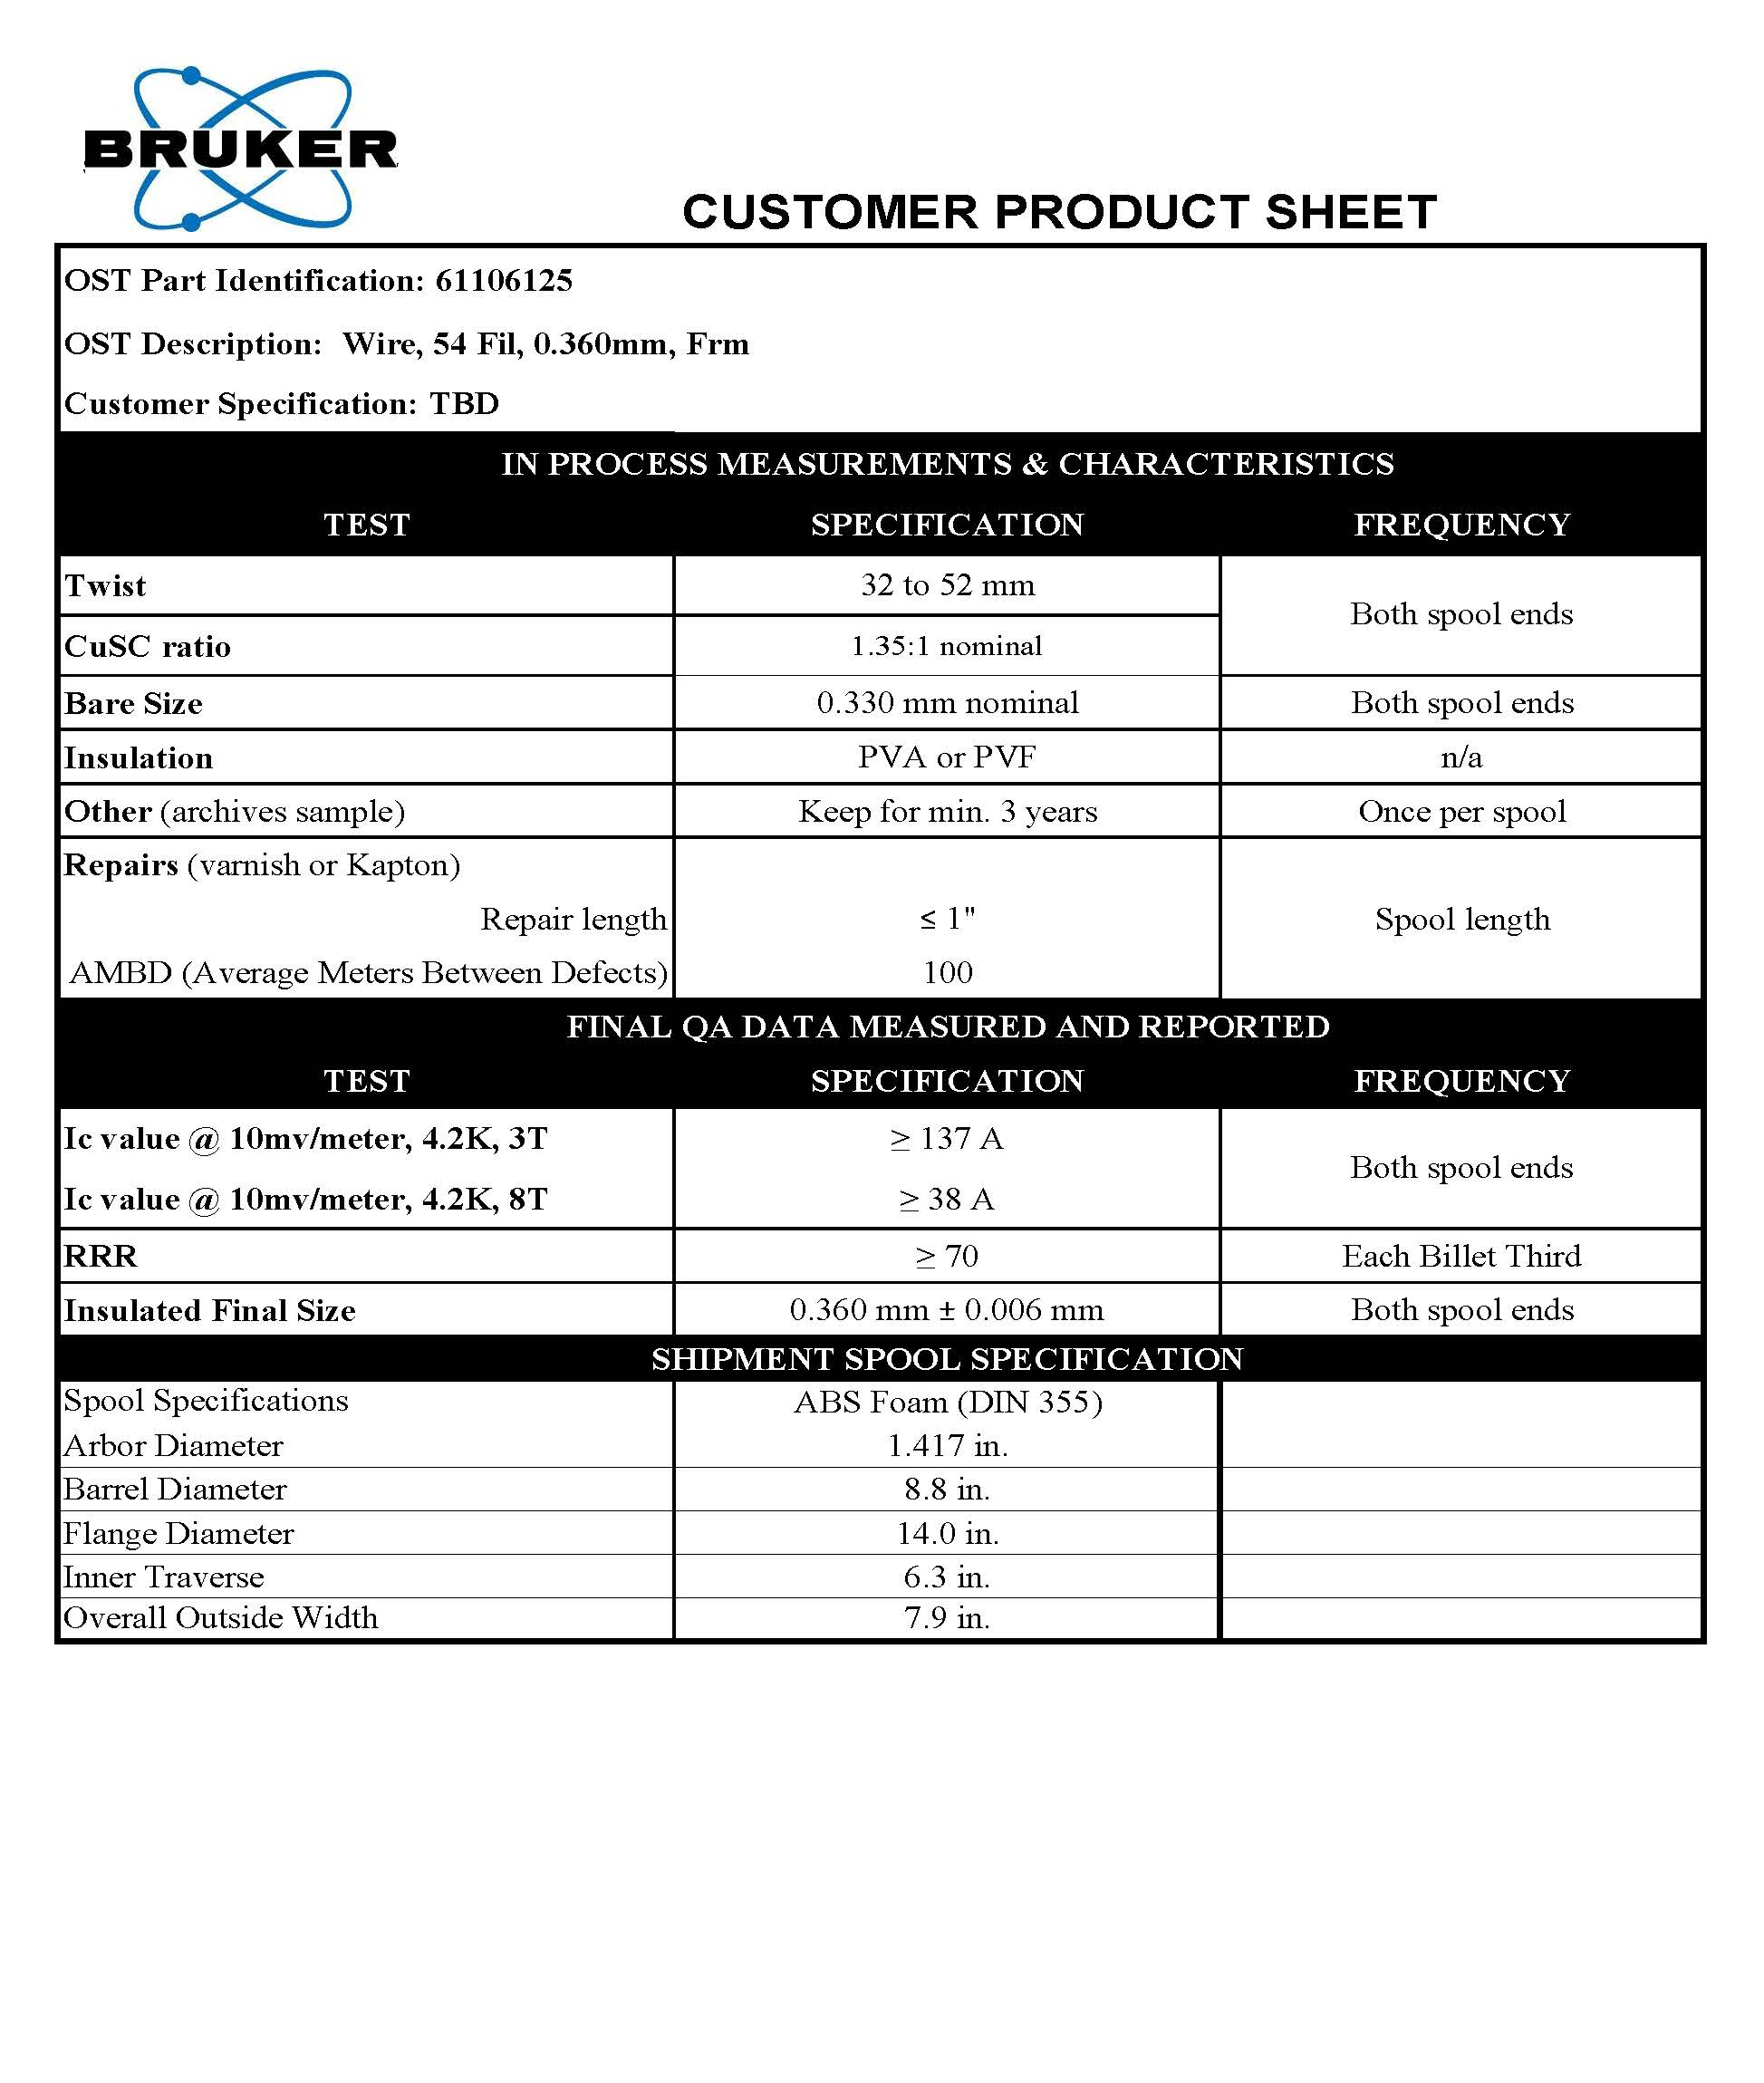
Supraledare - tråd
Bruker Energy & Supercon Technologies (BEST)
  https://www.bruker.com/content/bruker/int/en/products-and-solutions/superconductors.html
supraledande tråd
  diameter
    0.33 mm (w/o insulation = bare)
    0.36 mm (with insulation)
    insulation = formvar (or polyimide)
  filament approx. 29 µm
  bending radius 25 mm
  max. tensile strength 20 kg/mm²
  I_{critical} (4.2K, 3T) ≥ 137 A
    at 60% load line = 82 A
  koppar till supraledare förhållandet 1.35 : 1
  RRR ≥70

Slide 5
Supraledare - tråd
Bruker has send 100 m of wire
  shipment to Uppsala University (Kevin)
5 m to UU
  testing joints for installation in cryostat
5 m to CERN
  I_{c} testing between 2 and 5 T
    1.6 m per sample
  cross section investigation (photo)
remainder to Scanditronix
  test making joints
  make 6-around-1 cable
    check diameter & bending radius
    impregnation into channel (100 to 200 mm)
      check impregnation
      test insulation (let wire stick out of channel)

Slide 6
Supraledare - kabel
  kabel: 6-around-1
    förväntat diameter 1.08 mm
    I_{critical} (4.2K, 3T) ≥ 7x137 A = 959 A
      60% load line current = 574 A
    men koppla alla 7 ledare i serie → samma I_{critical} som tråden
  6 ledare vridas kring central ledare som blir därmed 10% kortare än de andra 6
    förväntas inte vara ett problem
  fråga: maximum böjnings radie?
    böjnings radie tråd = 25 mm
1.08 mm

Slide 7
Supraledare - längd
spår i magnetspindel
  166 vändningar
  2x5 = 10 lindningar per spår
längd i magnetspindel
  64,85 m per lindning
  648,5 m total kabel längd
  7 tråd per kabel
    7 x 64,85 m = 453,95 m tråd per lindning
    7 x 648,5 m = 4539,5 m tråd total
längd i magnet (2 magnetspindel)
  129,7 m per lindning
  1297 m total kabel längd
  7 tråd per kabel
    7 x 129,7 m = 908 m tråd per lindning
    7 x 1297 m = 9079 m tråd
per magnetspindel
  min. längd 65 m + extra = 70 m
  behövs 700 m rep-kabel
per magnet (= 2 spindel)
  min. längd 130 m + extra = 140 m
  behövs 1,4 km rep-kabel
CCT prototyp
  test spindel = 0,7 km
  2 magnet = 2,8 km
  1 reservmagnet = 1,4 km
  TOTAL = 5 km rep-kabel (= 35 km tråd)
    min. längd 140 m

Slide 8
Elektrisk diagram (anpassas för repkabel)

Slide 9
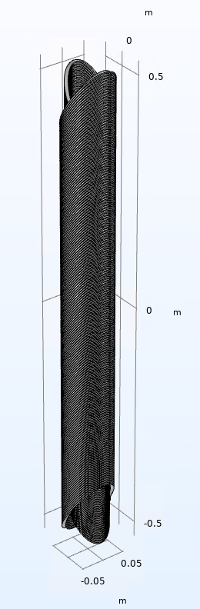
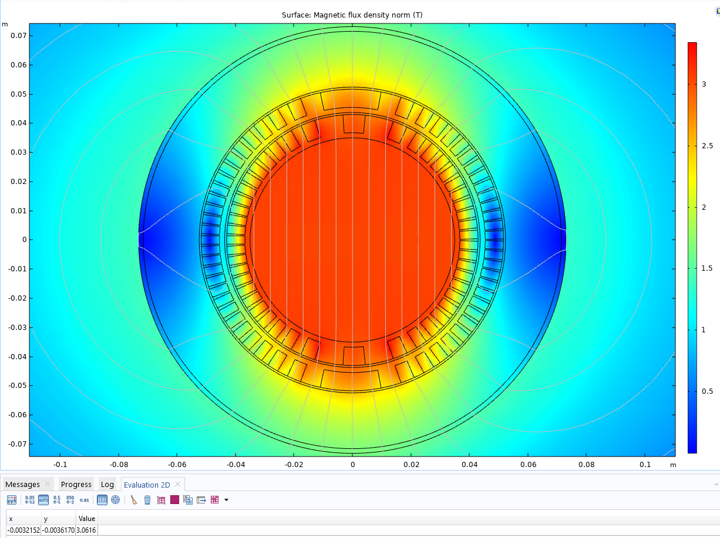

Magnetisk design
Winding pitch 5.5 mm
Mid-plane gap inner coil = 0.35 * cos (30 deg) = 0.303 mm
  166 turns corresponds to magnetic length of 913 mm and a total coil length of 1064 mm
I = 7*79A
  57.7% of short sample
B₀ = 3.06 T
$\int{Bdl}$ = 2.8 Tm

Slide 10
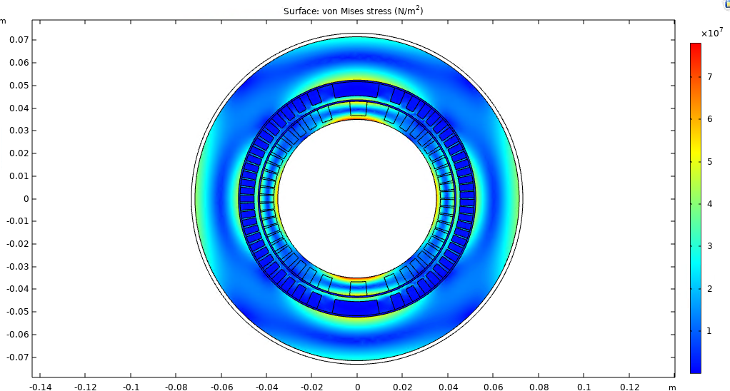
Magnetisk belastning
aluminium A6082-T6
  elasticity = 70 GPa
  tensile strength 300 MPa
  yield strength 400 MPa = 4x10⁸ N/m²

Slide 11
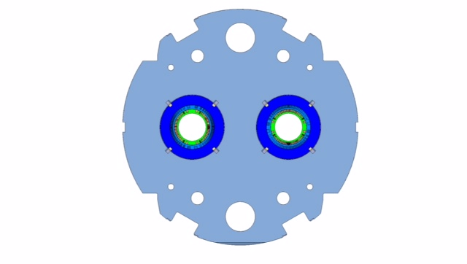
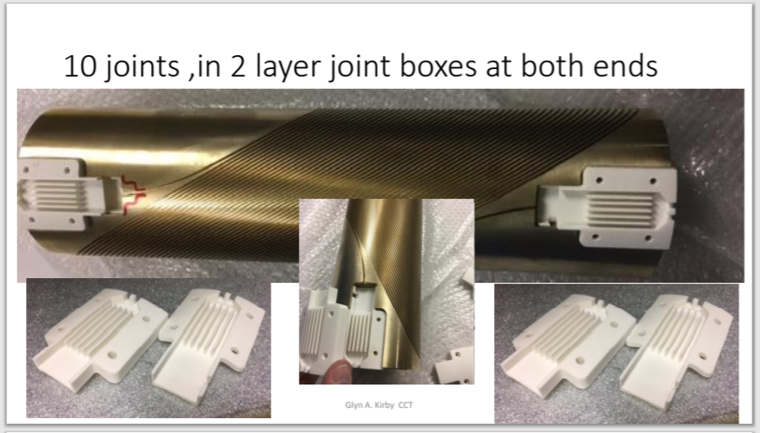
Mekanisk design
plats för elektriska skarv (joint-boxes)
  50cm modell: joint-box vid varje end
  alternativ ide: fram/baksida av järn ok

Slide 12
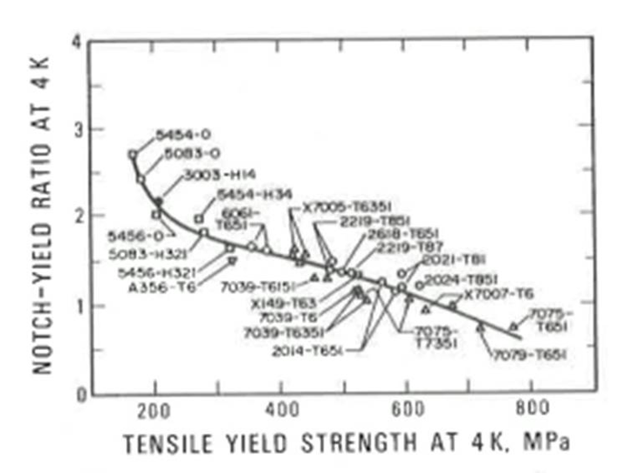
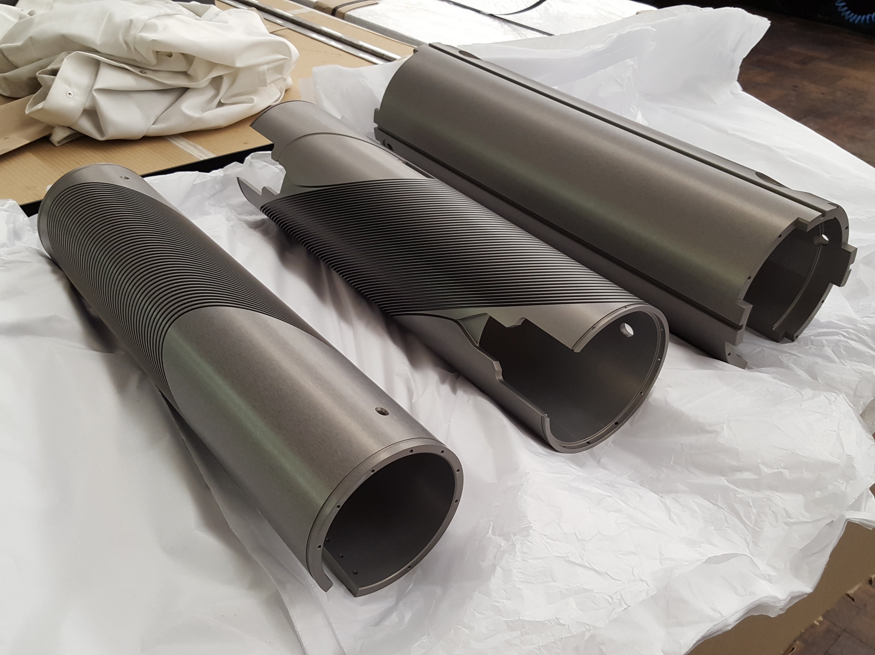
Magnetspindel
A6082-T6
  yield strength 400 MPa
  notch-yield ratio = tear resistance to yield strength
  operate below 120 MPa
  high RRR (quench skydd)
anodisering
  ändrar elektrisk motstånd
    ger extra isolation för kabeln
  hjälper anknytning av epoxy resin
  för 50cm modell magnet
    40 µm tjock
3 olika spindel
  2 med spår och 1 yttre stöd-spindel
  3D step modell transfer från CAD till CNC
viktig med dimension kontroll
AL 6082-T6
Ratio > 1.5
50cm CCT modell
Oxford University 2018

Slide 13
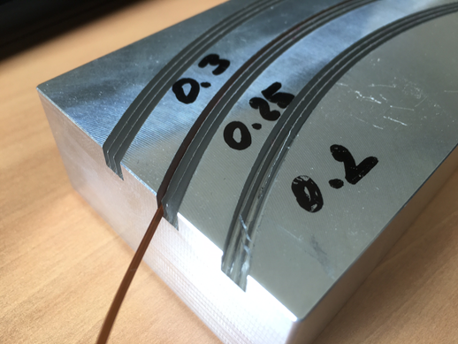
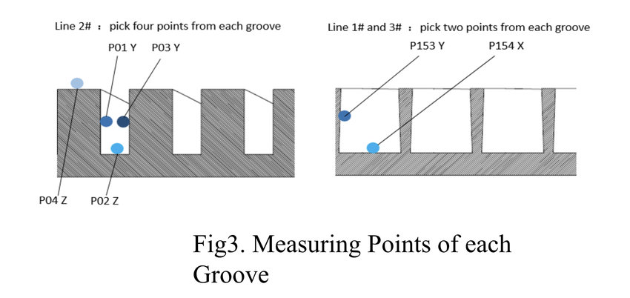
Magnetspindel
Erfarenhet Glyn
  spår max. 5 djup x 1 bred
Design
  spår pitch 3.1 mm
  bred 2 x 1.08 + 0.1 = 2.3 mm
  djup 5 x 1.08 + 0.1 = 5.5 mm
50cm CCT modell
Min wall 0.3mm with 2mm wide channel

Slide 14
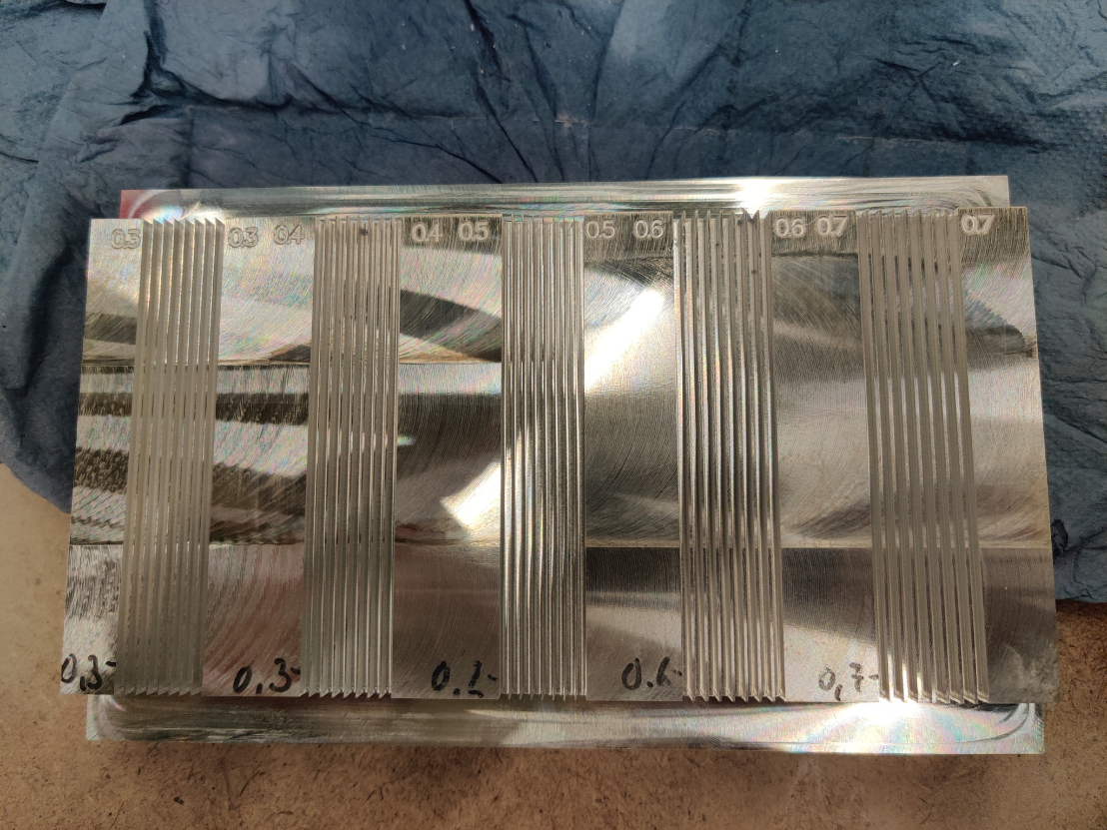
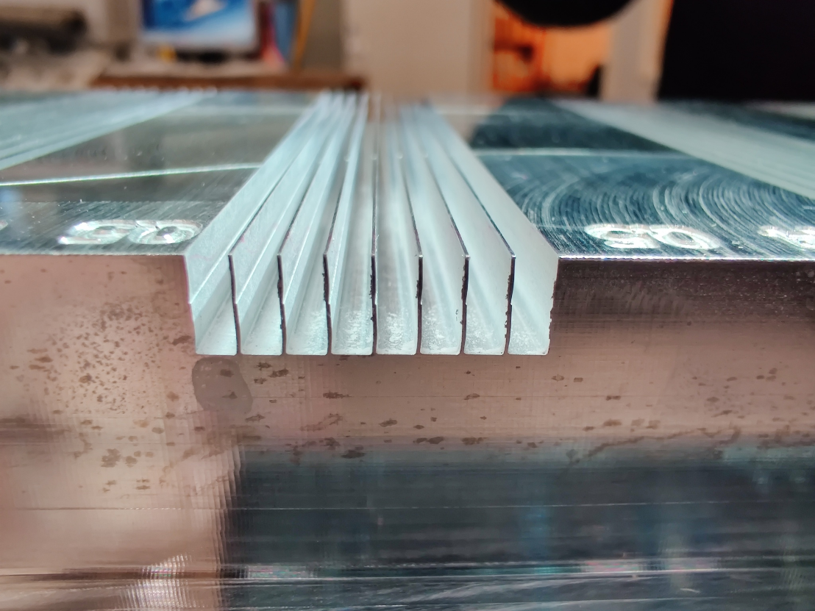
Magnetspindel
Spår i magnetspindeln
  7 wire per assemblage: ~1.1 mm
    spår blir ~2.3 mm x 6 mm

Slide 15
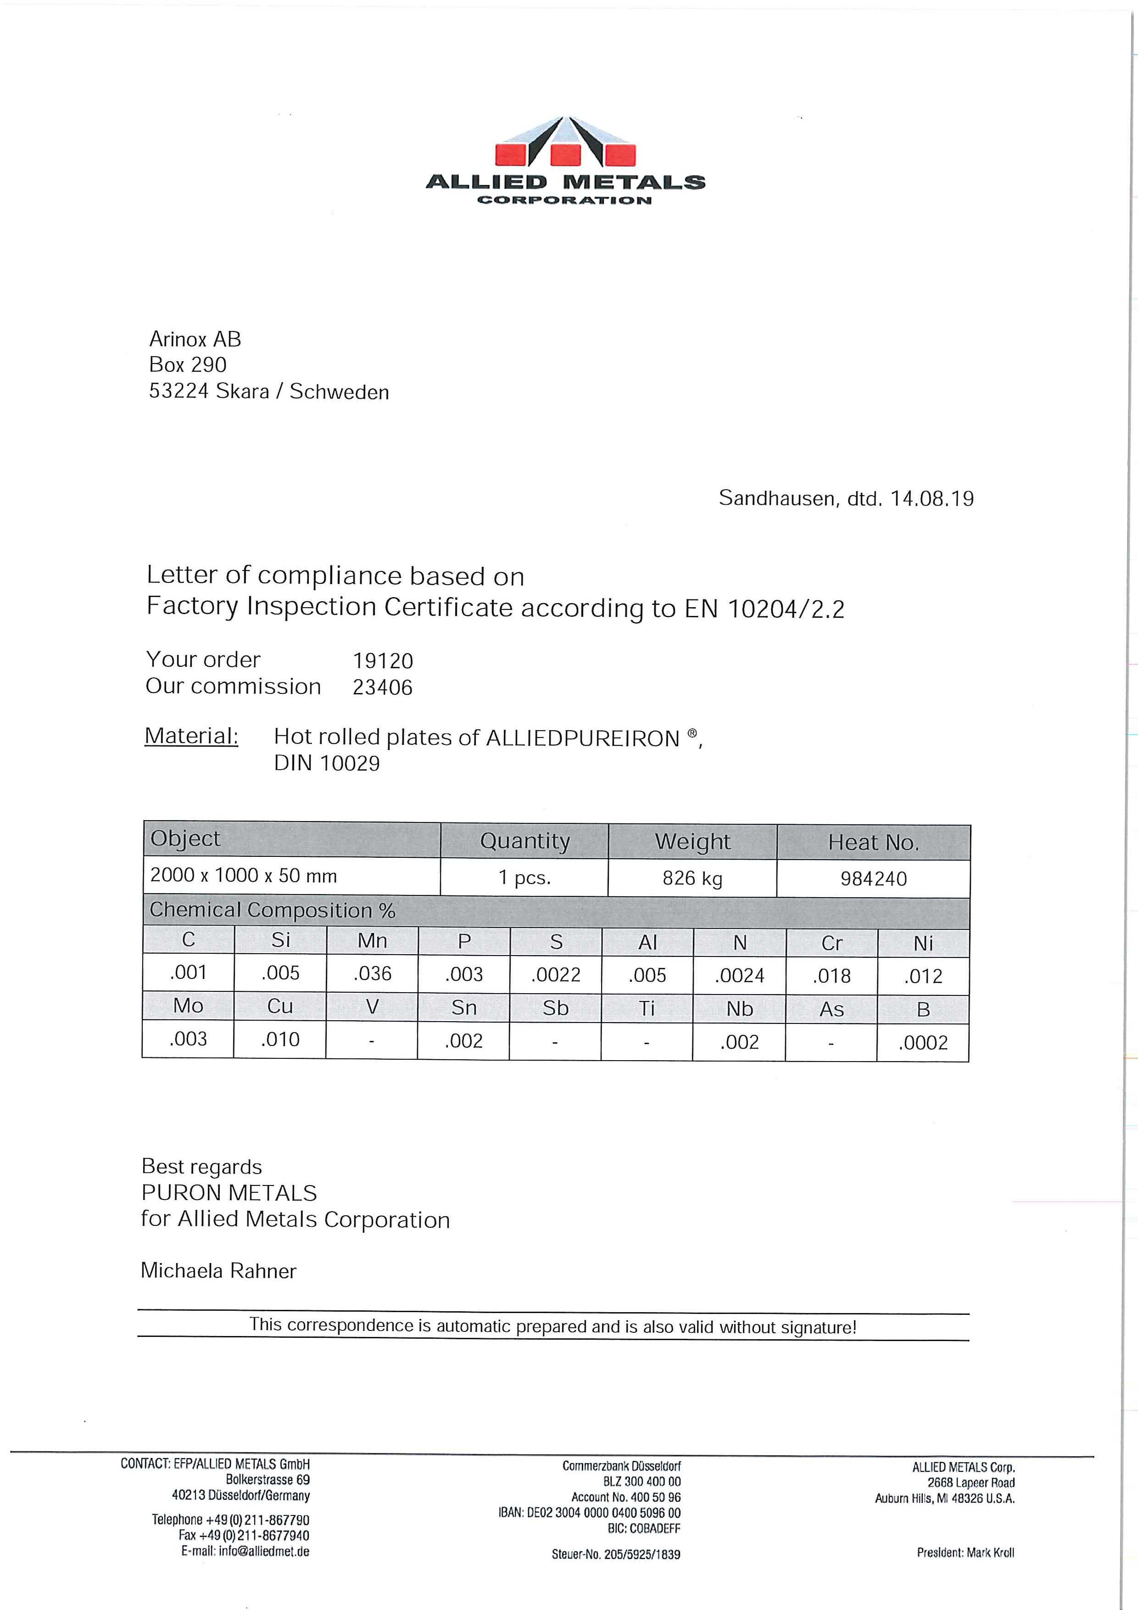
Järn ok
Förslag för järn typ: ARMCO
  https://alliedmet.com/alliedpureiron/
diskussion med CERN
  this product is basically good.
  ARMCO or PURE IRON is the same.
  5 mm or 6 mm thickness plates are standard values for the market.
  Originally CERN was using MAGNETIL,
  In the ... production for HL-LHC (5.8 mm, old LHC standard thickness) we have adopted the ARMCO Grade 4 (not the ARMCO grade 2) with a lower content of S, N, et (the presence of these components affecting the magnetic behaviour).
  ... had problems also with scaling (at the surface of the plates) and with the content of S (sometimes higher than 0.003, in this case we rejected the plates/heat).
  The supplier had problems in obtaining the correct grain size number too. We could never obtain the target value of Gs<4 (in the MS at the beginning CERN asked fro Gs< 3!). The Gs is important for the mechanical characteristics at low temp. Finally, the annealing process included in the spec in order to favourite the Gs reduction had to be abandoned.

Slide 16
Järn ok
MCBC/Y design har stor öppning för magneten
  CCT magnet design är mindre
  mer plats för järn
    förbättring av fältkvalitet
    mindre ström
cooling
MCBC/Y
tie rod
alternative
pin
keys
alignment slot

Slide 17
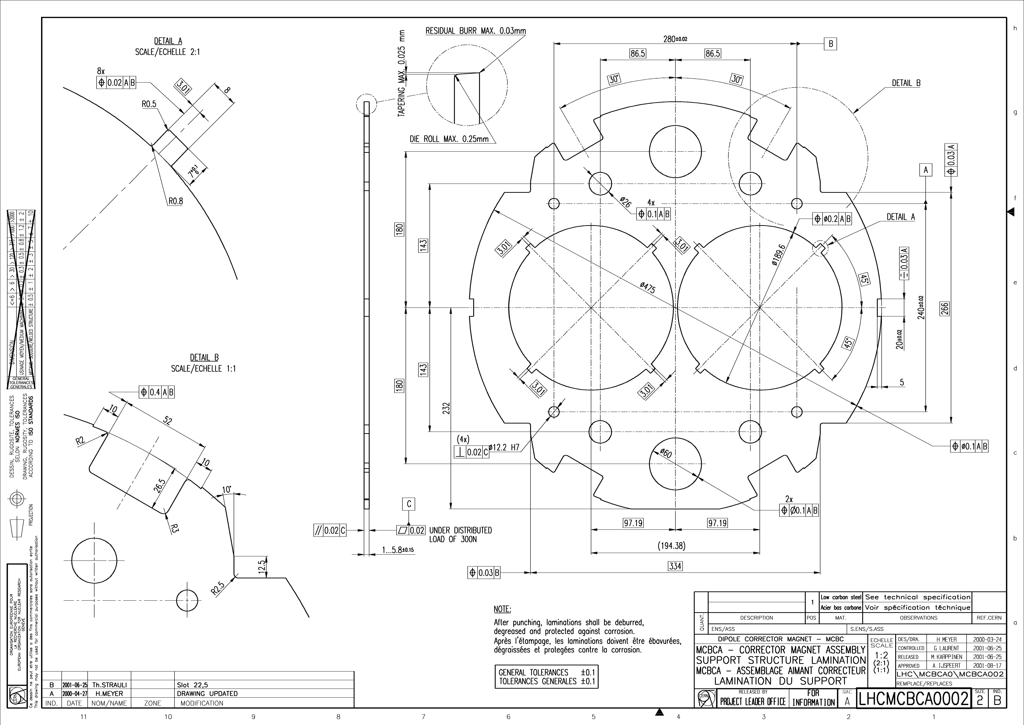
pin & rod
4x keys
guide thermal contraction
1...5.8±0.15

Slide 18
Next Steps
discussing collaboration contract with CERN
  to receive full 3D CAD model from CERN
  to receive advise/knowledge (Glyn Kirby) and engineering support
recruiting researcher/post-doc for simulations
  work on field and quench simulations, magnetic design
  discussion ongoing with candidate presently at CERN
tests on superconducting cable
  joints, cabling, impregnation
tests cutting iron for yoke laminations
  accuracy
submitted abstract to MT27 Magnet Technology Conference
  in Japan, 15-19 November 2021

