Slide 1
GERSEMI
TL012 modifications
Architectural Proposal
Zoom, 09/06/2017

Slide 2
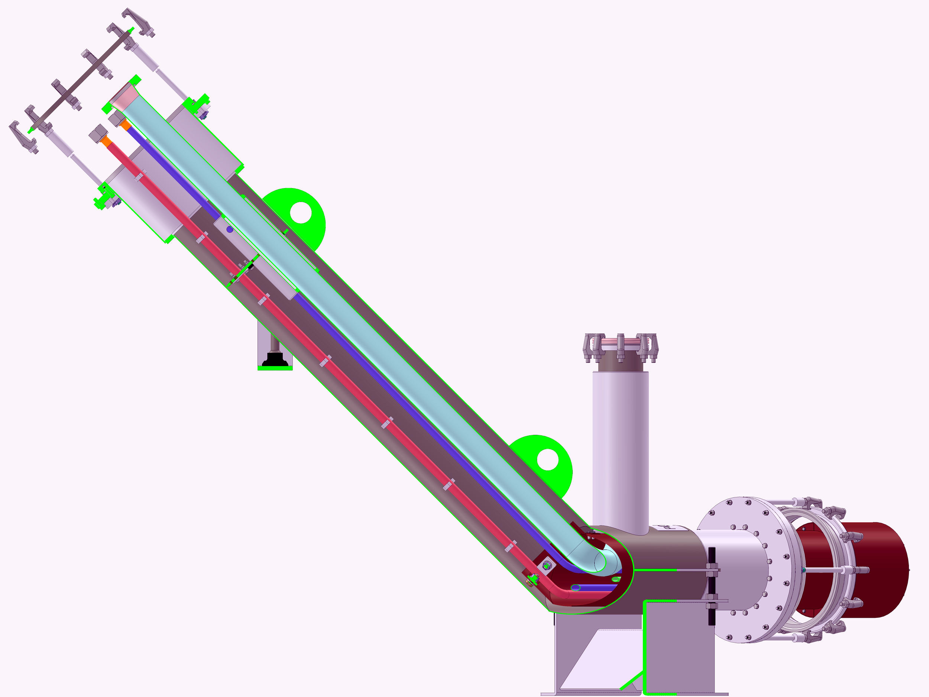

Slide 3
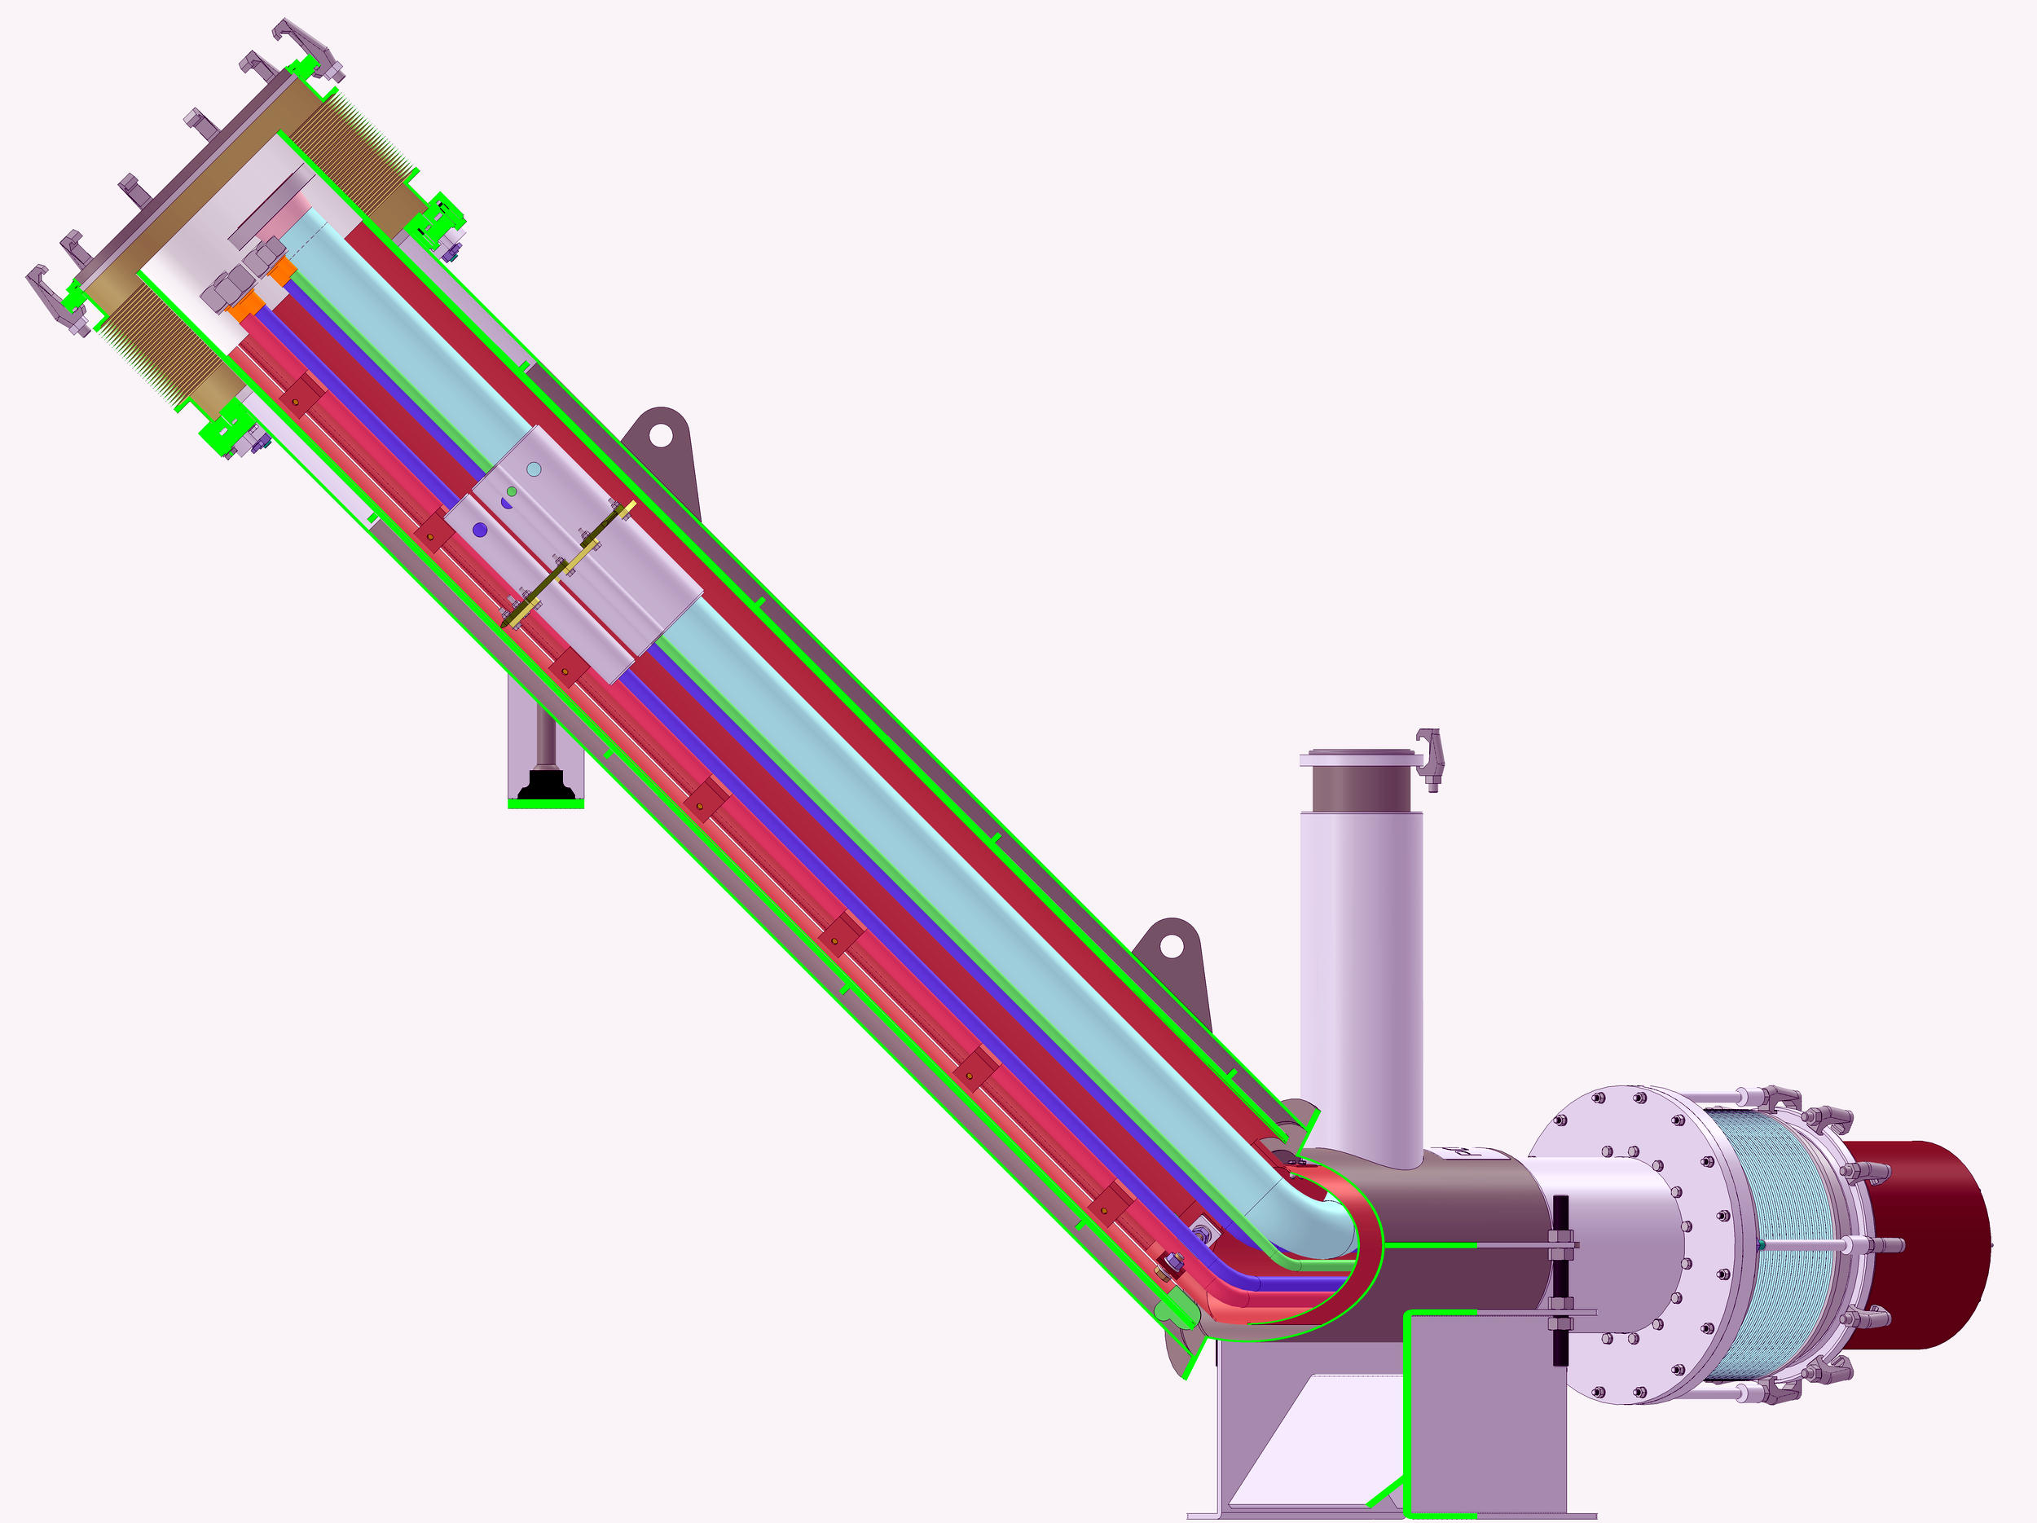

Slide 4
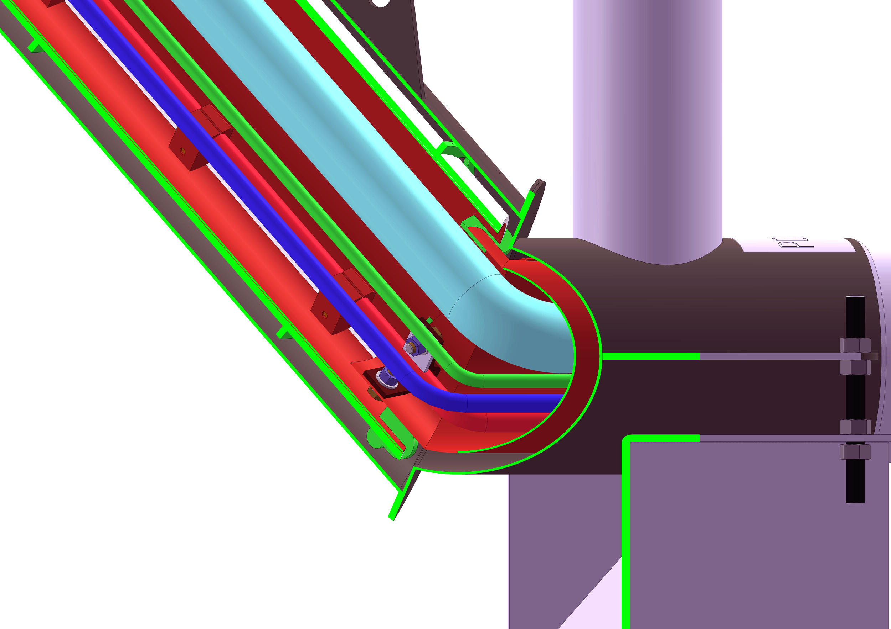

Slide 5
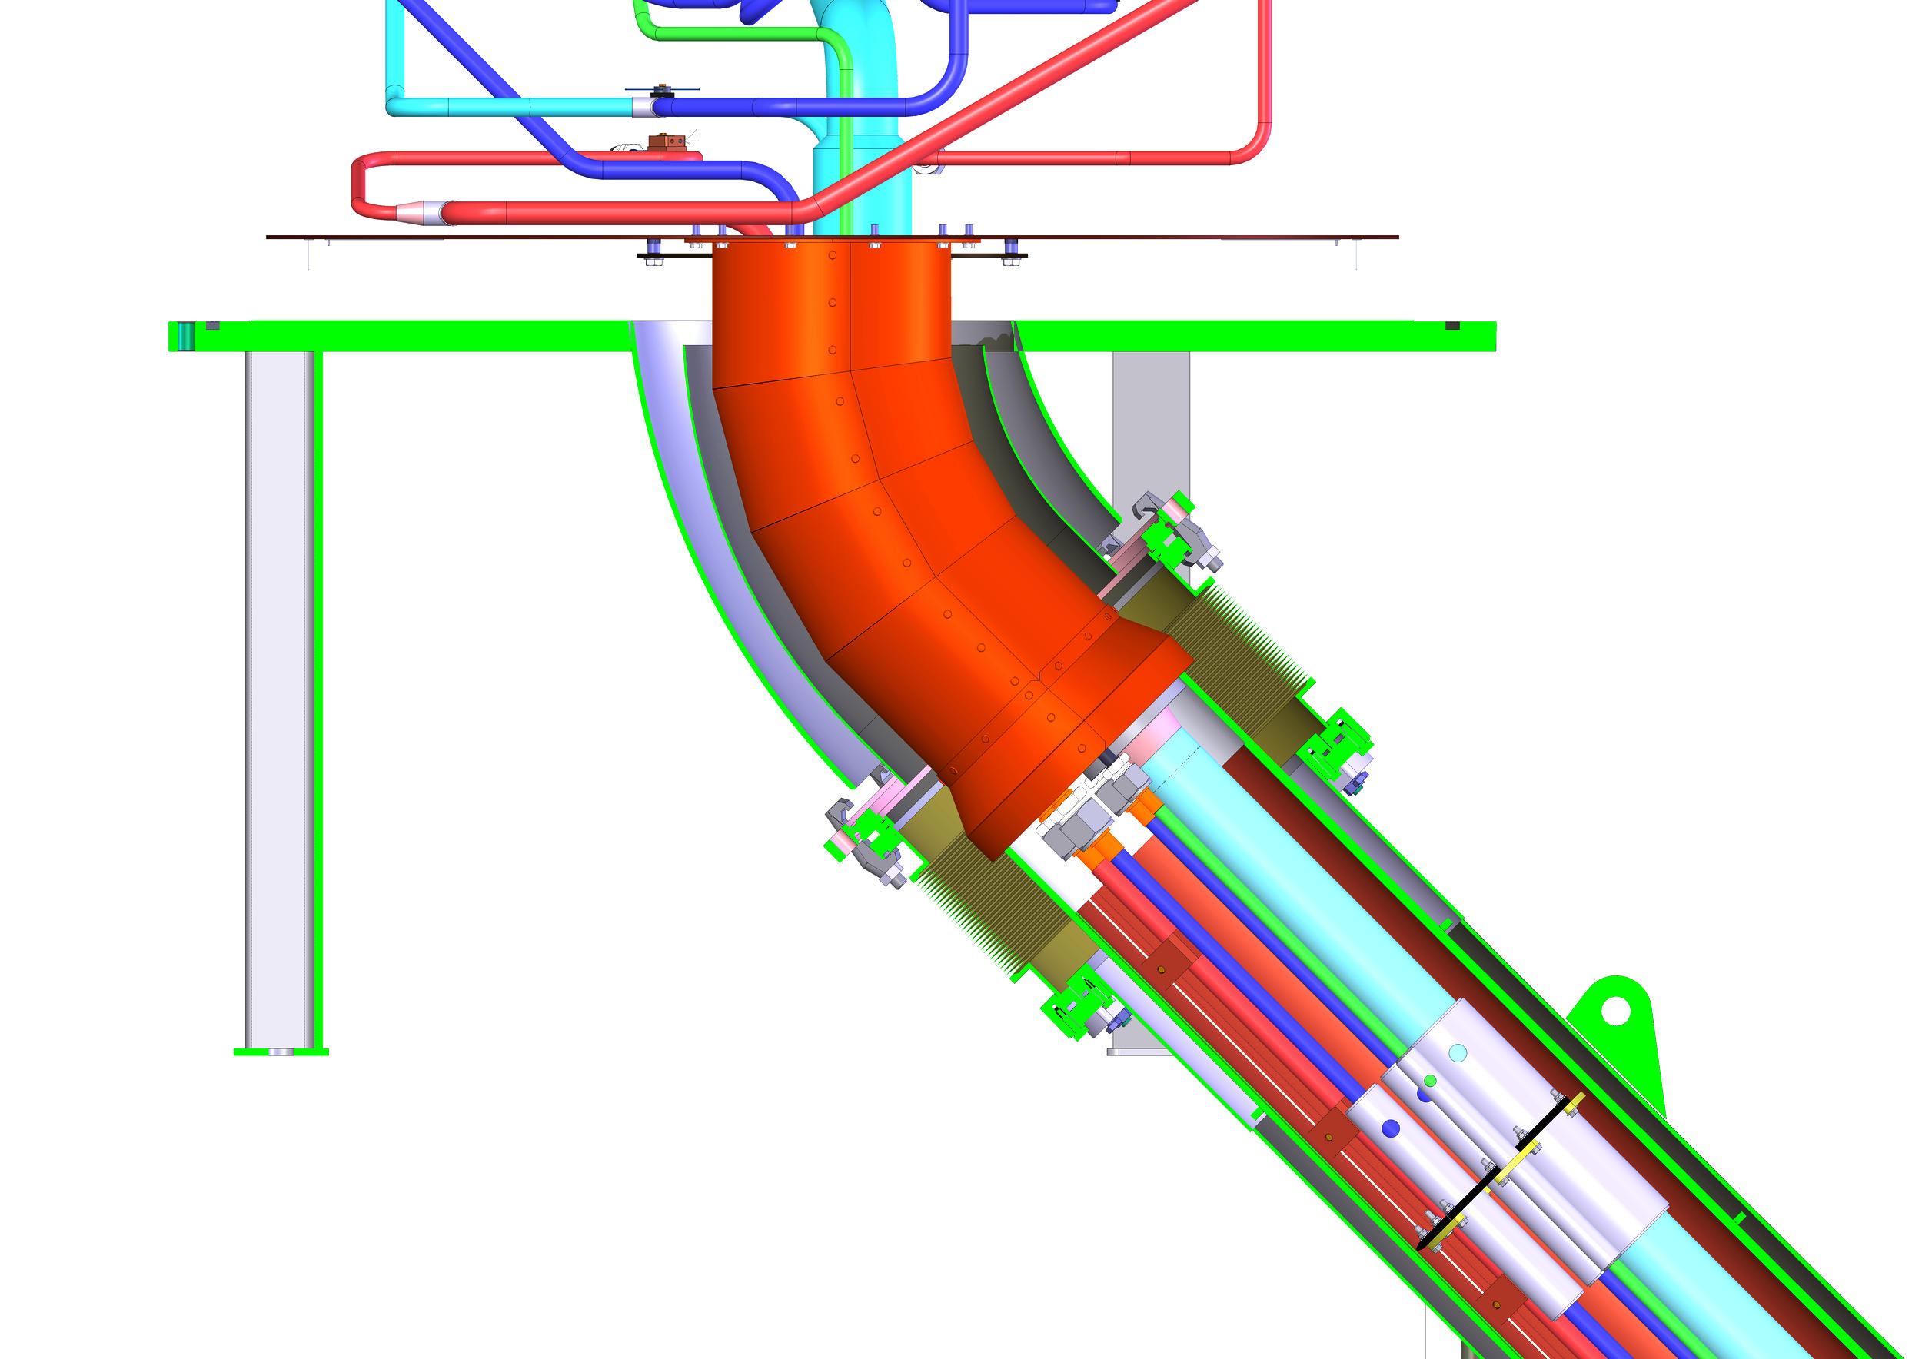

Slide 6
