Slide 1
GERSEMI
VB modifications
Architectural Proposal
TeleConf , 27/04/2017

Slide 2
HX600 vs 4K pot level

Slide 3
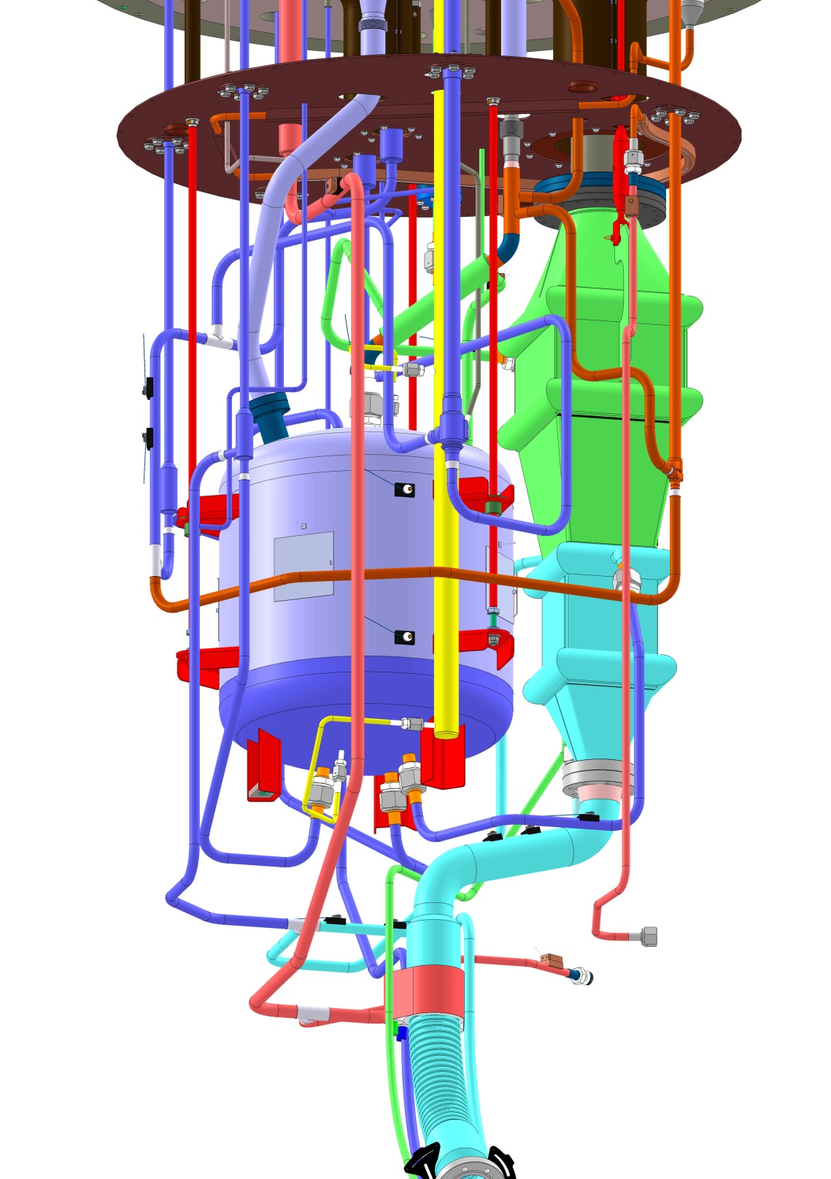
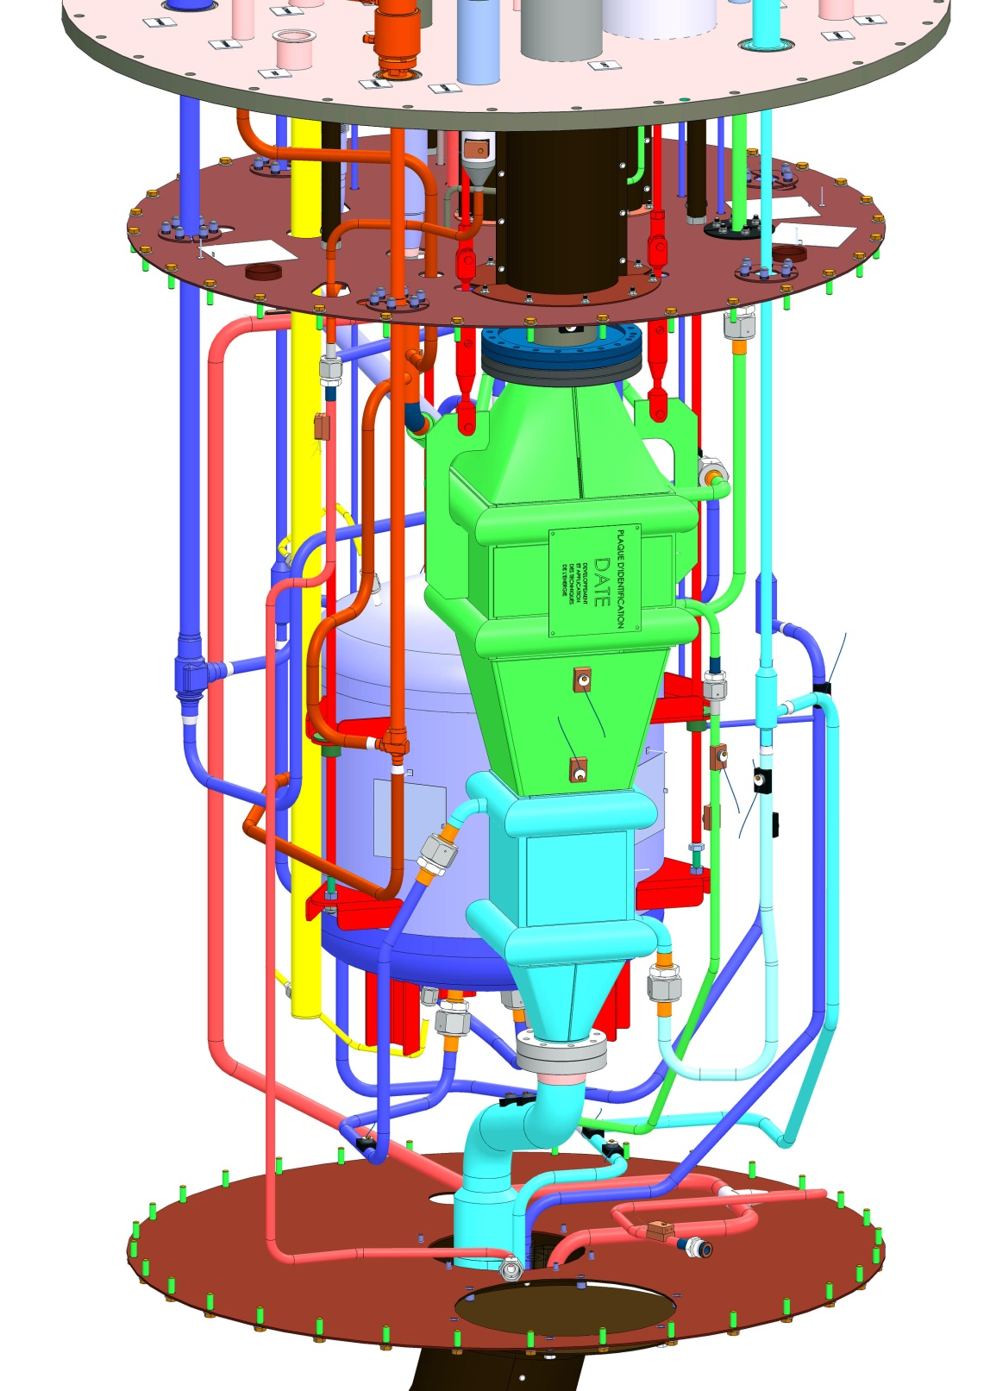

Slide 4
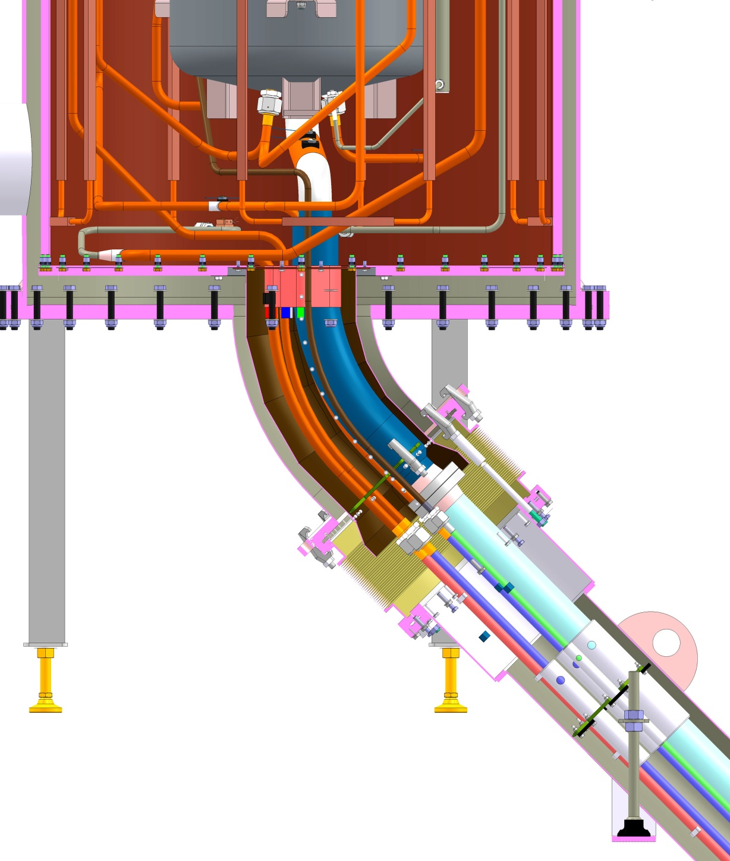
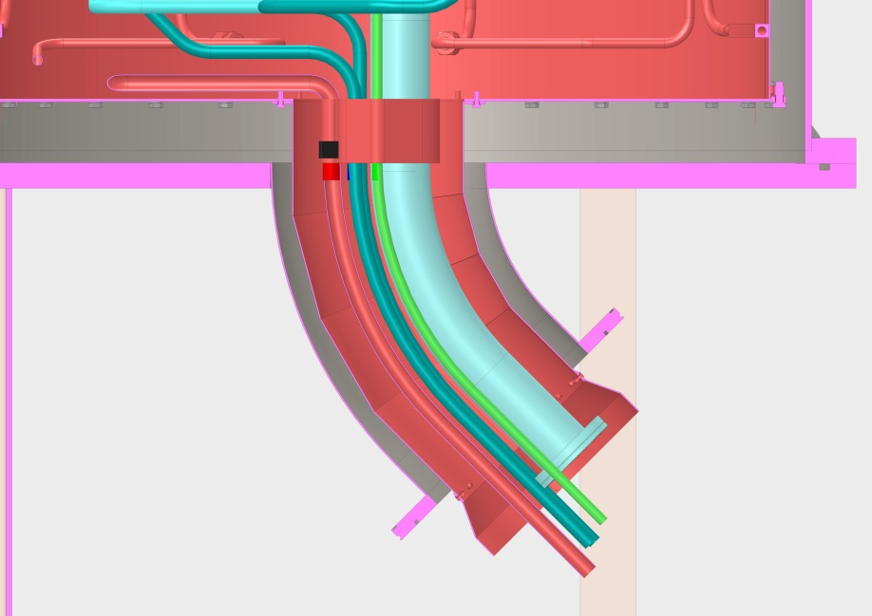
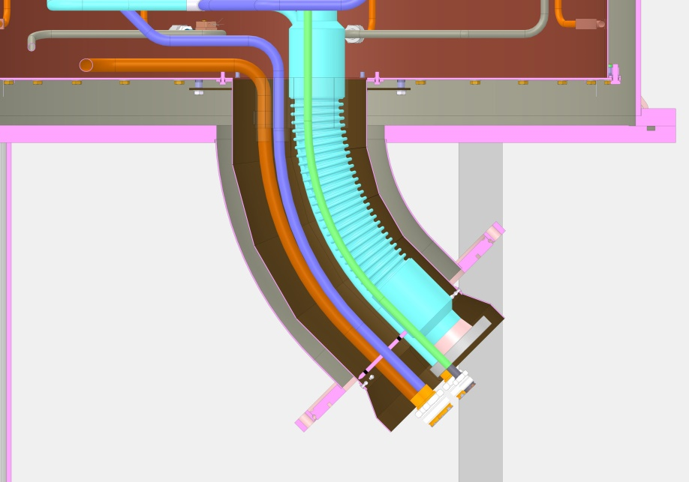

Slide 5
