Slide 1
GERSEMI Feedback after the vertical cryostat tests Change proposals
Meeting of 27th April 2021

Slide 2
Valve box
4K tank and sub-cooling heat exchanger
Observation
High liquid helium consumption
Need to limit filling of the 4K tank at 50%
The helium cold vapor temperature is too high > 7K
Temperature of the subcooling heat exchanger are not coherent
Assumptions and proposals
Taconis effects -> need more investigations and tests
The subcooling heat exchanger is filled with liquid helium when the tank liquid helium level is higher than 50%
A thermal contact between the low pessure line and the thermal shield is likely

Slide 3
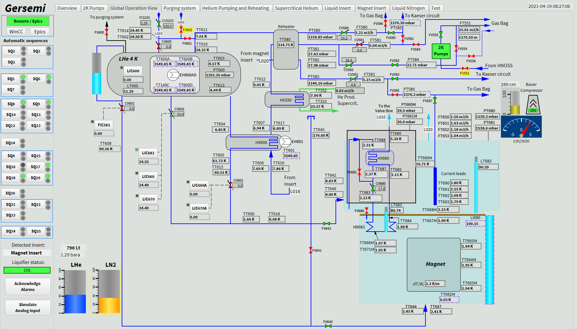

Slide 4
Valve box
4K tank and sub-cooling heat exchanger
Proposals
Change the piping between the 4K tank and the sub-cooling heat exchanger
Or remove the sub-cooling heat exchanger (and JT valve ?)
Change (if possible) the position of the pumping line to limit the contact with the thermal shield

Slide 5
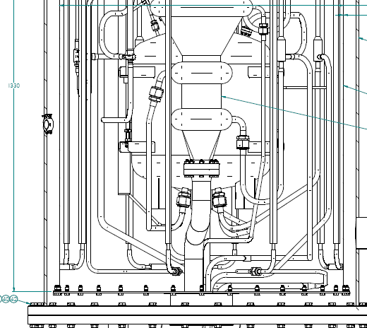
New piping
LT600 = 50%

Slide 6
Liquid insert
Observation
Taconism : difficulties to pump the liquid helium bath ⇒ filling the cold vapor volume with foam
It’s not possible to fill the cryostat with superfluid helium
Proposal
Install the subcooling heat exchanger and JT valve in a vacuum vessel which will be located under the insert thermal shield (similar of the Magnet insert). The helium filling will use the cryogenic line planned for the Vacuum insert.

Slide 7
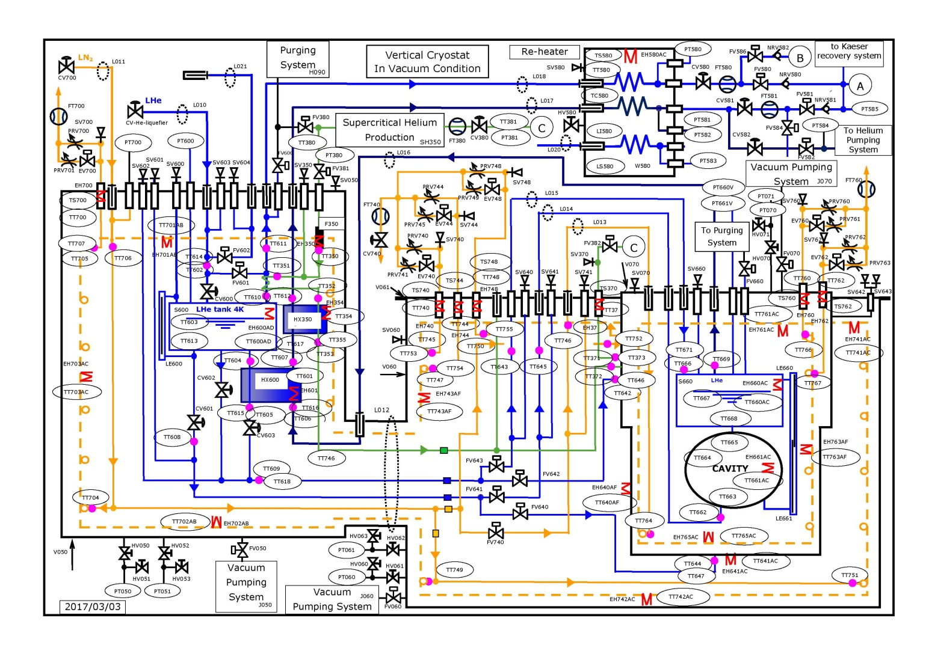

Slide 8
Magnet insert
Observation
The pressure drop through the current leads caused by the cooling flow is about 50 mbar.
To reach the nominal cooling flow, the vertical cryostat must operate at a pressure close of 1.17 bar
The vertical cryostat is connected to the gas bag, why is the cryostat pressure so high?
Proposal
Investigate to obtain the values of the pressure drop of the massflowmeter and the non-return valve

Slide 9
Vertical cryostat
Observation
The connectors of Pt100 sensors and electrical heaters anchored on the vertcal thermal shield are installed on the top flange of the vacuum vessel
It’s not possible to open the vacuum vessel without to disconnect the instrumentation and heaters
Several Pt100 wires have been broken during a previous opening of the vacuum vessel
Proposal
Change the position of the several feedthroughs ⇒ from top flange to vertical vessel

