Slide 1
CCT Superconducting Magnets
23 June 2021
Kévin Pepitone

Slide 2
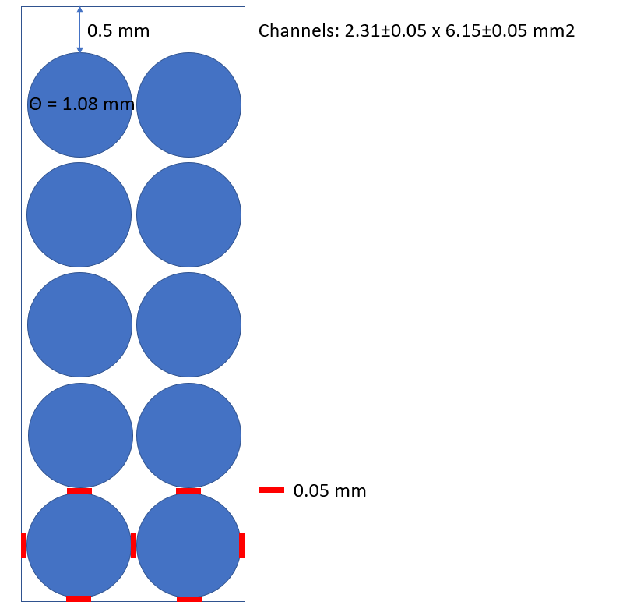
Channels explanation
0.05 mm gap cable-cable ; cable-former
0.5 mm on the top of the channel for more cable
Tolerance 0.05 mm
Cable 1.08 mm diameter

Slide 3
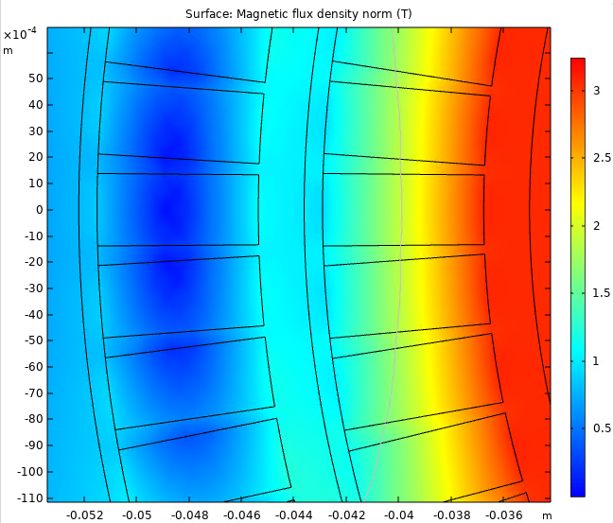
Jungle of numbers
Inner former inner radius = 35 mm
Channel = 5*1.25 x 2*1.25 = 6.25 x 2.5 mm2 ---------------- rope is 1.21 mm diameter
Channel 6.15 x 2.31 mm2 cable is 1.08 mm
Rcoil 1 inner = Inner former inner radius + 1.75 mm = 36.75 mm
Rcoil 1 outer = Rcoil 1 inner + Tcoil (= 6.15) = 42.9 mm
Outer former inner radius = Rcoil 1 outer + T former gap (= 0.7) = 43.6 mm
Rcoil 2 inner = Outer former inner radius + 1.75 mm = 45.35 mm
Rcoil 2 outer = Rcoil 2 inner + Tcoil (= 6.15)= 51.5 mm
Rsupport inner = Rcoil 2 outer + T former gap (= 0.7) = 52.2 mm
Rsupport outer = Rsupport inner + Tsupport (= 19.15 mm) = 71.35 mm
Ryoke inner = Rsupport outer + Tyoke gap (= 1.6 mm) = 72.95 mm
Ryoke outer = 240 mm
Tilt = 30 deg

Slide 4
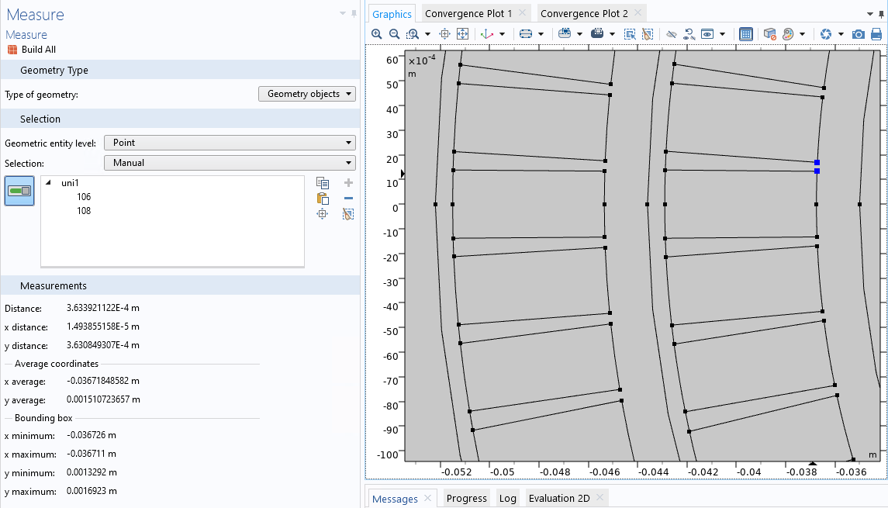
Definition of pitch and Bfield
With a pitch of 5.3 mm I have a gap of 0.363 mm in the mid plane inner coil
0.363 * cos (30 deg) = 0.314 mm
Based on this 172 turns corresponds to magnetic length of 911.6 mm and a total coil length of 1064 mm
-> Bfield = 2.8 T.m ; Magnetic length = 911.6 mm
We need a Max field of 3.071 T.

Slide 5
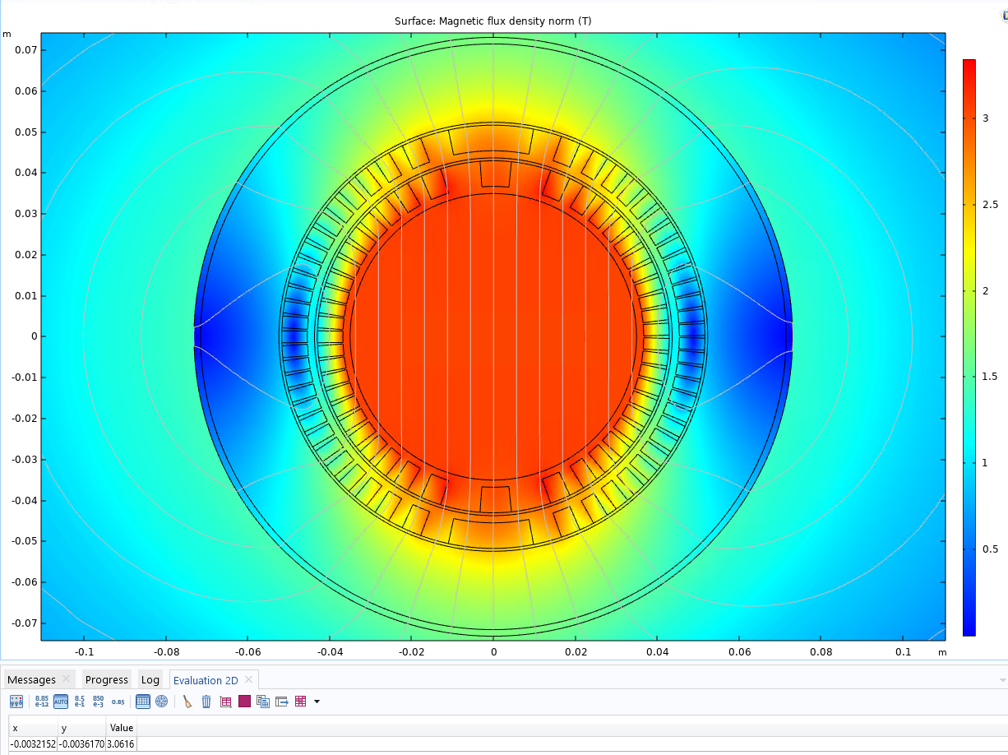
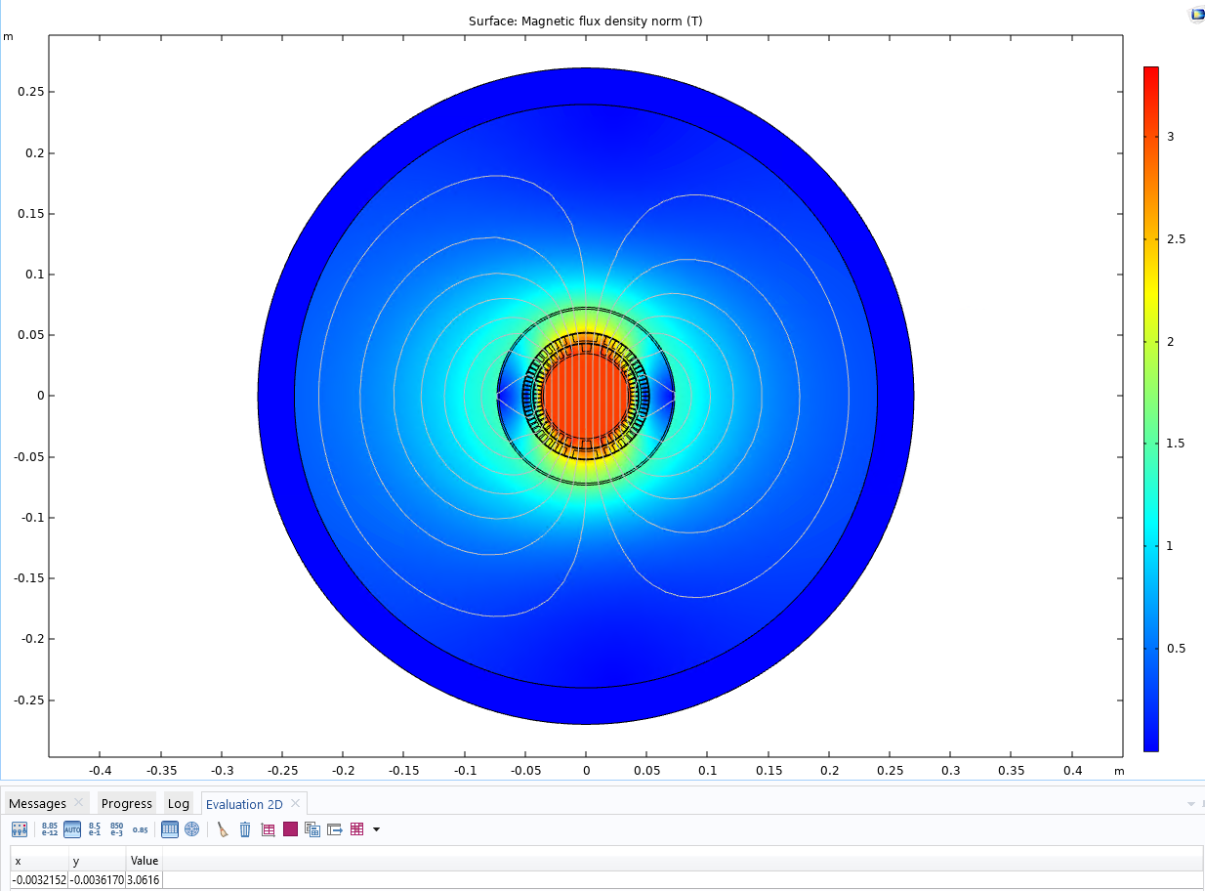
Results with COMSOL with 7 x 74 A
After some iterations…
3.08 T
The COMSOL CCT model has been developed by Martin Istvan Noval (CERN TE-ABT-SE) https://indico.cern.ch/event/727555/contributions/3436414/

Slide 6
Quench studies
If 7 strands are powered, the central one doesn’t see the same heat transfer during a quench. Solution power 6 strands.
Total current is either 7 x 74 (= 518 A) or 6 x 86 (= 516 A)
For the quench simulation I can to 2 x 30 cables in the channel
30
29
2
1

Slide 7
Conclusions COMSOL simulations
2D simulations updated
Max field 3.08 T obtained for I = 7 x 74 A (54.0% of the short sample at 4.2 K)
I = 6 x 86 A (62.7% of the short sample at 4.2 K)
Bfield is 2.8 T.m
Design ok, but ready for MORE improvements

