Slide 1
Projekt kalla magneter
Tillverkningsteknik
Roger Ruber
för projektgruppen
Uppsala, 31 May 2021

Slide 2

Nuvarande MCBC/MCBY Orbit Corrector
Parameters | MCBC | MCBY
Coil inner diameter | 56.4 mm | 70.4 mm
Magnetic length | 0.904 m | 0.899 m
Operating temperature | 1.9 K and 4.5 K | 1.9 K and 4.5 K
Nominal field (at 1.9/4.5 K) | 3.11/2.33 T | 3.00/2.5 T
Nominal current (at 1.9/4.5 K) | 100/74 A | 88/72 A
Peak field in coil (at 1.9/4.5 K) | 3.65/2.68 T | 3.60/2.96 T
Short sample current (at 1.9/4.2 K) | 172/127 A | 162/120 A
Stored energy (at 1.9 K) | 14.2 kJ | 13.6 kJ
Self-inductance | 2.84 H | 5.27 H
DC resistance (RT) | 375 Ω | 501 Ω
Overall length | 1100 mm | 1100 mm
Outer diameter of assembly | 452 mm | 475 mm
Magnet module mass | 203 kg | 193 kg
Total mass including the support structure | 1234 kg | 1247 kg
Superconductor type | Nb-Ti in Cu matrix | Nb-Ti in Cu matrix
SC wire dimension | 0.38 mm x 0.73 mm (+0.0/-0.01) | 0.38 mm x 0.73 mm (+0.0/-0.01)
Ribbon construction | 14 wire (glued) | 15 wire (glued)
Kombination
B₀ = 3.11 T
L_{magnetic} = 0.904 m
$\int{Bdl}$ = 2.81 Tm
aperture = 35.2 mm
I_{max} = 100 A

Slide 3
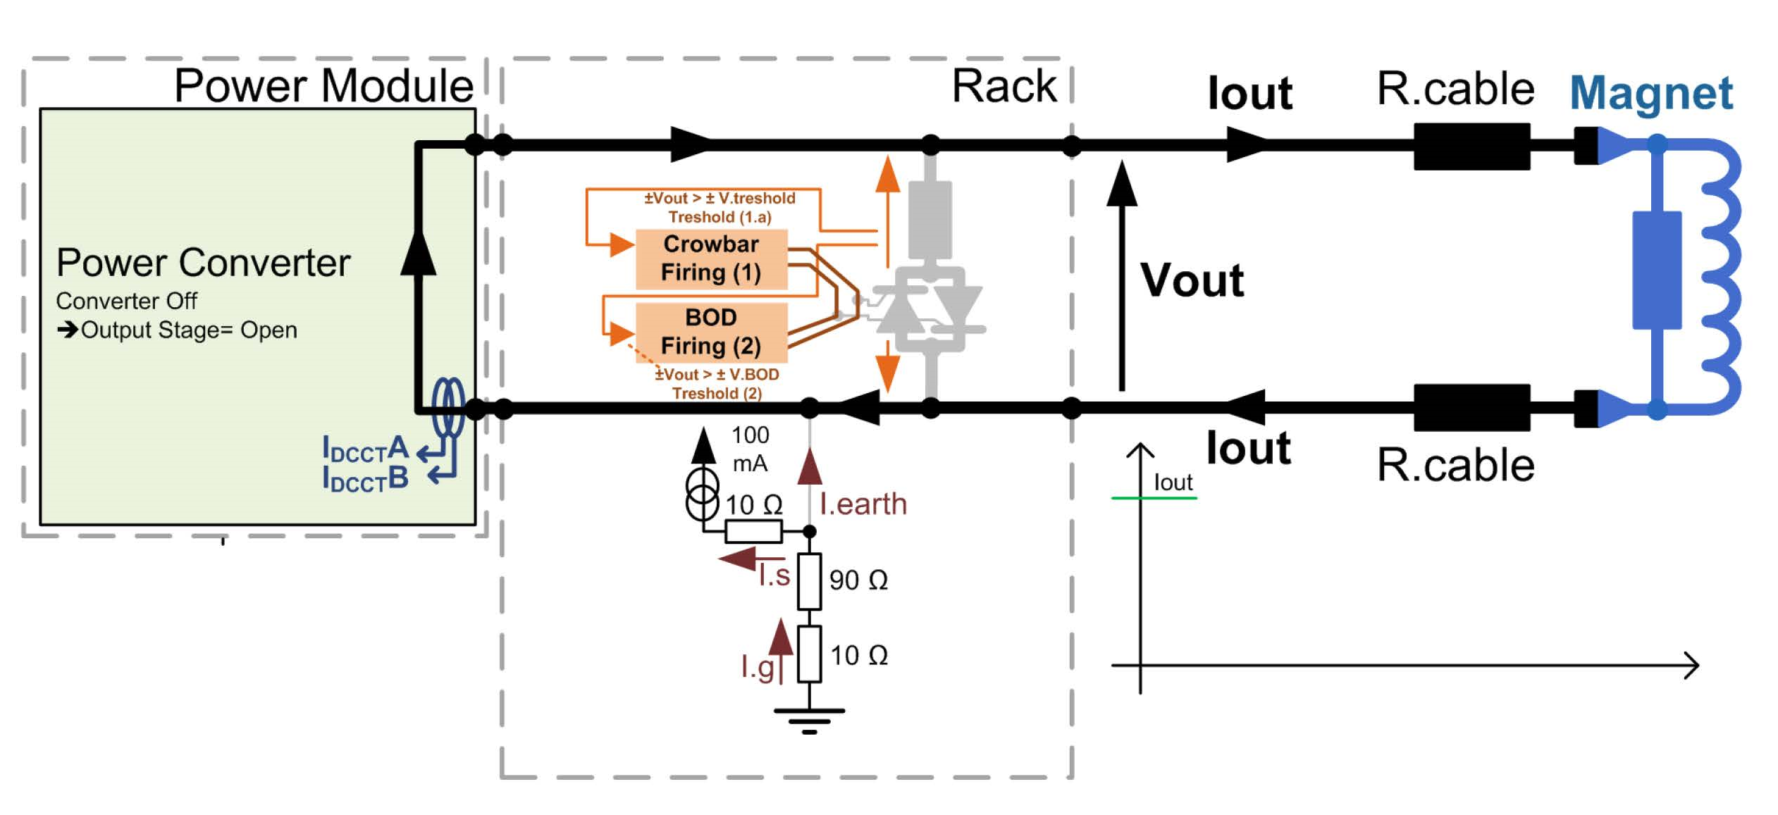
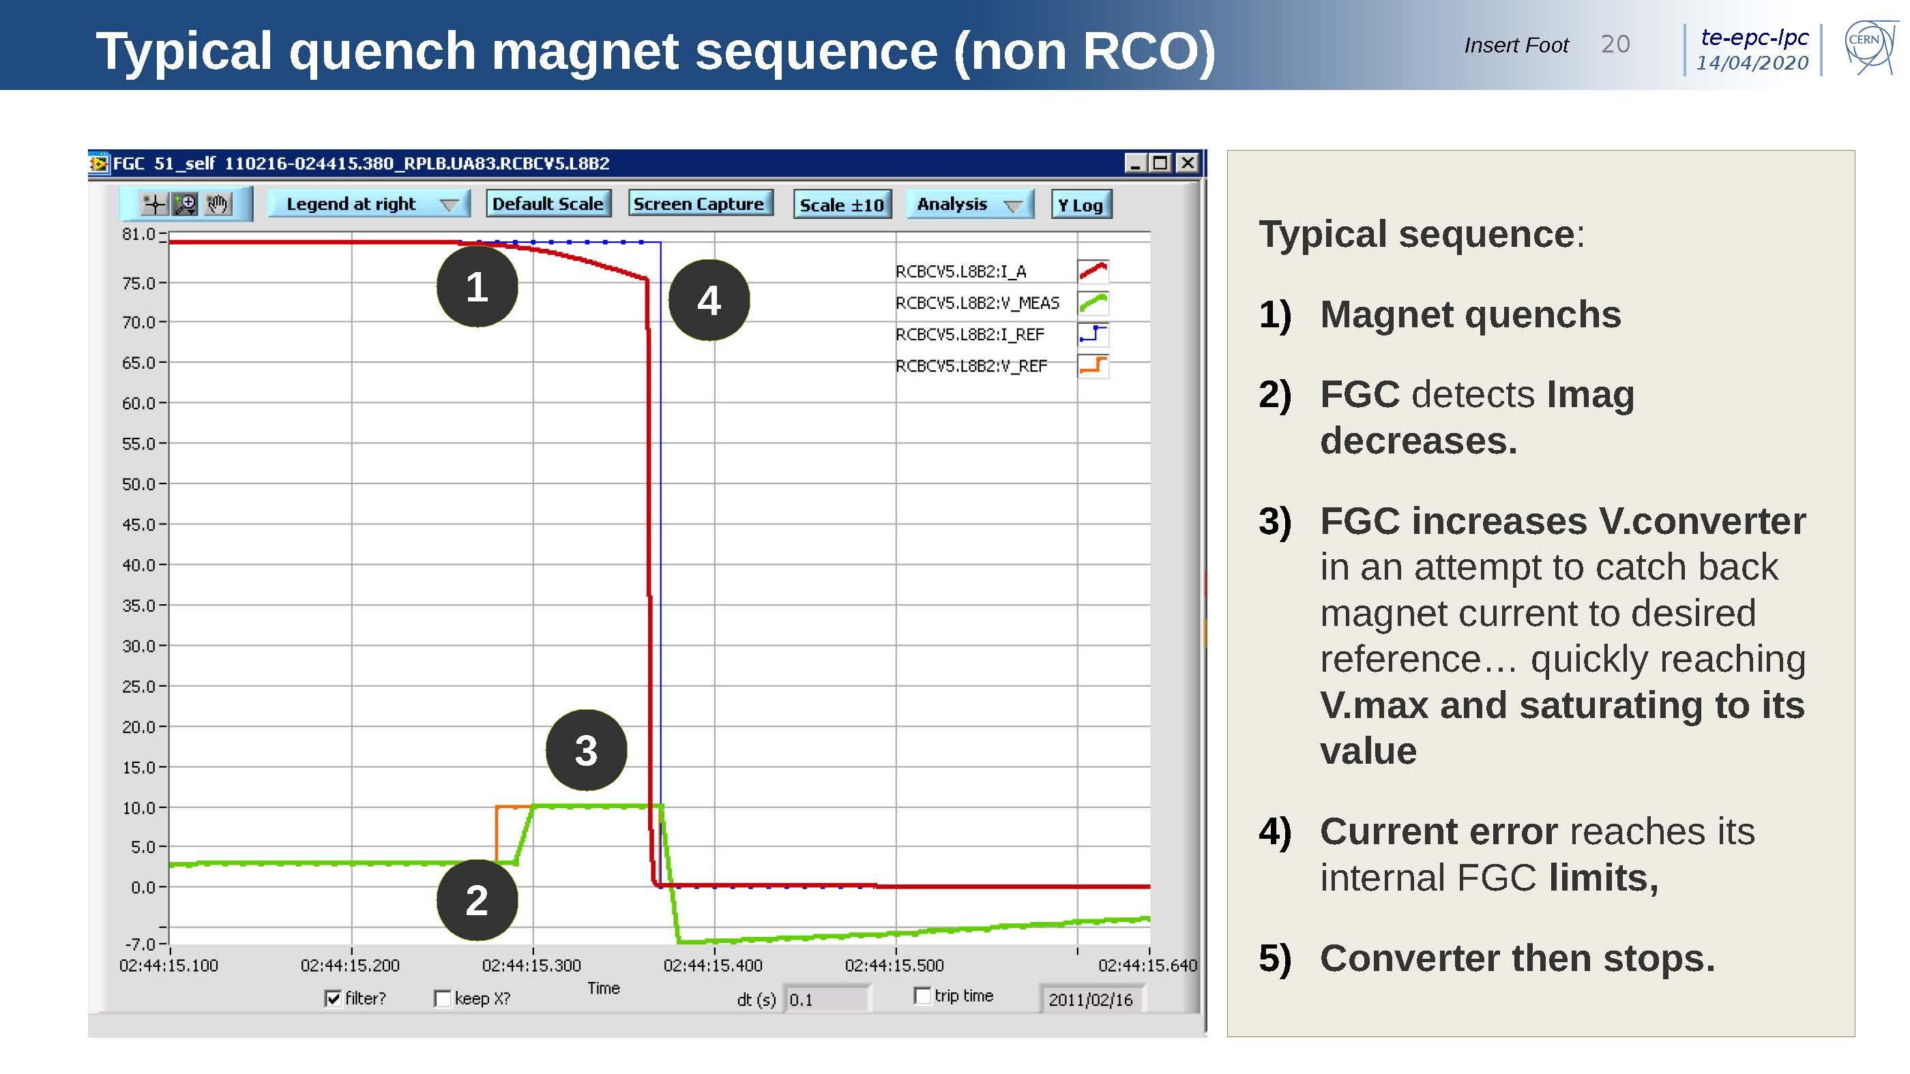
Elektrisk strömstyrka
Maximum ström
  begränsas av teknisk installation i LHC tunneln
  200 av denna typ av magnet
Power converter
  nuvarande ström circuit ±120 A, ± 10 V
    interlock för quench skydd:
      extern signal eller ström fel
    ingen energy extraction
  dokumentation
    http://sy-dep-epc-lpc.web.cern.ch/converters/lhc120a-10v/general.stm
    https://indico.cern.ch/event/904900/
Behöver passiv quench skydd
  diod och motstånd
  kall system, dvs inbyggd i magnetens kryostat
  att diskutera med CERN
FGC=function generator/controller

Slide 4
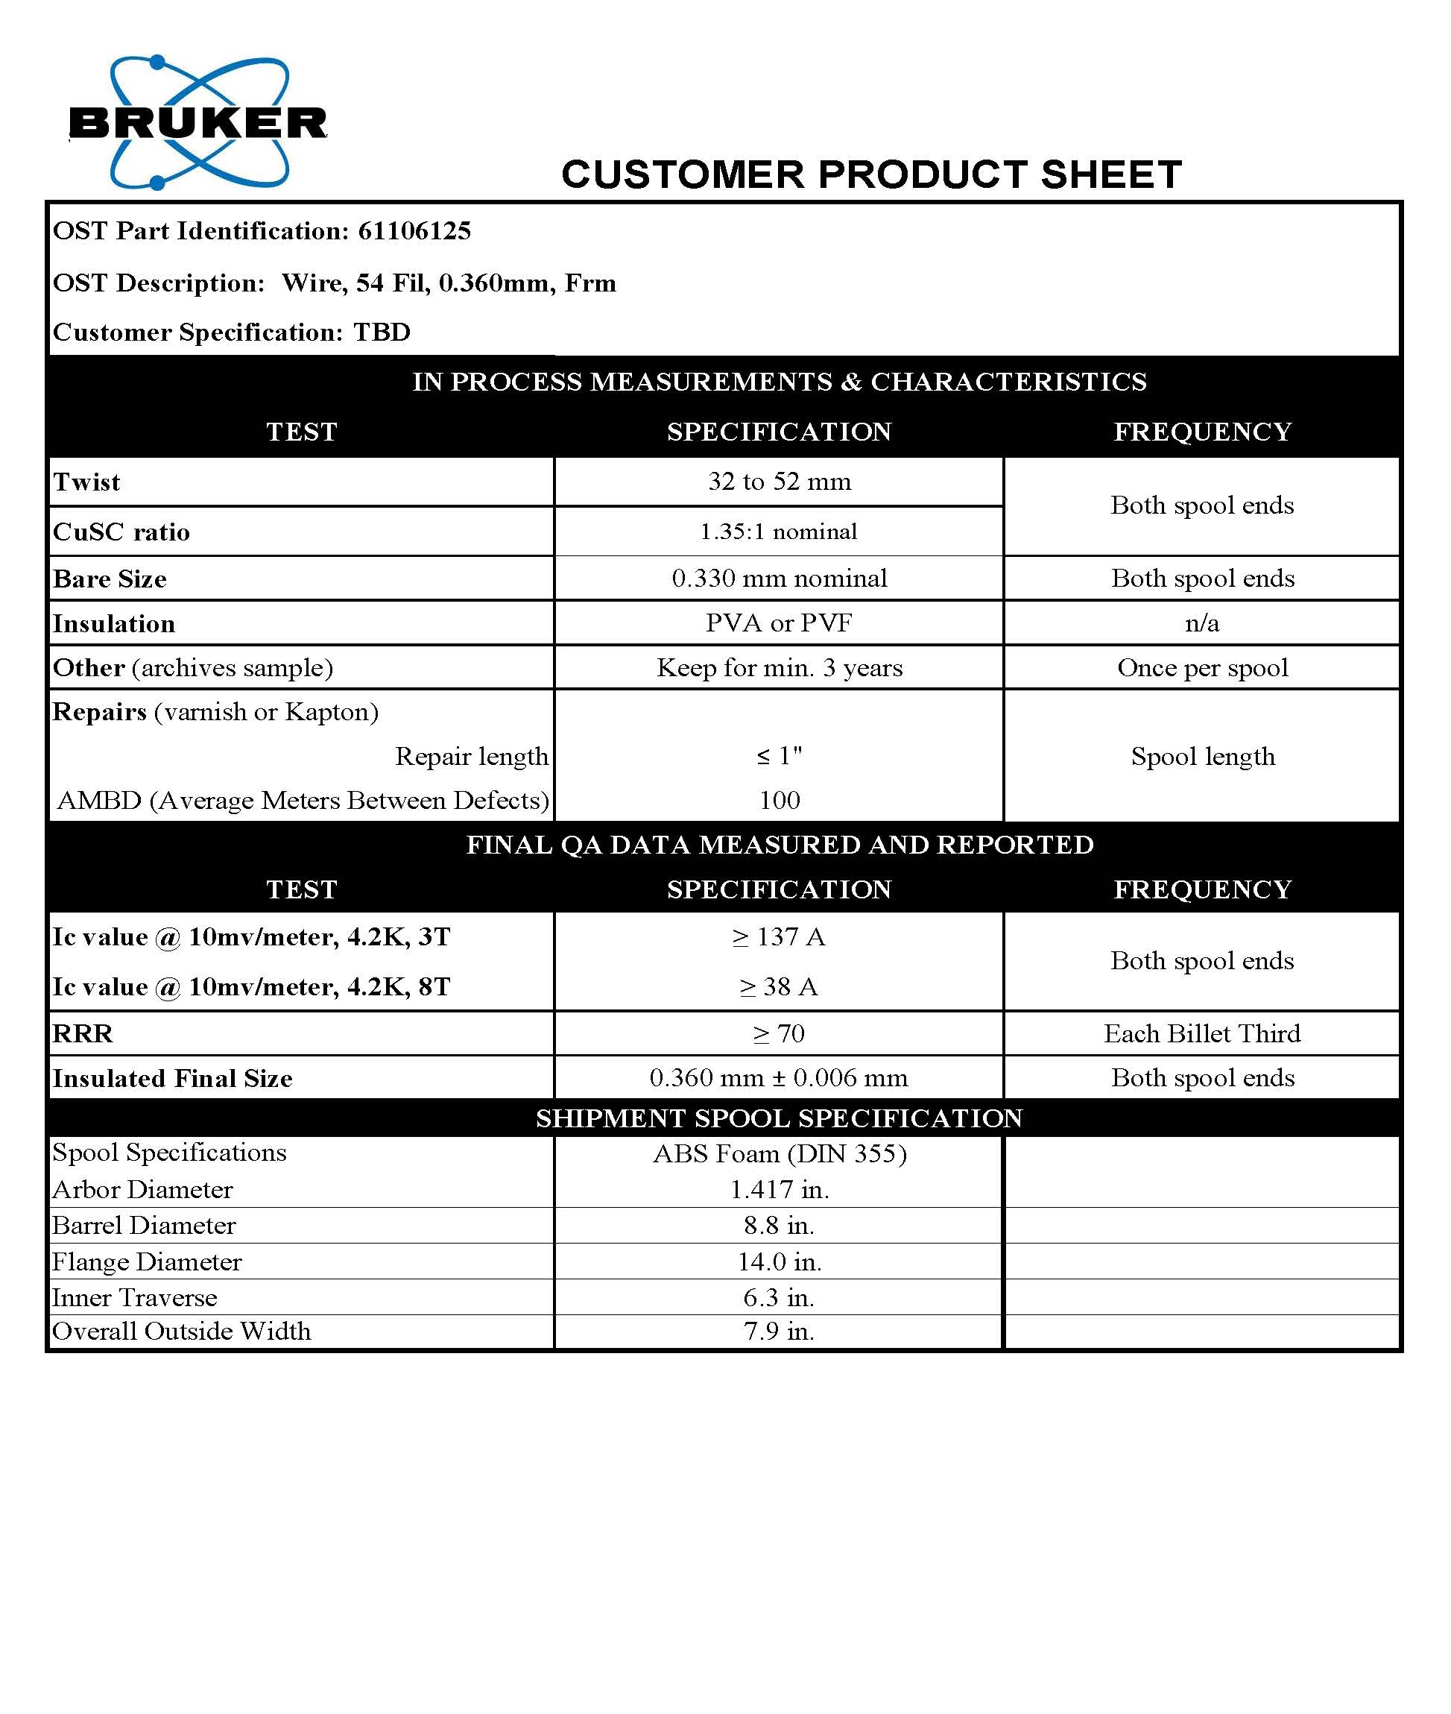
Supraledare - tråd
Bruker Energy & Supercon Technologies (BEST)
  https://www.bruker.com/content/bruker/int/en/products-and-solutions/superconductors.html
supraledande tråd
  diameter
    0.33 mm (w/o insulation = bare)
    0.36 mm (with insulation)
    insulation = formvar (or polyimide)
  filament approx. 29 µm
  bending radius 25 mm
  max. tensile strength 20 kg/mm²
  I_{critical} (4.2K, 3T) ≥ 137 A
    at 60% load line = 82 A
  koppar till supraledare förhållandet 1.35 : 1
  RRR ≥70

Slide 5
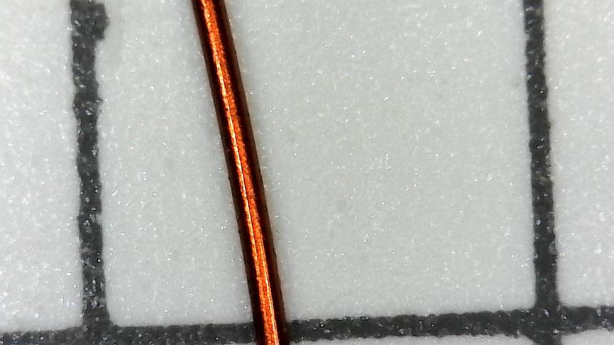
Supraledare - tråd
Cable
arrived
14-Apr
Bruker has send 100 m of wire
5 m to UU
  resistance measurement: 0.365 Ω/m
  testing joints for installation in cryostat
2+5+50 m to CERN
  cable test
    I_{c} testing between 2 and 5 T (1.6m/sample)
    cross section investigation (photo)
  6-around-1 cabling
38 m remainder to Scanditronix
  test making joints
  make 6-around-1 cable
    check diameter & bending radius
    impregnation into channel (100 to 200 mm)
      check impregnation
      test insulation (let wire stick out of channel)

Slide 6
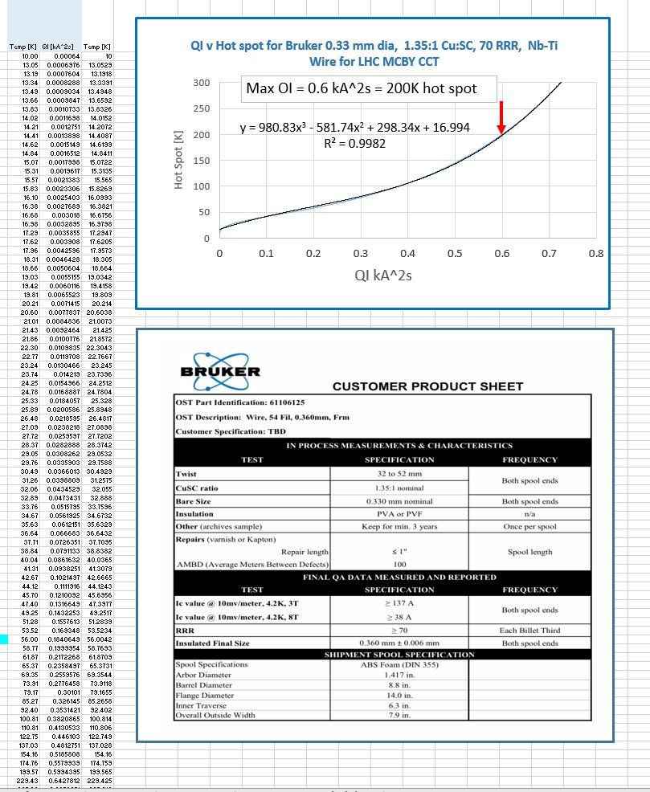
Superconductor - Quench Integral
from Glyn

Slide 7
Superconductor – Wire / Strand
Grid 5x5mm²
Mechanical parameters
Magnet parameters
Resistance measurement: 0.365 Ω/m

Slide 8
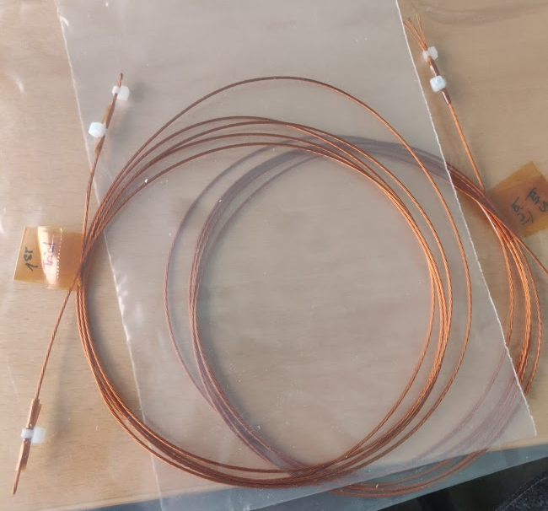
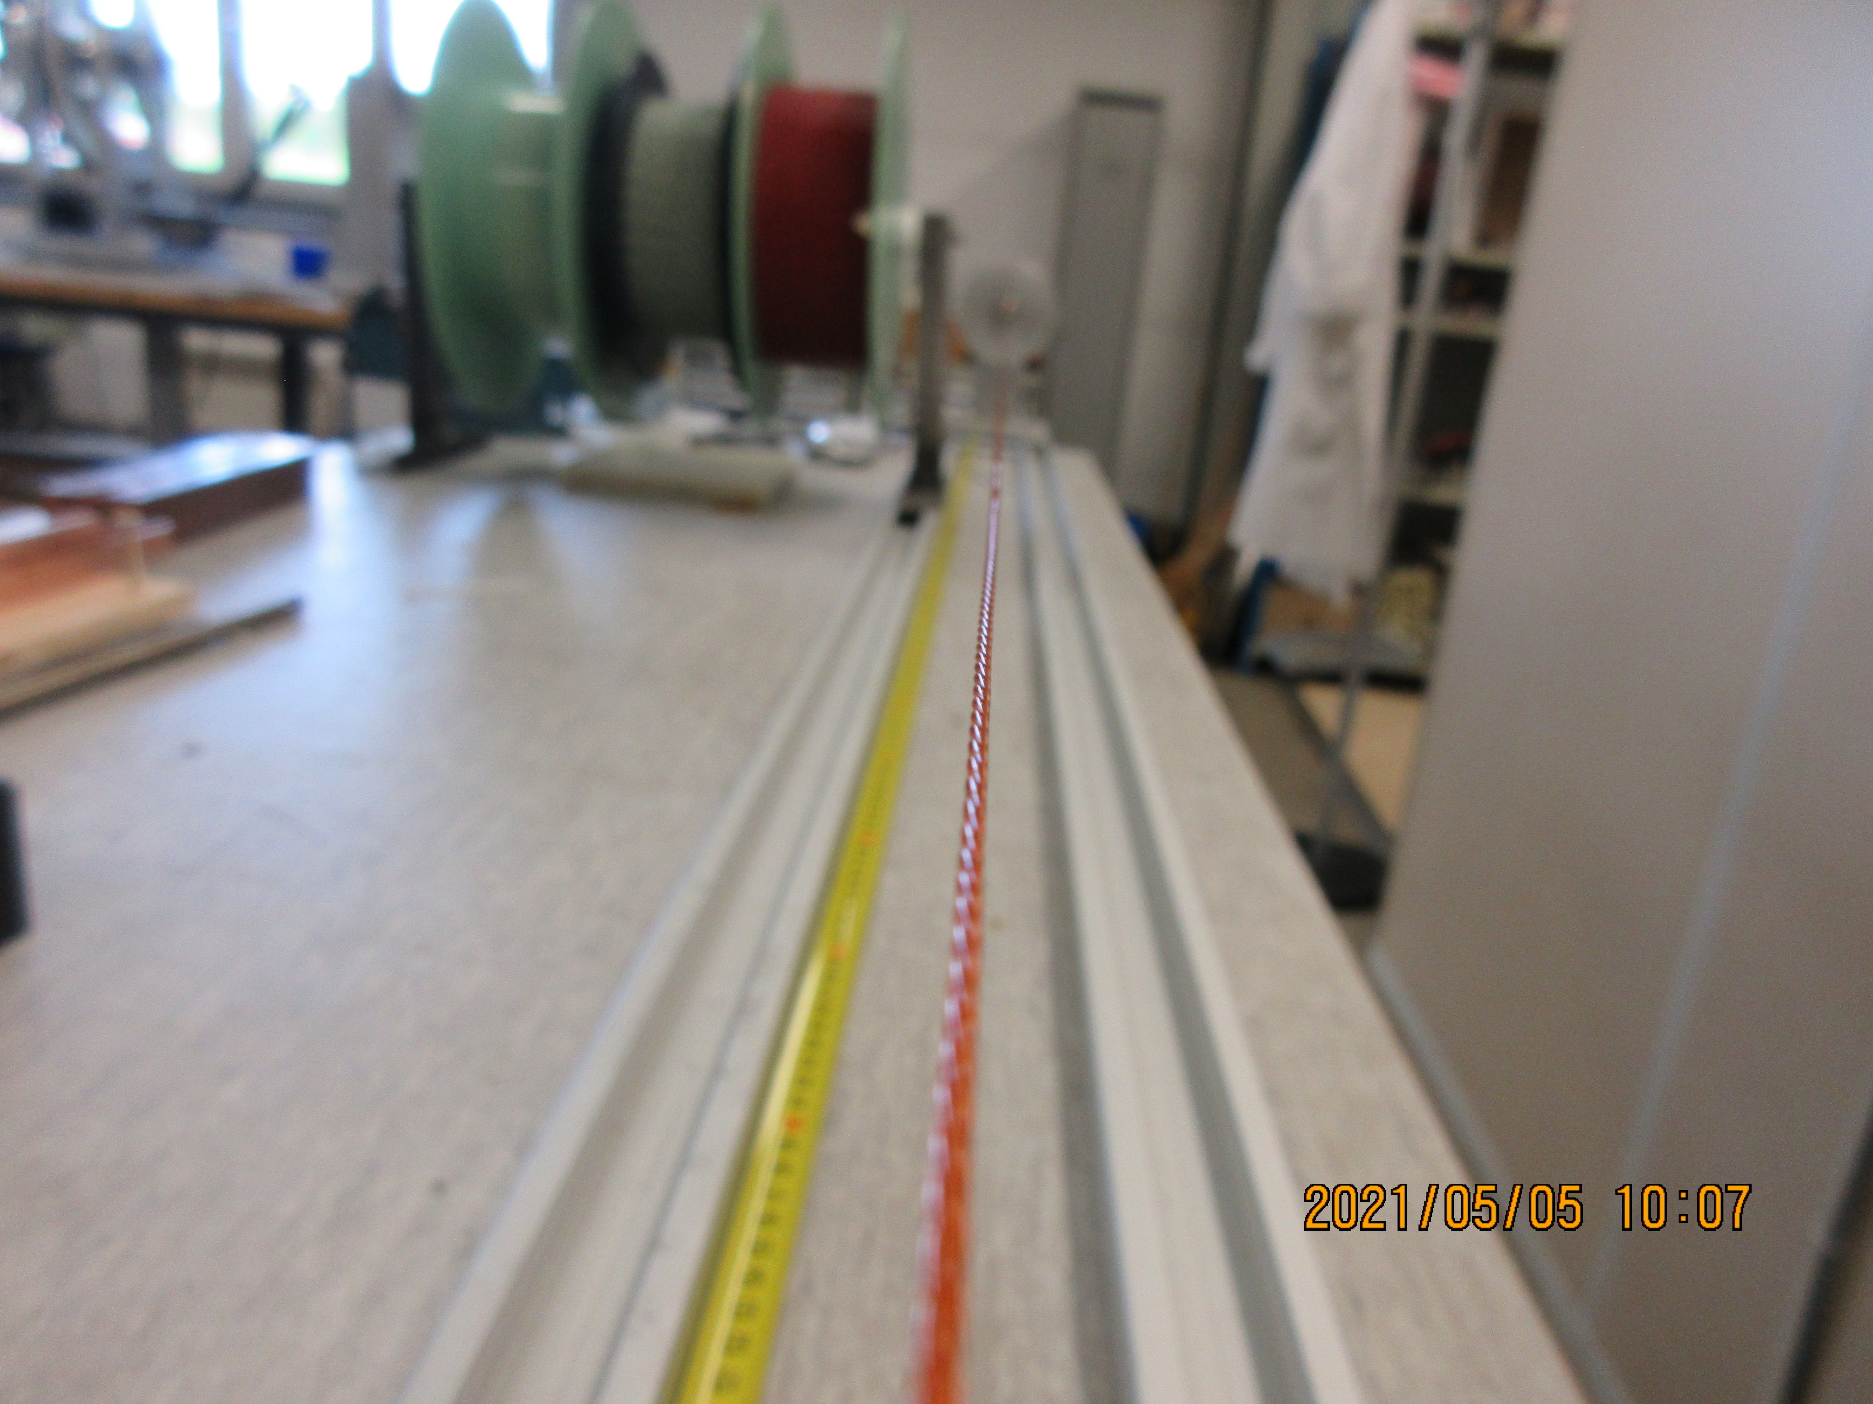
Supraledare - kabel
round cable: 6-around-1
  expected diameter 1.08 mm (~3x wire diameter)
  I_{critical} (4.2K, 3T) ≥ 7x137 A = 959 A
    60% load line current = 574 A
  connecting all 7 wires in series → same I_{critical}
6 wires twisted around 1 central wire
which will be about 10% shorter than the others
  not expected to be a problem
  each wire will touch neighbouring cable
  → increased quench velocity
question: maximum bending radius?
  wire bending radius = 25 mm
CERN prepared 2 lengths of 2m each
  twist pitch is 10-15 mm
1.08 mm
6-around-1
cable winding,
CERN,
5-May-2021

Slide 9
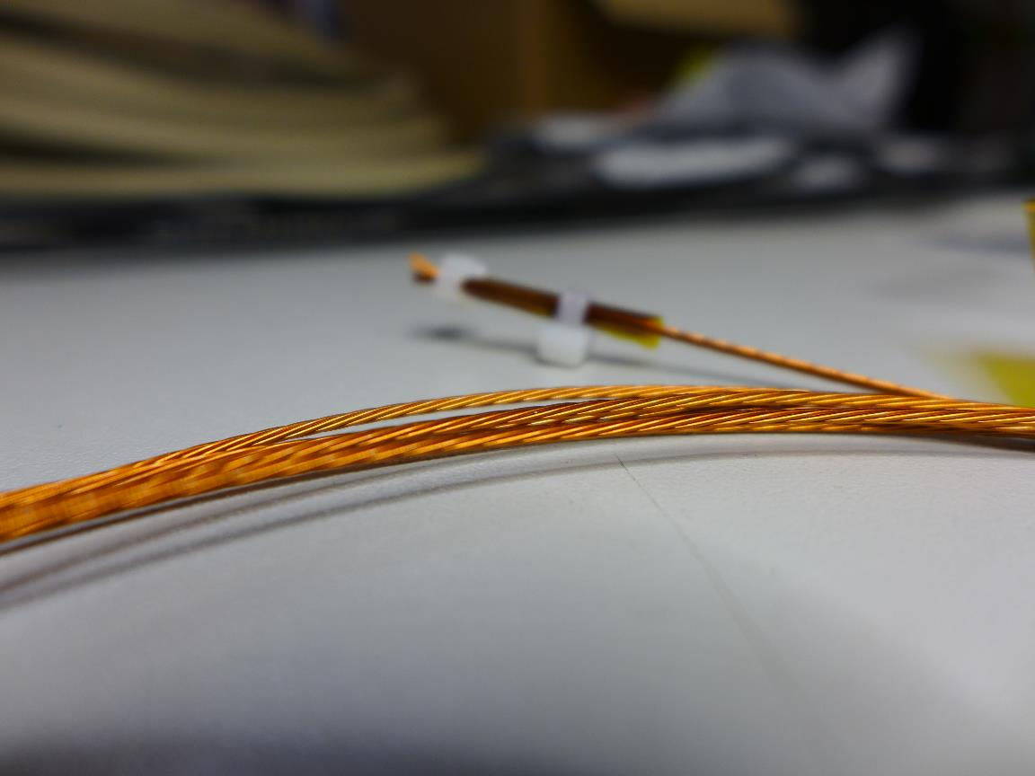
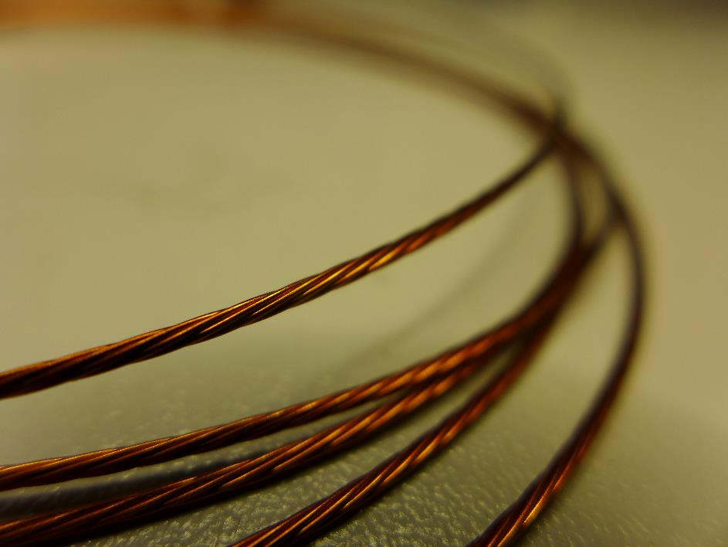
Superconductor – Cable 6-around-1

Slide 10
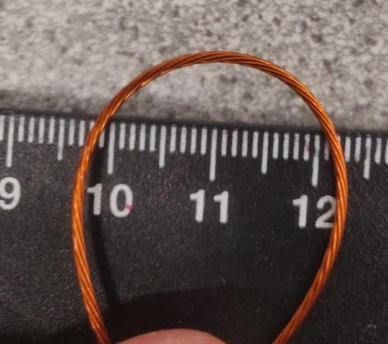
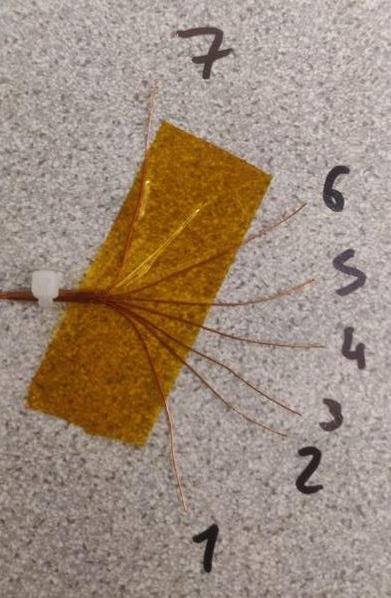
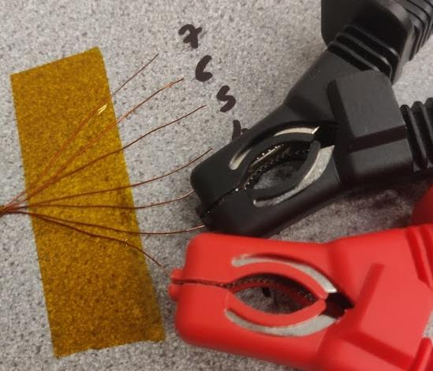
Superconductor – Cable Measurements
2 cables receives
  2.12 m
  2.00 m
Bending radius ~10 mm
Spring, untwisting effect important
Measurement voltage insulation
  1 kV for 30 s between 2 strands
Breakdown voltage
  4.5 kV on cable2, stand 1-2
Cable2
Cable1

Slide 11
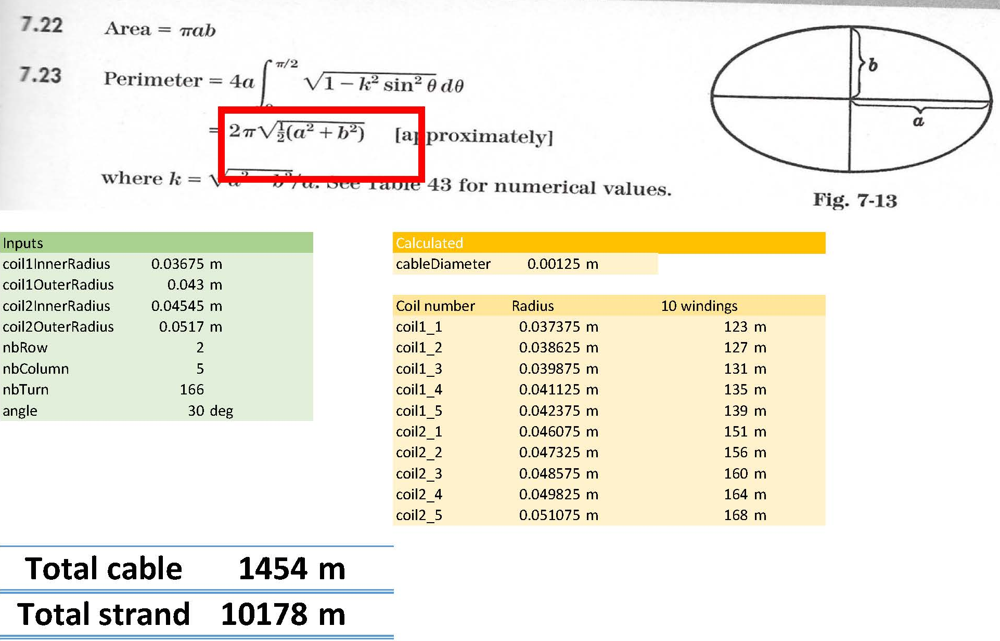
Superconductor – Cable Length
One coil
total 1454 m cable
min length 168 m
or multiple thereof
spare
  5 m for winding operation
  per min length
  3+2 winding lengths
Total: 15x173m = 2595m
Asked offer for
total 2600 m cable
min length 173 m
or multiple thereof
Kevin, 10 May 2021

Slide 12
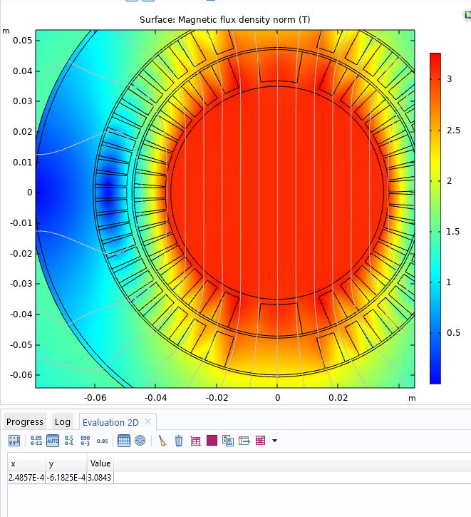
Superconductor – Option #2
Use a thicker wire with higher Sc:Cu ratio
0.5 mm wire diameter
5 strand cable
  about 1.4 mm diameter
  calculate with 1.48 mm diameter
2 x 7 turns
138 windings, same magnetic length
102 A to reach 3.1 T B0
Response companies:
  too expensive to make special order
1.36 mm

Slide 13
Superconducting Cable – Questions (1/2)
From Glyn (12-Apr-2021):
there must be a formula for the twist pitch that is possible and the resulting dia of the rope.
should we twist CW or ACW?
what is the difference in length of the spiraling outer strands to the central strand.
  Bruker mentioned ~10% with their cable twist
what is the effect on inductance. the strands in the rope must have a small increase in inductance! is this important or not. we could measure when we have it may be?
stress in a twisted rope when the magnetic field / hoop stress is applied? it must be a small effect but we should think about it.
as a thought experiment , imagine the twisted rope, wind it into the channel. the wires must slide relative to each other a little. if an axial tension is applied to the rope the outer conductors must try to squeeze the central conductor. we need to think about the insulation point stresses in the rope. there must be some papers on this?

Slide 14
Superconducting Cable – Questions (2/2)
it a rather deep in consideration and we can probably ignore it but someone will ask. don't want the insulation to fail!
to keep rope from springing open, do we need to put an outer tape on it? may be? this will change the channel width.
i was thinking we should wind the rope, open the wires at the ends, and check the insulation between wires! so need to think about how to fix the ends without shorts.
we could put the ropes into the channel, impregnate with some resign or wax! press the ropes into the channel with a small bar at the pressure we expect to see in the magnet and check the insulation between wires.?
what is the effect of the twist on the current, it has some effect on the effective current due to the twist angle.
what is the field in the cable, just a variation of engineering current density?

Slide 15
Elektrisk diagram (anpassas för repkabel)

Slide 16
Voltage Taps
Comment Glyn, 11-May-2021:
For the prototype or model it be nice to have some at the return end.
To be able to see if quenches are in the inner or outer layer. You don’t get this with the std. you need the 5 vtap system and need to use the symmetric quench detection card. Most quenches are symmetrical and are missed by the std 3 tap system with start end and center!!!!
If we can open the rope and get to the center wire in the rope at the return end we would only have 10 at that end. But you need to develop an idea, test it on a model.

Slide 17
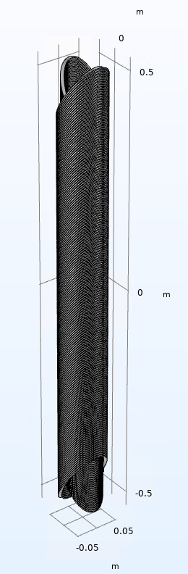
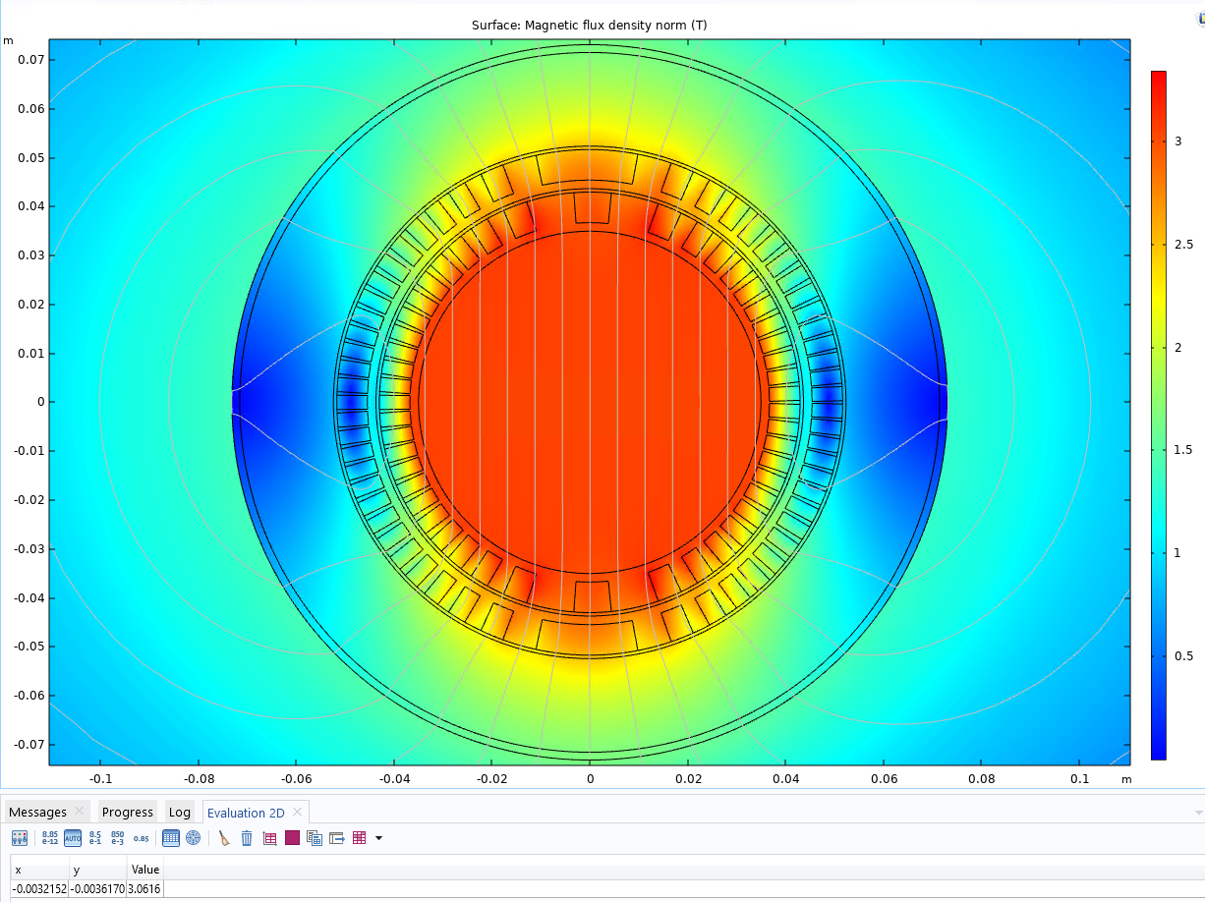

Magnetisk design
Winding pitch 5.5 mm
Mid-plane gap inner coil = 0.35 * cos (30 deg) = 0.303 mm
  166 turns corresponds to magnetic length of 913 mm and a total coil length of 1064 mm
I = 7*79A
  57.7% of short sample
B₀ = 3.06 T
$\int{Bdl}$ = 2.8 Tm

Slide 18
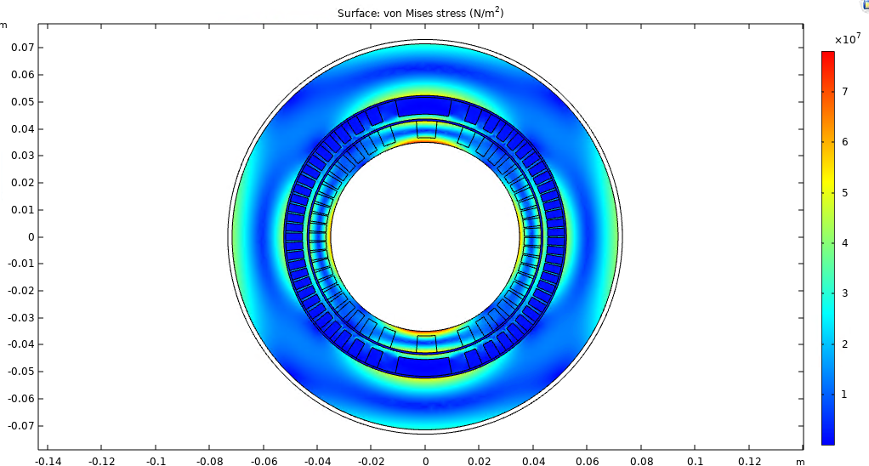
Magnetisk belastning
aluminium A6082-T6
  elasticity = 70 GPa
  tensile strength 300 MPa
  yield strength 400 MPa = 4x10⁸ N/m²

Slide 19
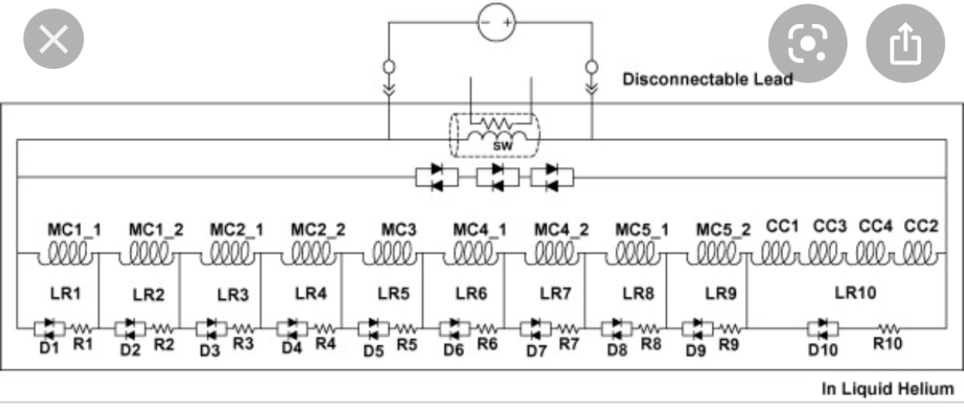
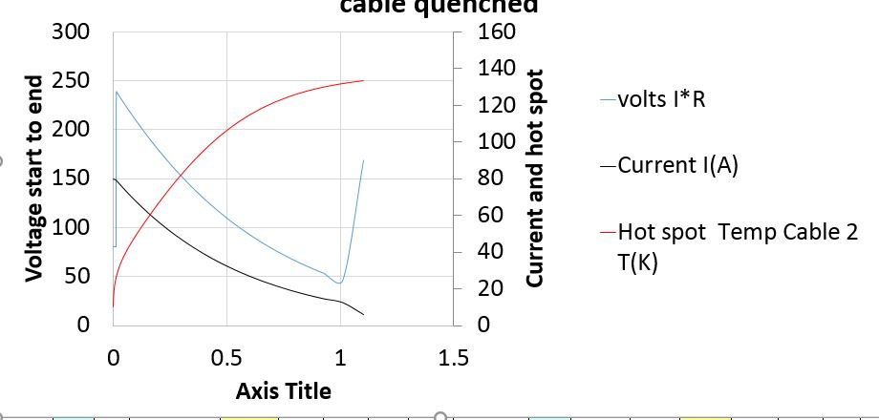
Quench Protection (from Glyn 28-04-2021)
Example of a protection circuit
  this is for MRI magnet, think 4 circuits, no switch
Simulation (Glyn)
  80A, Bruker 0.33 wire, 5 km of wire
  6.7 H coil inductance?
  10 2 ohm EE dump resistor, 12 ms opening time
  no quench back! in the former so expect ~ 20% may be.

Slide 20
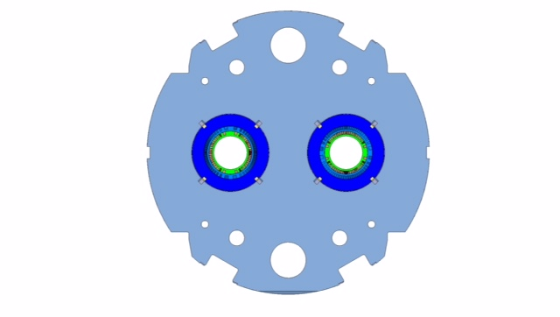
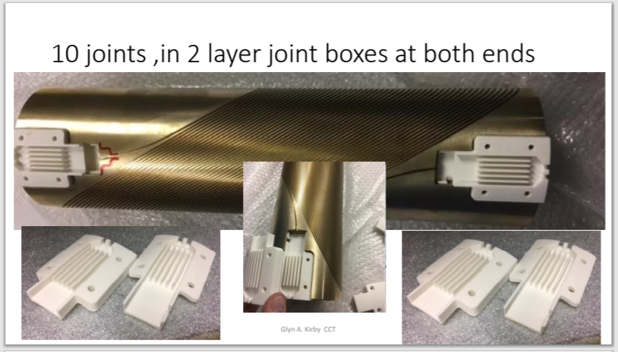
Mekanisk design
plats för elektriska skarv (joint-boxes)
  50cm modell: joint-box vid varje end
  alternativ ide: fram/baksida av järn ok

Slide 21
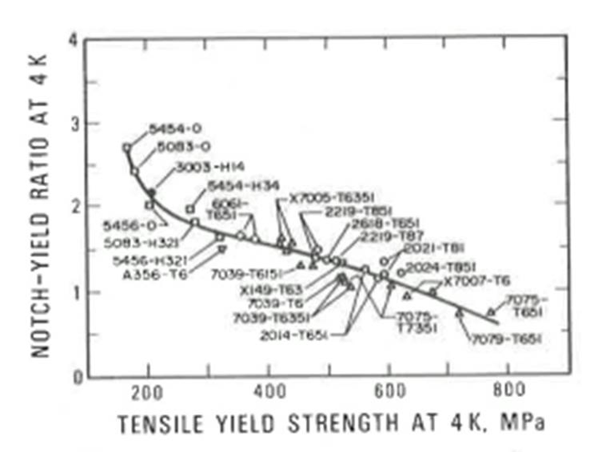
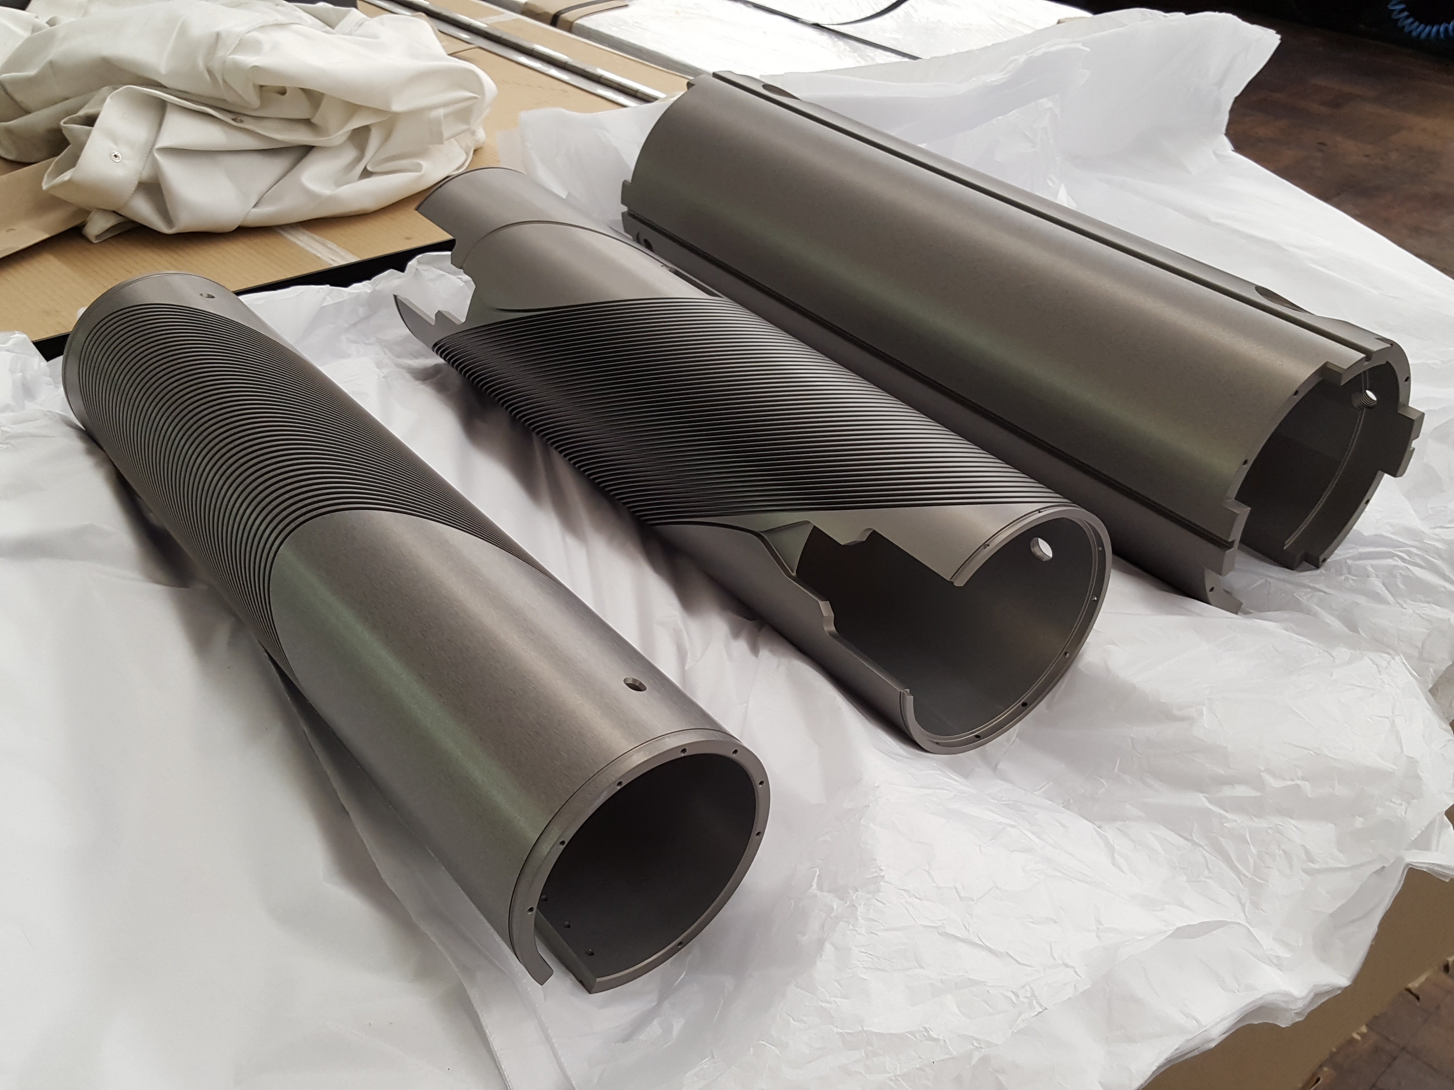
Magnetspindel
A6082-T6
  yield strength 400 MPa
  notch-yield ratio = tear resistance to yield strength
  operate below 120 MPa
  high RRR (quench skydd)
anodisering
  ändrar elektrisk motstånd
    ger extra isolation för kabeln
  hjälper anknytning av epoxy resin
  för 50cm modell magnet
    40 µm tjock
3 olika spindel
  2 med spår och 1 yttre stöd-spindel
  3D step modell transfer från CAD till CNC
viktig med dimension kontroll
AL 6082-T6
Ratio > 1.5
50cm CCT modell
Oxford University 2018

Slide 22
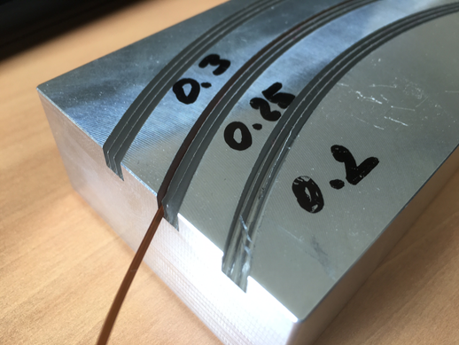
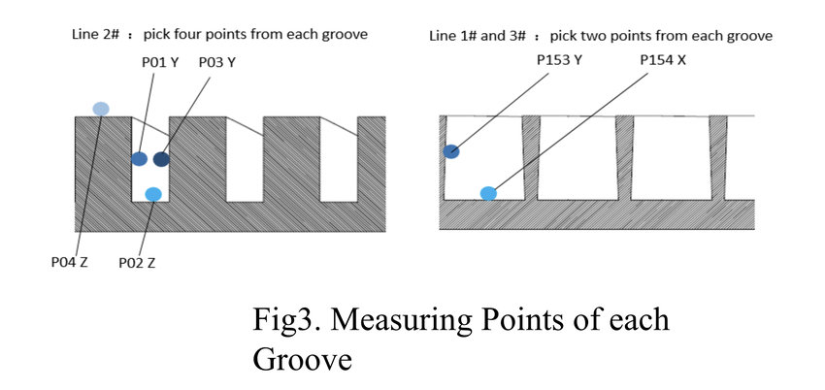
Magnetspindel
Erfarenhet Glyn
  spår max. 5 djup x 1 bred
Design
  spår pitch 3.1 mm
  bred 2 x 1.08 + 0.1 = 2.3 mm
  djup 5 x 1.08 + 0.1 = 5.5 mm
50cm CCT modell
Min wall 0.3mm with 2mm wide channel

Slide 23
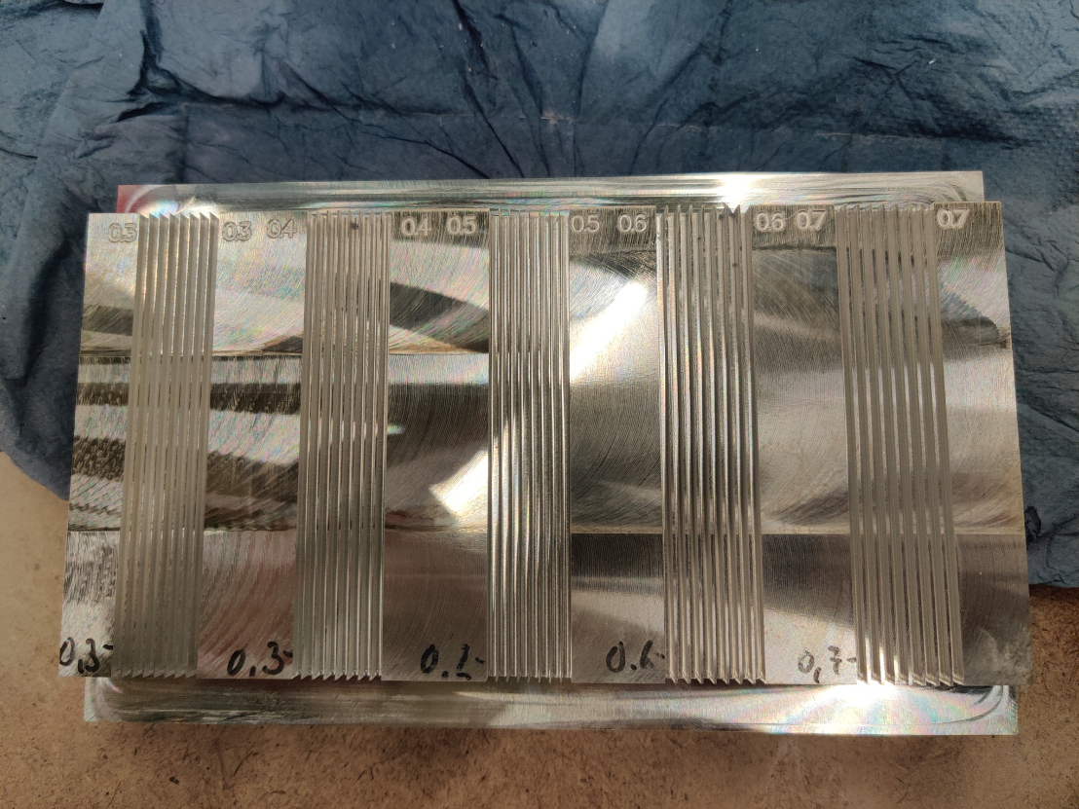
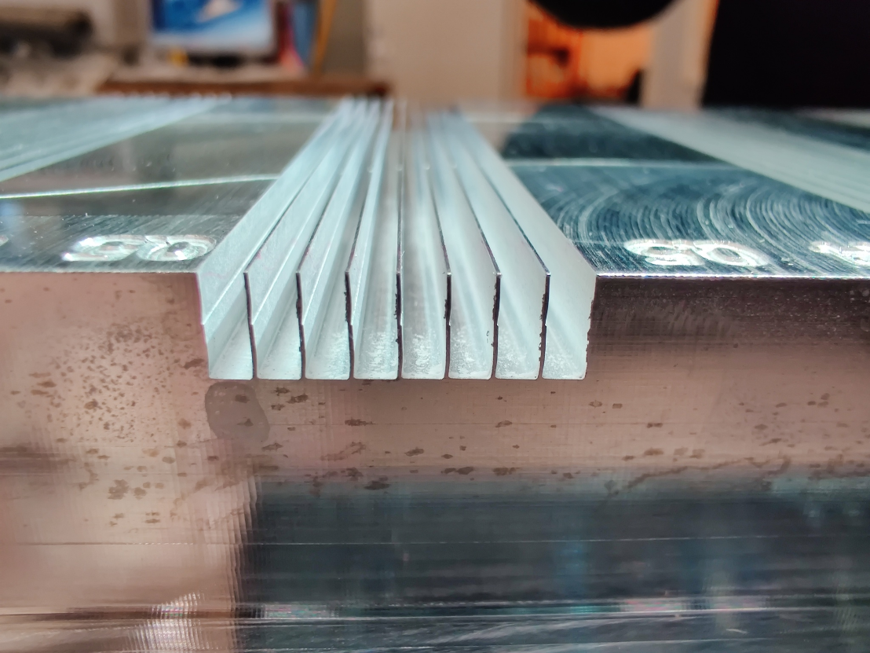
Magnetspindel
Spår i magnetspindeln
  7 wire per assemblage: ~1.1 mm
    spår blir ~2.3 mm x 6 mm

Slide 24
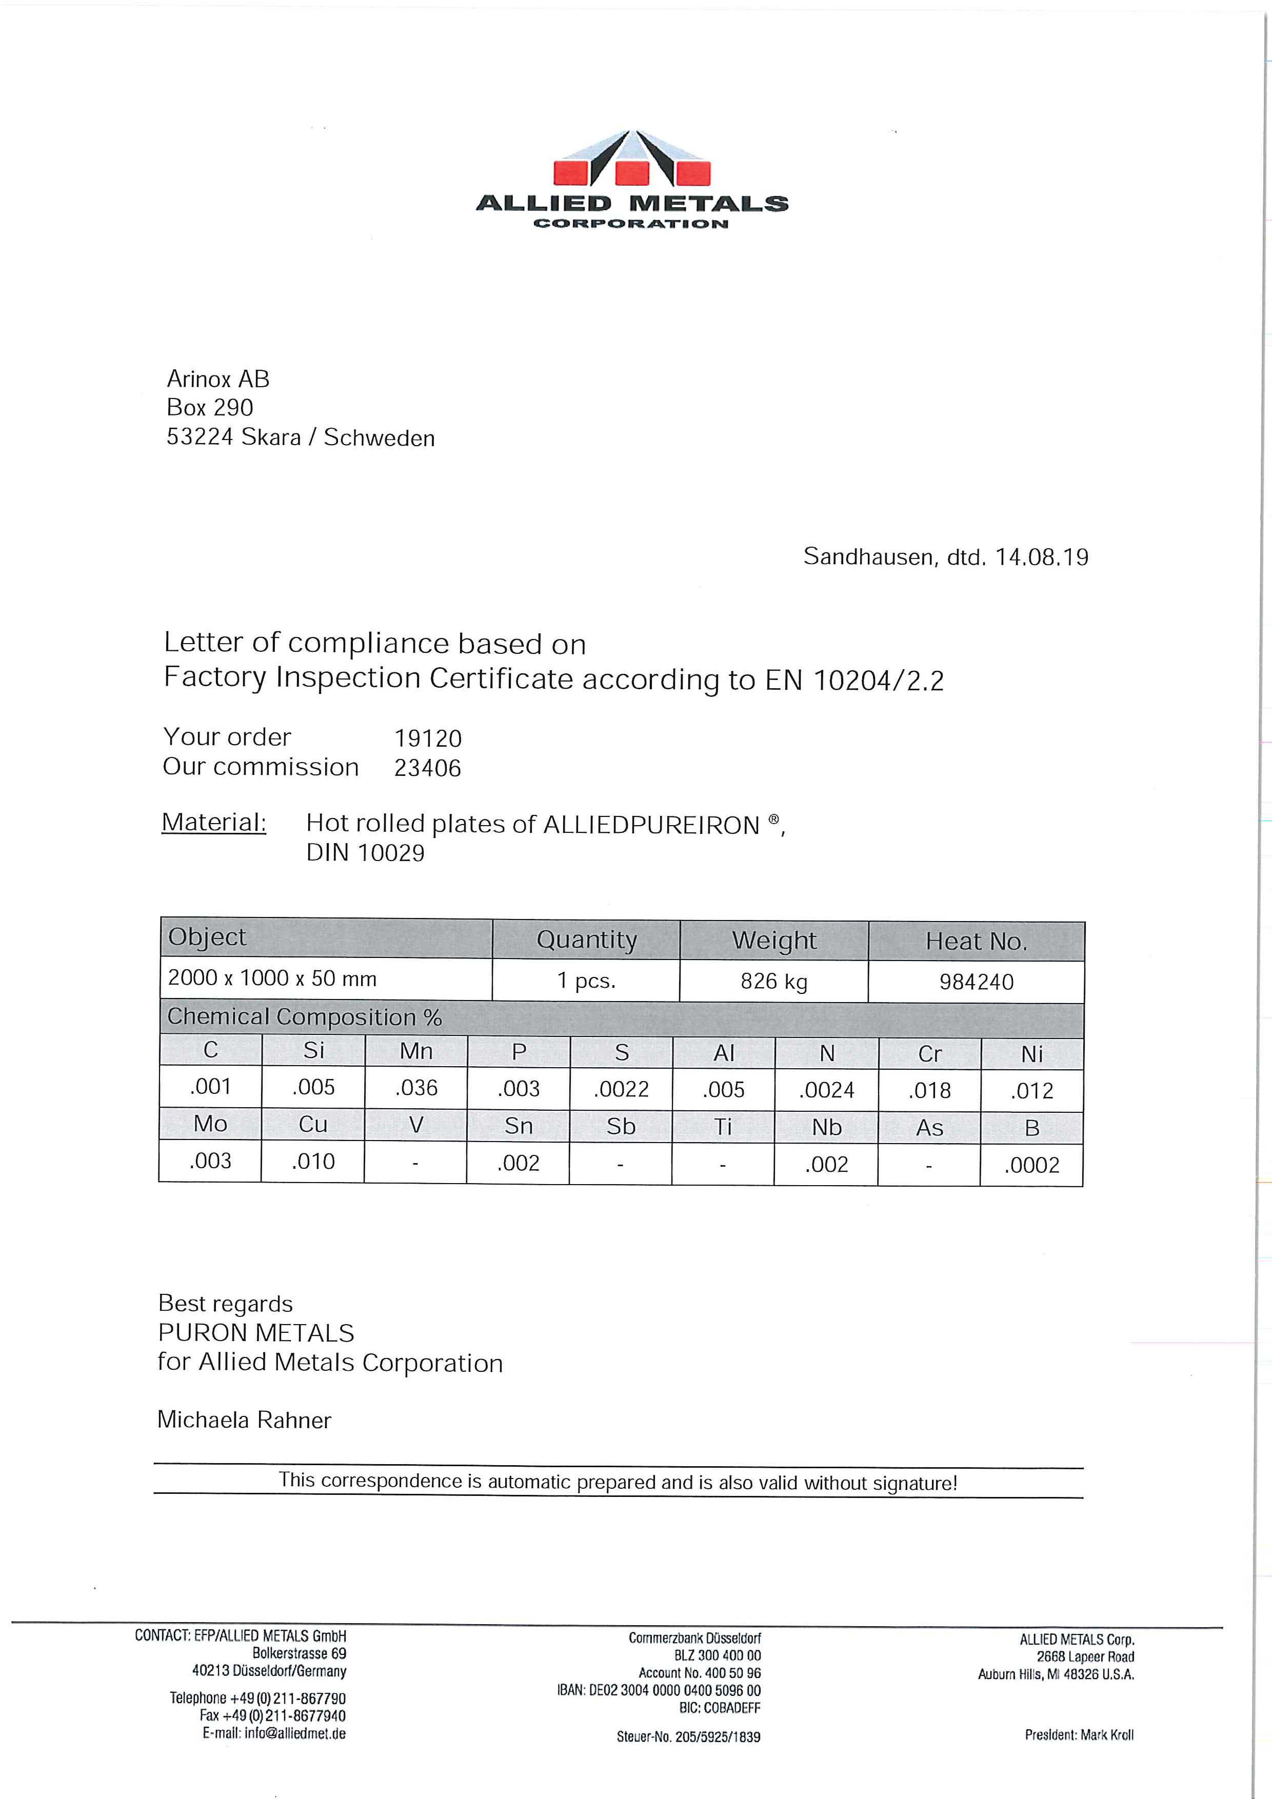
Järn ok
Förslag för järn typ: ARMCO
  https://alliedmet.com/alliedpureiron/
diskussion med CERN
  this product is basically good.
  ARMCO or PURE IRON is the same.
  5 mm or 6 mm thickness plates are standard values for the market.
  Originally CERN was using MAGNETIL,
  In the ... production for HL-LHC (5.8 mm, old LHC standard thickness) we have adopted the ARMCO Grade 4 (not the ARMCO grade 2) with a lower content of S, N, et (the presence of these components affecting the magnetic behaviour).
  ... had problems also with scaling (at the surface of the plates) and with the content of S (sometimes higher than 0.003, in this case we rejected the plates/heat).
  The supplier had problems in obtaining the correct grain size number too. We could never obtain the target value of Gs<4 (in the MS at the beginning CERN asked fro Gs< 3!). The Gs is important for the mechanical characteristics at low temp. Finally, the annealing process included in the spec in order to favourite the Gs reduction had to be abandoned.

Slide 25
Järn ok
MCBC/Y design har stor öppning för magneten
  CCT magnet design är mindre
  mer plats för järn
    förbättring av fältkvalitet
    mindre ström
cooling
MCBC/Y
tie rod
alternative
pin
keys
alignment slot

Slide 26
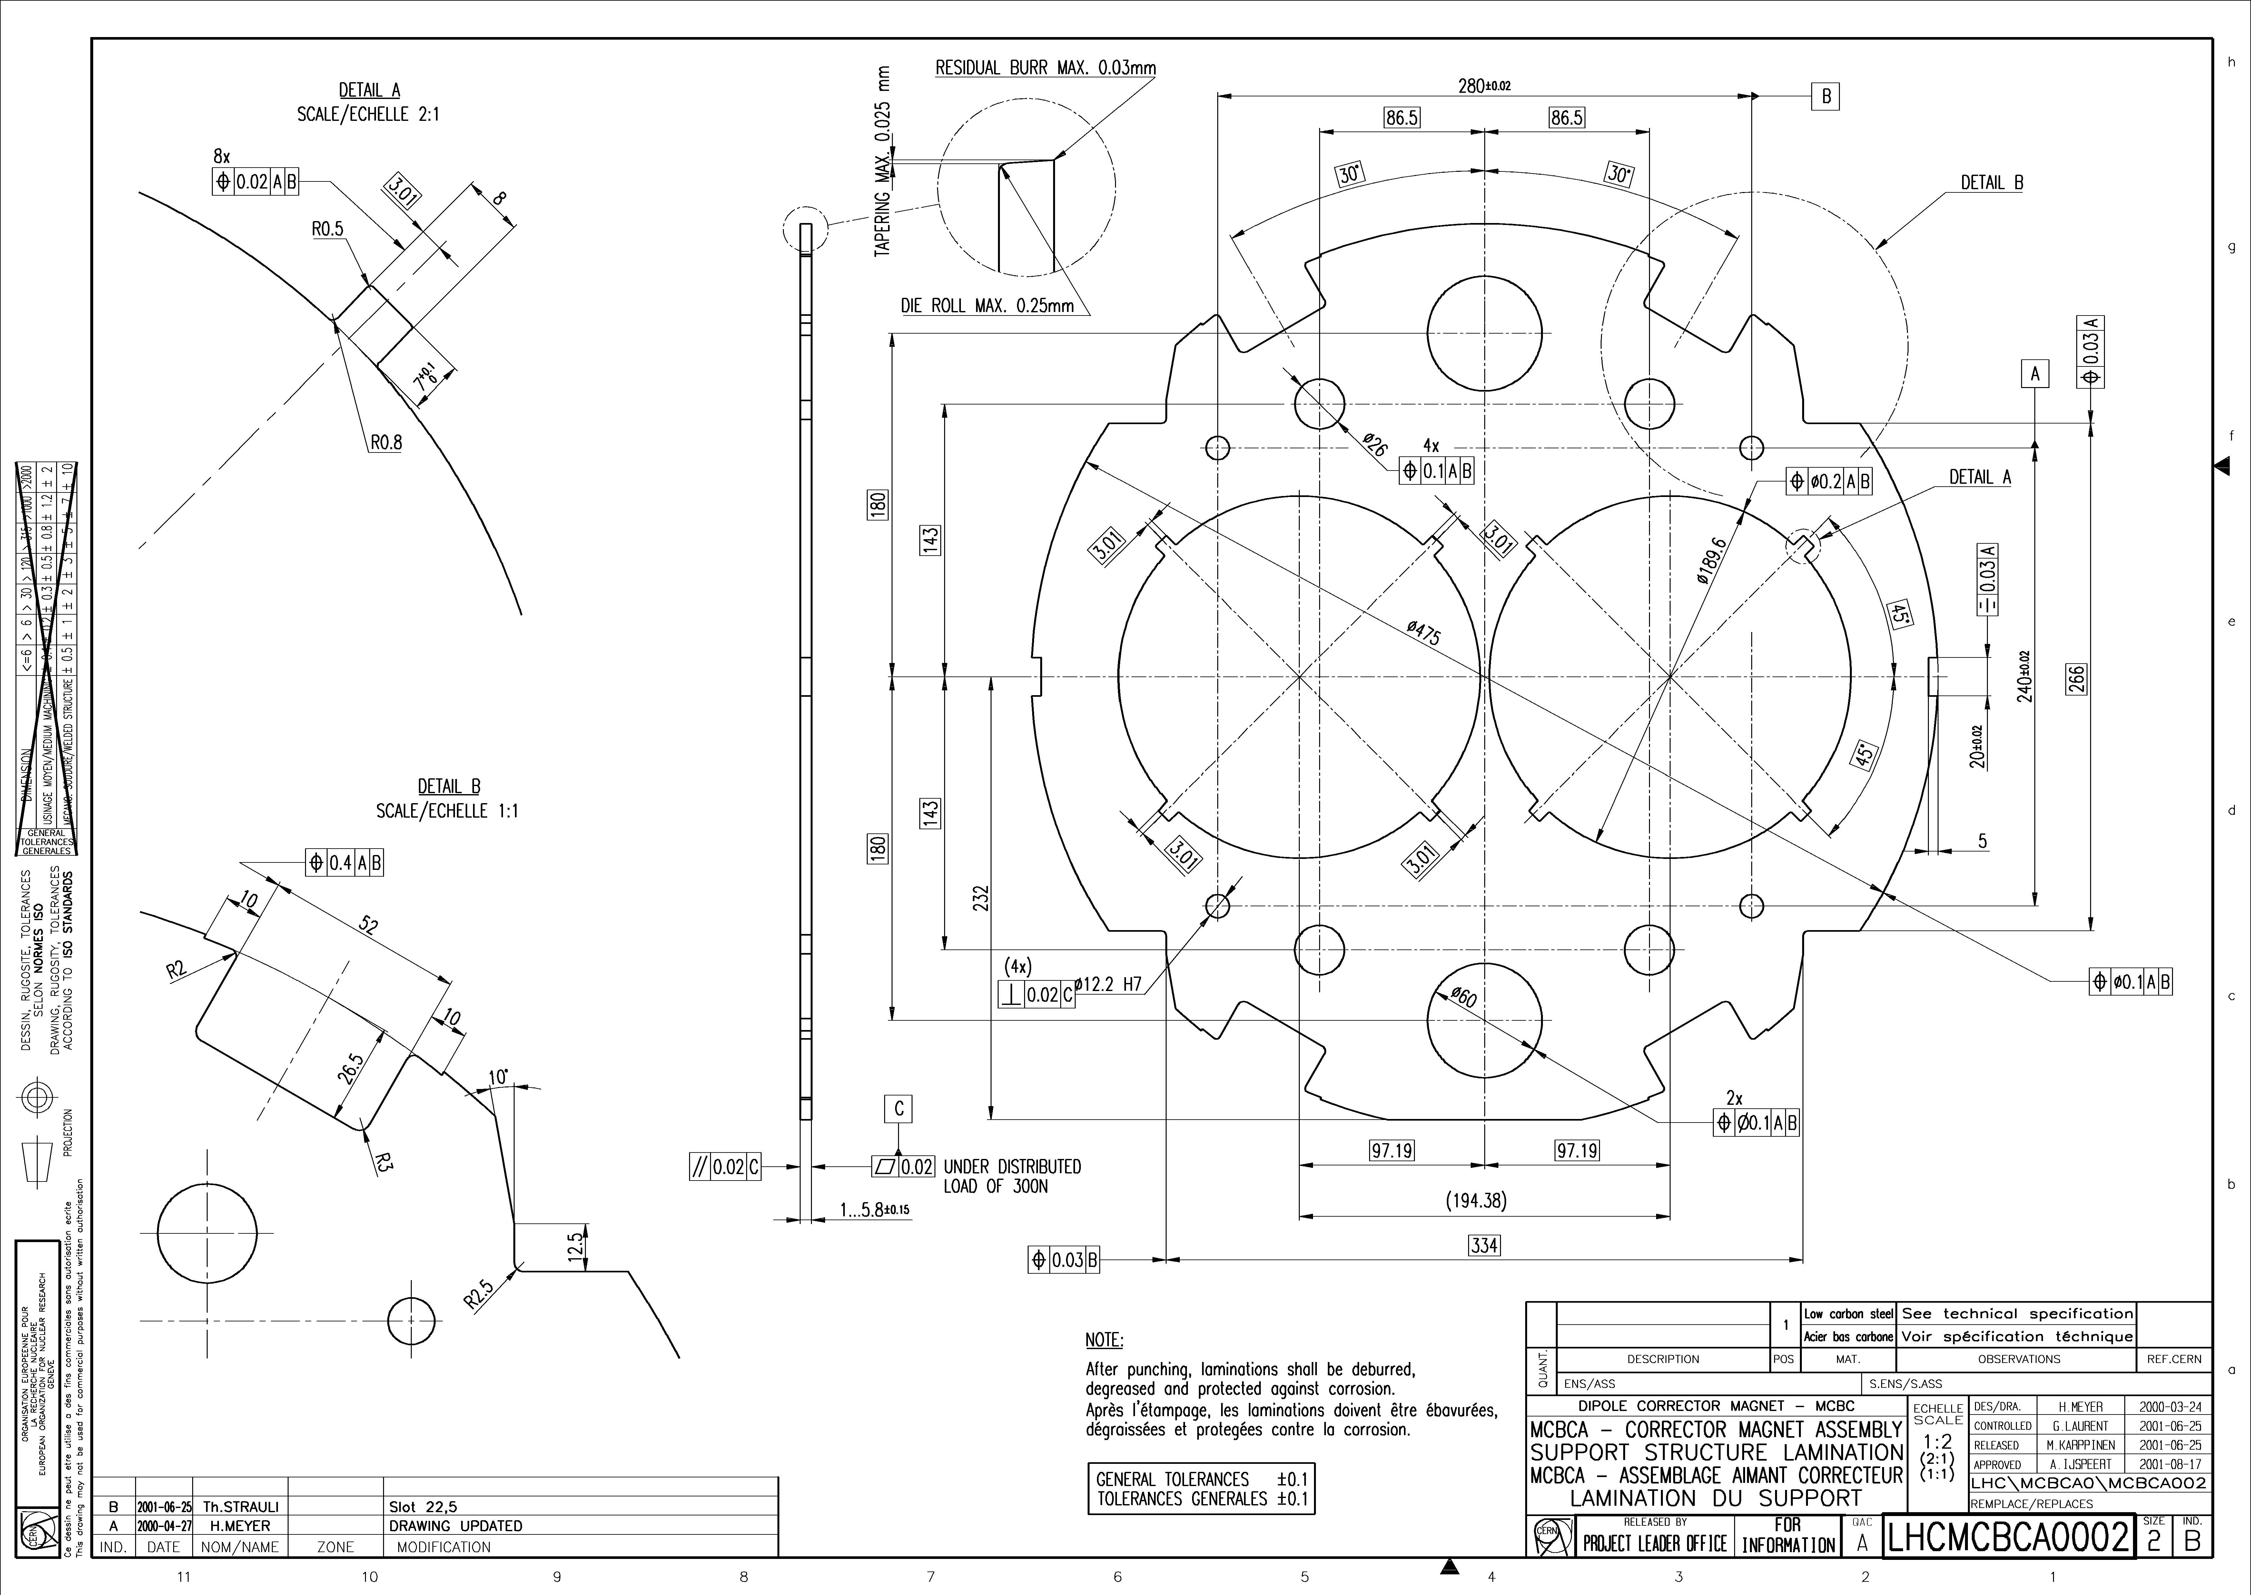
pin & rod
4x keys
guide thermal contraction
1...5.8±0.15

Slide 27
Next Steps
discussing collaboration contract with CERN
  to receive full 3D CAD model from CERN
  to receive advise/knowledge (Glyn Kirby) and engineering support
recruiting researcher/post-doc for simulations
  work on field and quench simulations, magnetic design
  discussion ongoing with candidate presently at CERN
tests on superconducting cable
  joints, cabling, impregnation
tests cutting iron for yoke laminations
  accuracy
submitted abstract to MT27 Magnet Technology Conference
  in Japan, 15-19 November 2021

