Slide 1
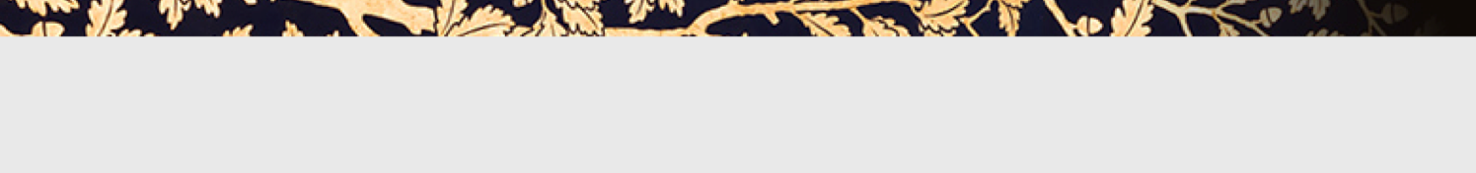


Thursday, March 20, 2014
The upgrade of the ESS linear accelerator
to produce the world’s most intense neutrino Super Beam
–
a challenge
Elena Wildner, CERN

Slide 2
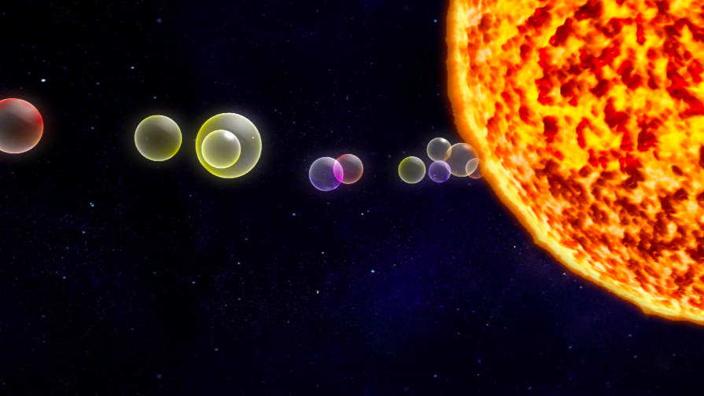
Outline
Introduction
Overview of the facility
The Linac
The Linac upgrades for neutrinos
The accumulator
Challenges for accelerator physicists

Slide 3
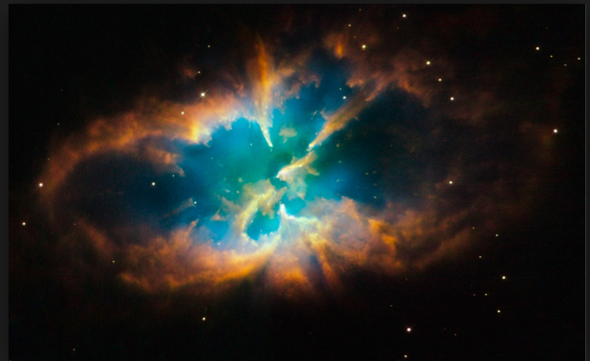
Why do we want to produce neutrinos
The neutrino can help us to find answers to very important questions like:
  Matter- Antimatter Asymmetry of the Universe
The neutrino oscillates between different flavor states
It has mass
Physics beyond the standard model
…

Slide 4
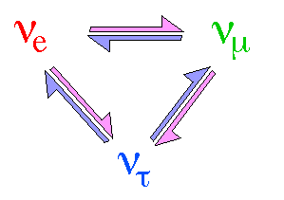
The Neutrino Oscillations

Slide 5
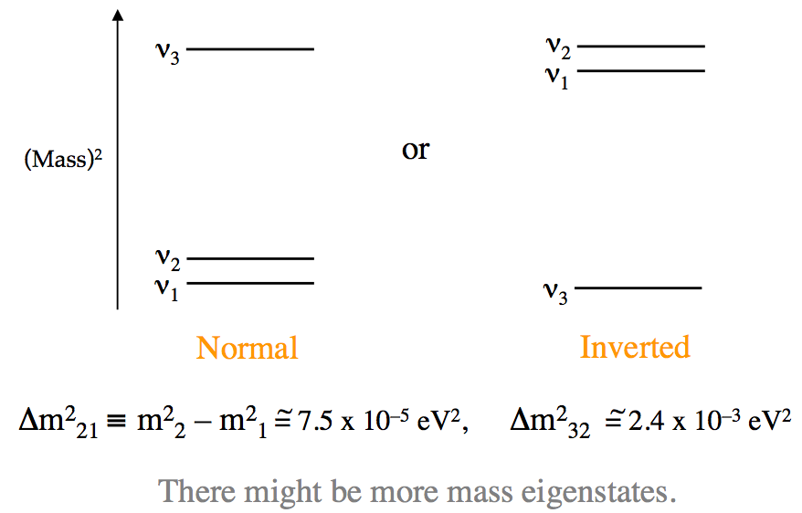
The Three Neutrino (Mass)² spectrum
We do not know its absolute mass
Some accelerator experiments can measure the hierarchy.
Absolute mass measured by other than accelerator experiments:
nuclear beta decay (KATRIN and MARE)
Measure of half life of neutrinoless double-beta decay of certain nuclei (e.g. GERDA, CUORE/Cuoricino, NEMO-3 and others) but requires the neutrino is majorana (its own antiparticle).

Slide 6
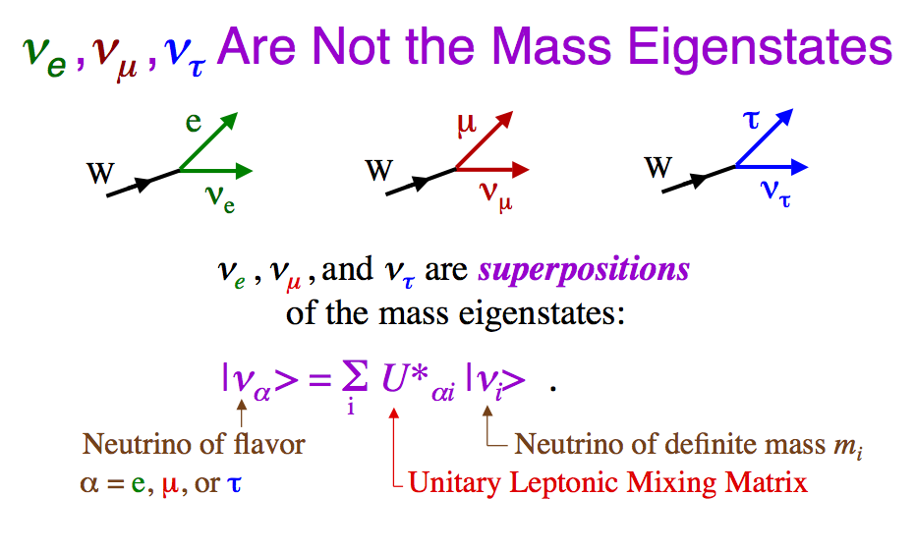
Leptonic Mixing

Slide 7
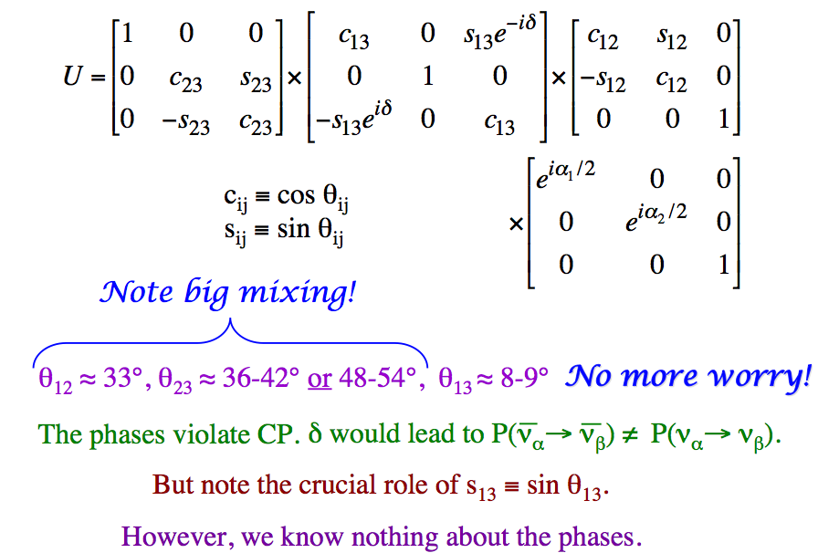
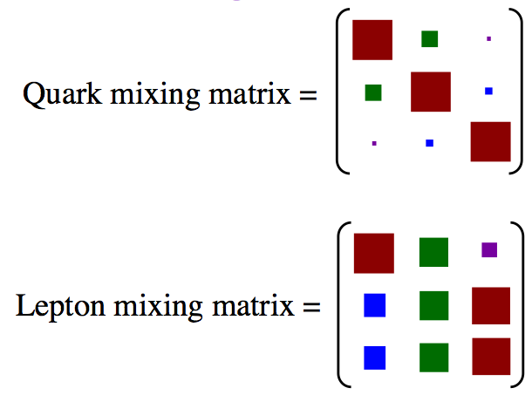
The Lepton Mixing Matrix U

Slide 8
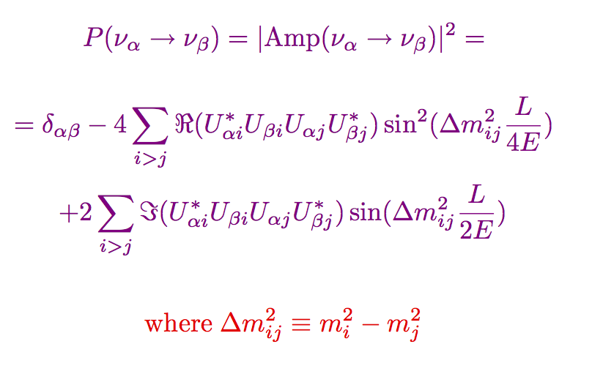
Probability of neutrino Oscillation in vacuum

Slide 9
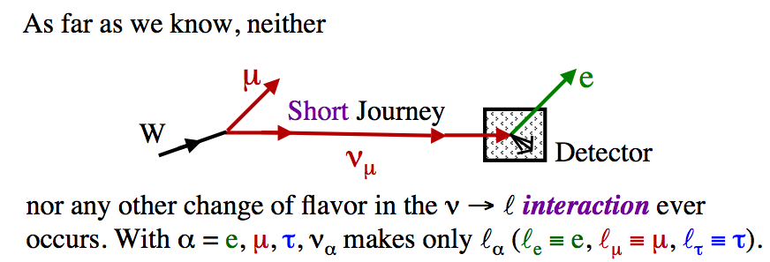
The Lepton Mixing Matrix U

Slide 10
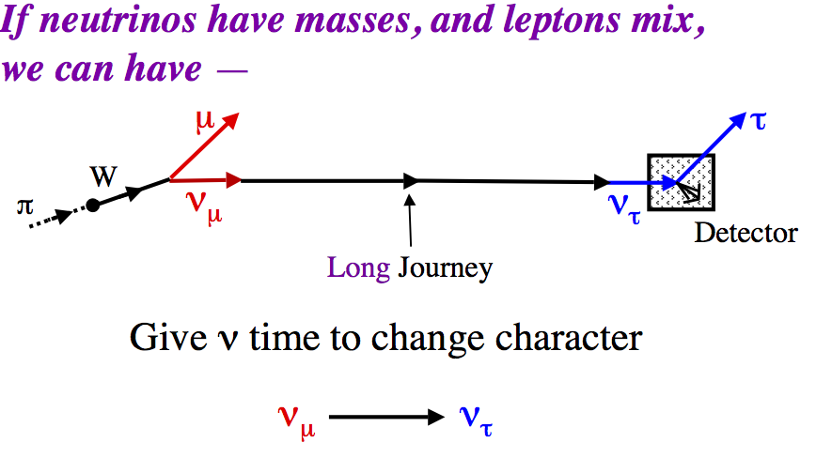
The Lepton Mixing Matrix U

Slide 11
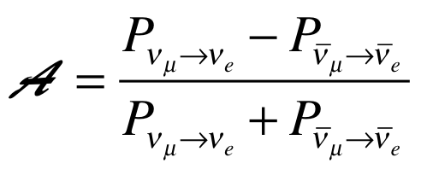
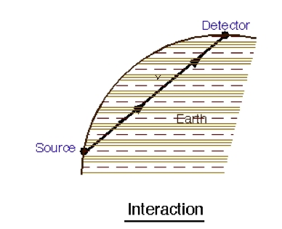
Asymmetry
≠0 ⇒ CP Violation
However, matter effects also create asymmetry: Do not put the detector too far
Some specific distances (for a given E) may enhance to suppress the matter effects on asymmetry
Other CP violating processes complete the picture

Slide 12
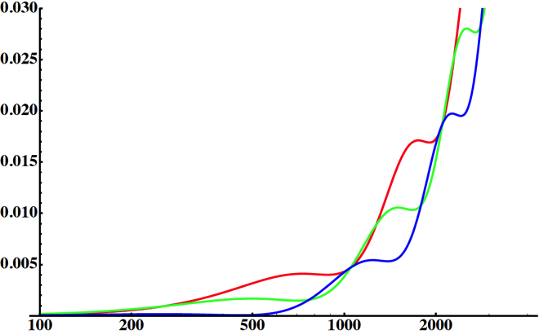
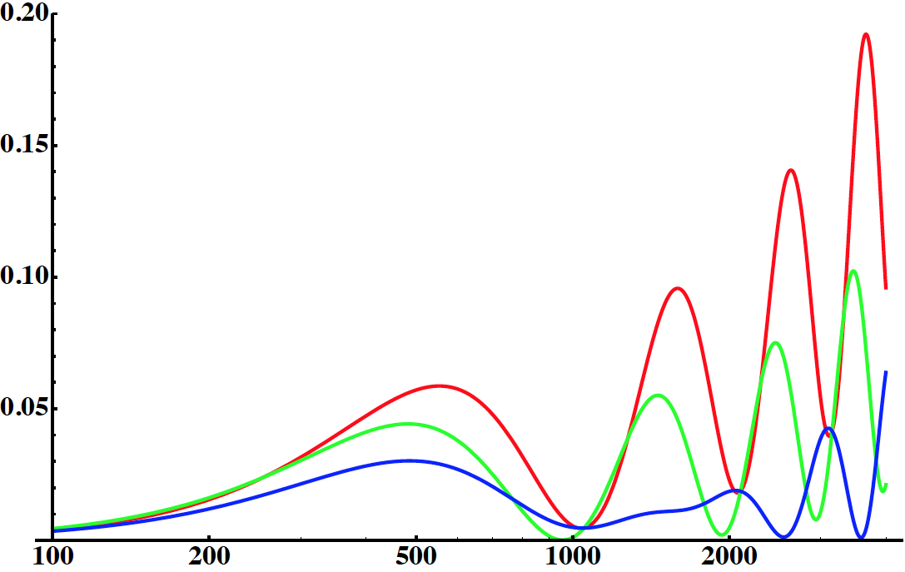
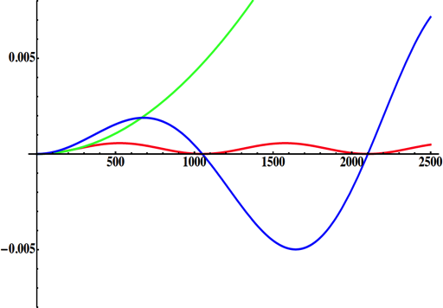
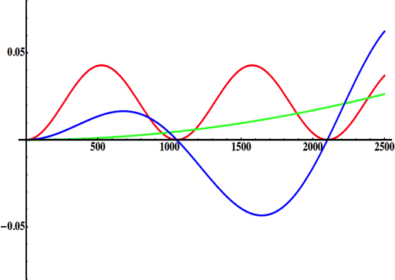
Neutrino Oscillations with "large" θ₁₃
2nd oscillation maximum
P(ν_{μ}→ν_{e})
1st oscillation maximum
θ₁₃=1º
("small" θ₁₃)
δ_{CP}=-90
δ_{CP}=0
δ_{CP}=+90
θ₁₃=8.8º
("large" θ₁₃)
L/E
L/E
solar
atmospheric
for "large" θ₁₃ 1st oscillation maximum is dominated by atmospheric term,
for small θ₁₃ 1st oscillation maximum is better
atmospheric
solar
L/E
L/E
CP interference
θ₁₃=1º
CP interference
θ₁₃=8.8º
2nd oscillation maximum is better
(arXiv:1110.4583)

Slide 13
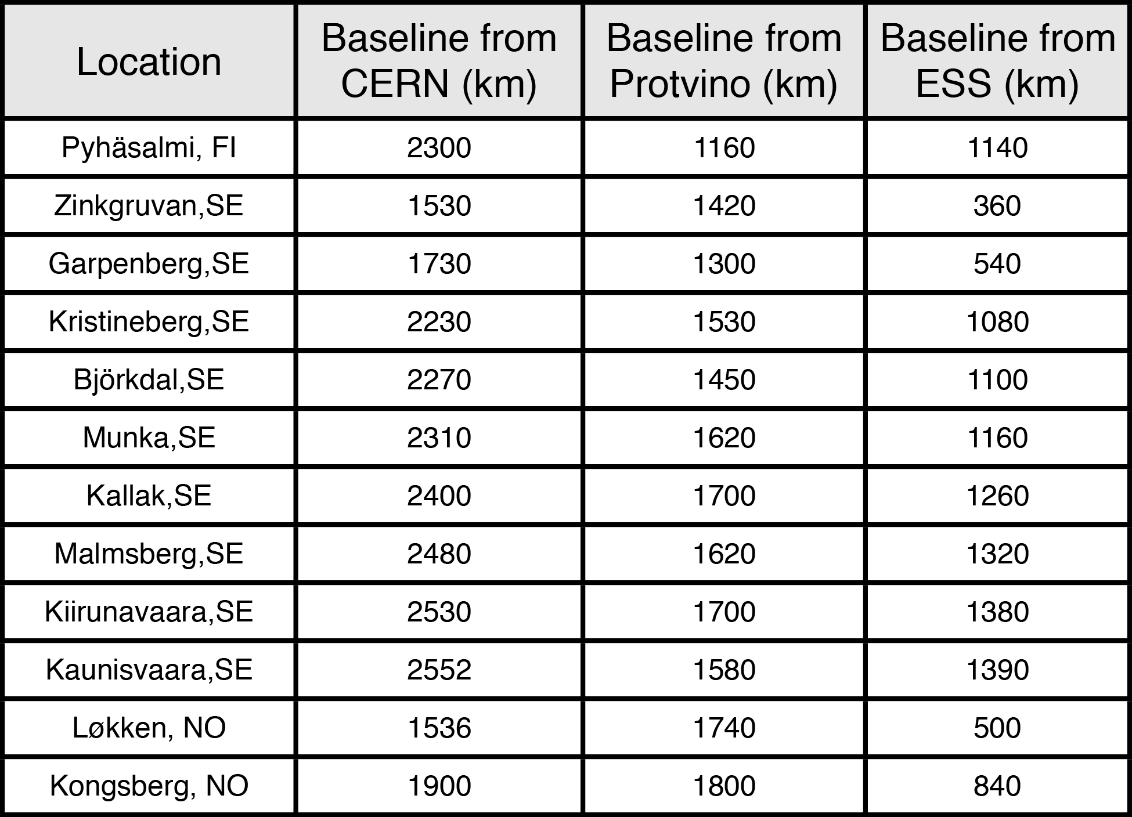
L/E for good physics
ESS
Kongsberg
Løkken
CERN
Length to detector
Energy of neutrino
Lund 2014
M. Dracos IPHC/CNRS-UdS
13

Slide 14
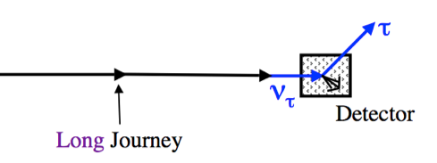
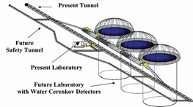
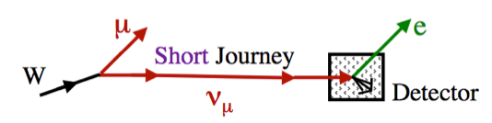
The accelerator physicist’s role
e
~300 MeV ν_{μ} beam to far detector
e
proton driver
28 or 70 Hz
H-
ESS 2-3 GeV, 5 MW
Accumulator
ring
Magnetic
horn capture
(collector)
p
Target
hadrons
The accelerator: high flux, flux control
However: an expensive setup…
Takes a long time to decide and build…
Physicists are waiting for results …
Several ideas and projects around the world…
How can we find synergies ?
Are there opportunities?
YES …
ν, μ
decay tunnel
To build this tool !!!
We also have to profit of the short journey to count what we produce to have a comparison

Slide 15
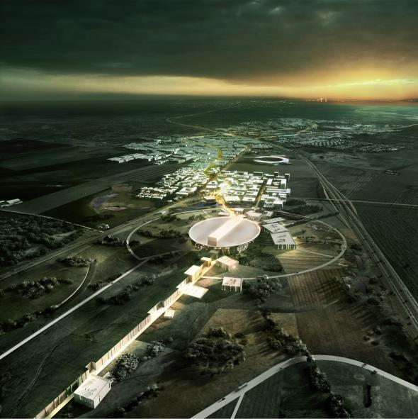




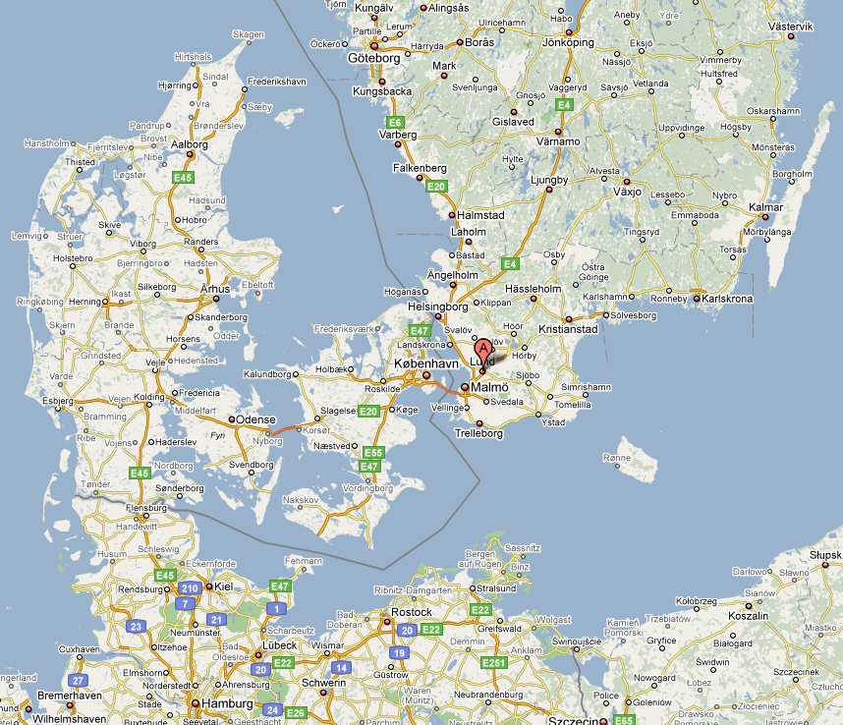
ESS
ESS is located in Lund
It will provide a world-class material research center for Europe (neutron production) in 2019
ESS has an extremely powerful proton-driver (this is a real asset)
ESS pulsing would permit extra pulsing to accelerate H- for other research: neutrino production
Target
Instruments
Proton Linac

Slide 16
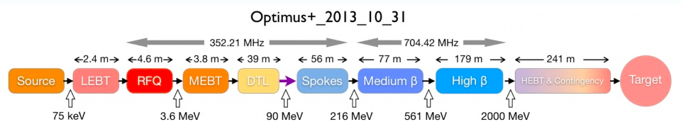
ESS proton linac for neutron production
5 MW average proton beam power
125 MW peak power
14 Hz repetition rate (2.86 ms pulse duration, 1.1 10¹⁵ protons)
4% duty factor (low…)
Linac mostly ( >97%) superconducting
2 GeV protons (Upgrades?)
>2x10²³ p.o.t/year
ESS Technical Design Report, April 23, 2013
ESS-doc-274
http://europeanspallationsource.se/documentation/tdr.pdf

Slide 17
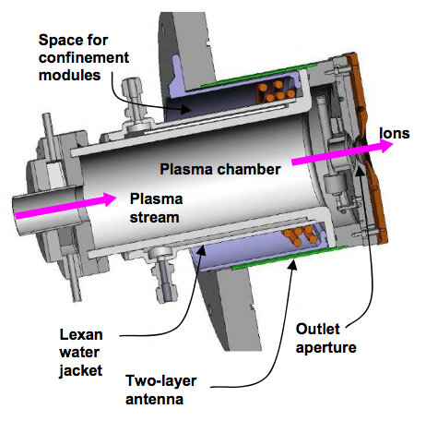
ESS H- acceleration for neutrinos
H-
?
?
The Linac will be built for neutron spallation (proton acceleration)
Duty factor low (4%); some additional capacity is available
Repetition rate can be increased to 28 Hz, to permit an extra acceleration cycle
Neutrino option: acceleration of 5 MW H-
H- necessary for efficient injection into an accumulator
Add-ons:
  H- Source
  Accumulator with beam lines for injection and extraction
  Target station
H- acceleration must not perturb the neutron facility
Modifications (upgrades) of the Linac permit the doubling of power (5 + 5) MW

Slide 18
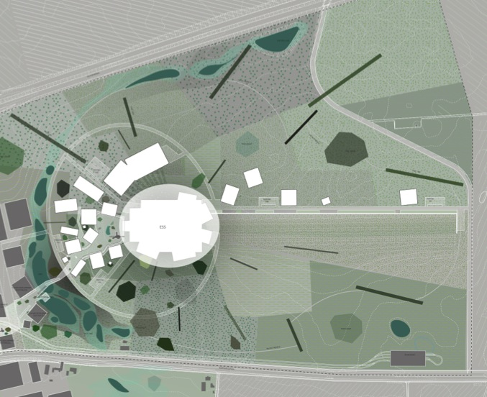
ESSnuSB for neutrinos
Preliminary layout
Neutron
spallation
target
p
H⁻
ESS linac
Target/horn station
Neutrino beam
Accumulator
Beam-line for energy upgrade

Slide 19
H⁻ Source
SNS at Oak Ridge Natl. Lab.
Parameter | Unit | ISIS | SNS | BNL | CERN, L4 | ESS ν | SPL
Beam Energy | keV | 16-35 | 65 | 35,40 | 45 | 75 | 45
Pulse duration | ms | 0.5 | 1 | 0.8 | 0.4 | 3 | 1.2
Repetition Rate | Hz | 50 | 60 | 6.6 | 1 | 14 | 50
H⁻ current | mA | 35 | 60 | 65 | 80 | 62.5 | 80
H⁻ production mode |  | Cs-Arc | Cs-Surf. | Cs-Surf. | Cs-Surf. | Cs-Surf. | Cs-Surf.
Plasma Heating
Emmittance In RFQ Norm RMS | mmmrad |  | 0.25 |  | 0.25 | 0.20
Cs-consumption | mg/day | 100 | 0.4 | 12
Operation MTBM | weeks | 5 | 6 | 36 | 52
There exist sources that could give the required performance for ESSνSB
Courtesy: J. Lettry

Slide 20
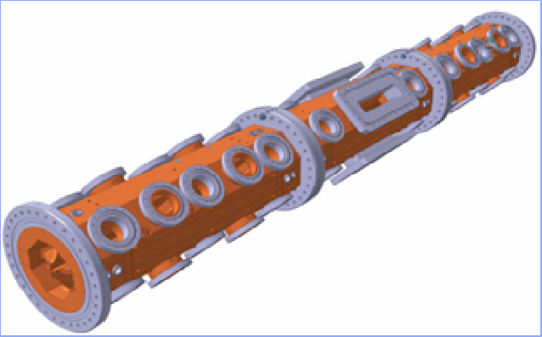
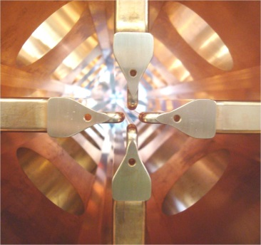
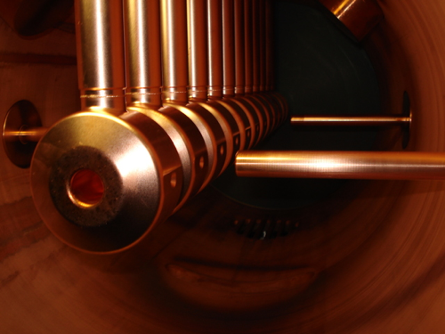
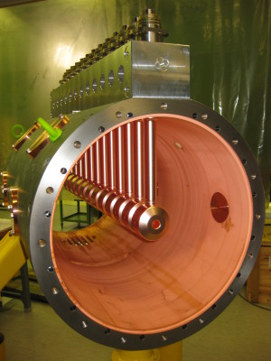
ESS Front End
The RFQ and DTL will be similar to the CERN Linac 4 design.
The RFQ
  will be 4.5 meters long
  and reach an energy of 3.6 MeV
The DTL
  Will consist of five tanks
  Each tank ~7.5 meters in length
  Final energy will be 88 MeV
Six klystrons
  at 352 MHz
  with a maximum saturated power of 2.8 MW
  and a duty factor of 4% are required for the Front End

Slide 21
ESS Superconducting RF
Over 97% of the ESS linac will be superconducting cavities.
Compared to copper cavities, superconducting cavities can offer:
  over three times the gradient
  over 10 times the aperture
  with virtually no power dissipated in the cavities

Slide 22
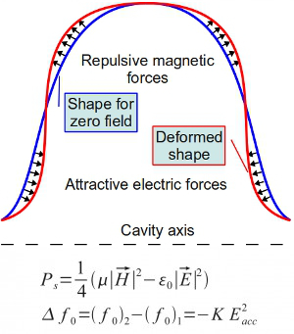
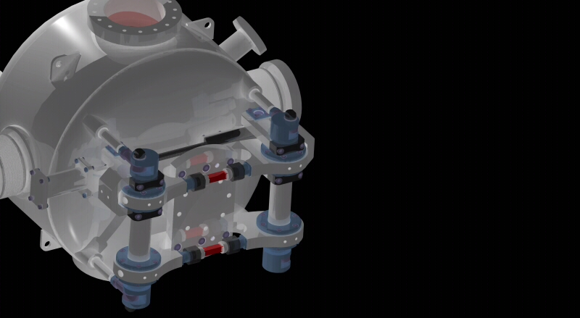
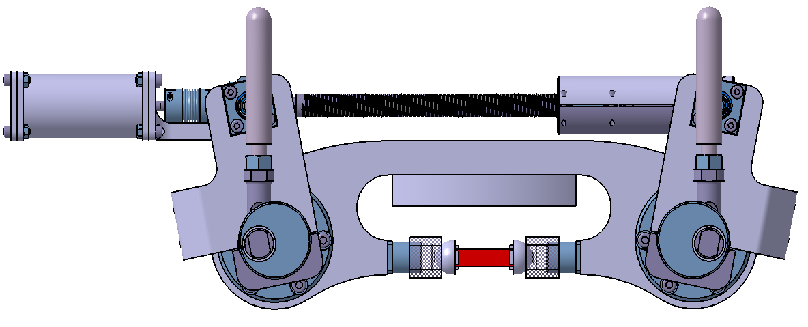
Lorentz detuning
Because of the enormous gradients in superconducting cavities,
  the radiation pressure deforms the cavities
We expect over 400 Hz of detuning in the ESS cavities.
  Unloaded cavity bandwidth = 0.07 Hz
  Loaded cavity bandwidth = 1 kHz
The mechanical time constant of the cavities is about 1 ms compared to the pulse length of 3 ms
  Static pre-detuning as done in SNS will not be sufficient
  Dynamic de-tuning compensation using piezo-electric tuners is a must!
  Or else pay for the extra RF power required

Slide 23
Transit Time Factor
For proton linacs using copper RF cavities
  the cavity cell structure is tuned to match the changing proton velocity as it accelerates.
  The power profile is usually flat
Because of high fabrication costs and difficulty,
  The cell structure of superconducting cavities is tuned for only one beam velocity.
  Multiple families of cell velocities are chosen. ESS cell velocities:
    Spoke: β_{g} = 0.5
    Medium beta: β_{g} = 0.67
    High beta: β_{g} = = 0. 86
  There is a limit on the surface field in a SCRF cavity (ESS 45 MV/m)
    Since, the particle velocity does not match the geometrical velocity for the entire acceleration range,
    The power profile is not flat

Slide 24
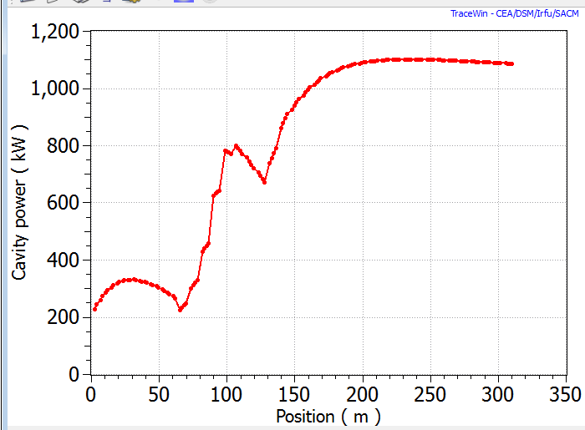
ESS Power Profile

Slide 25
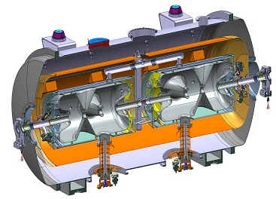
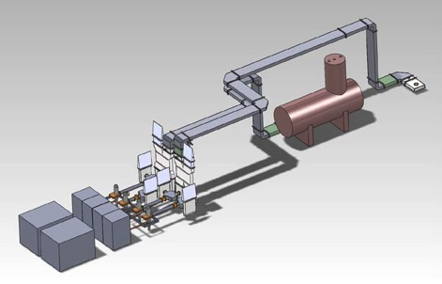
ESS Spoke Cavities
ESS will transition to superconducting cavities at 88 MeV
ESS will be the first accelerator to use 352 MHz double spoke cavity resonators
Twenty-eight cavities with an accelerating gradient of 8 MV/m are required.
Each cavity will operate at a nominal peak power of 320 kW
What type of power source to choose?
  Tetrode
  Klystron
  IOT
  Solid State
Layout of the 352 MHz RF
source, wave guides and test
cryostat in the FREIA hall

Slide 26
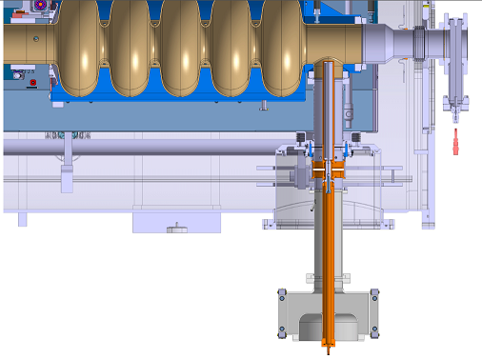
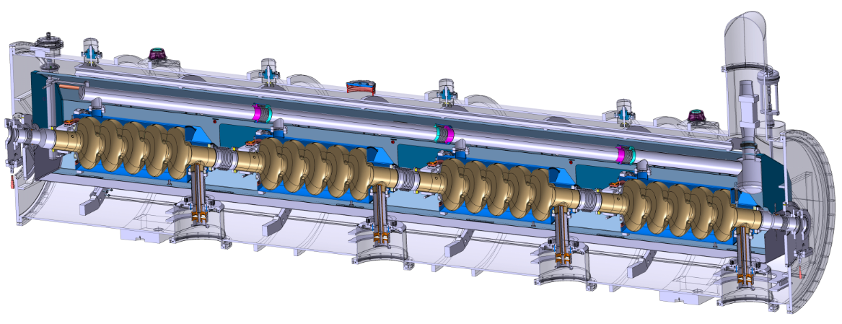
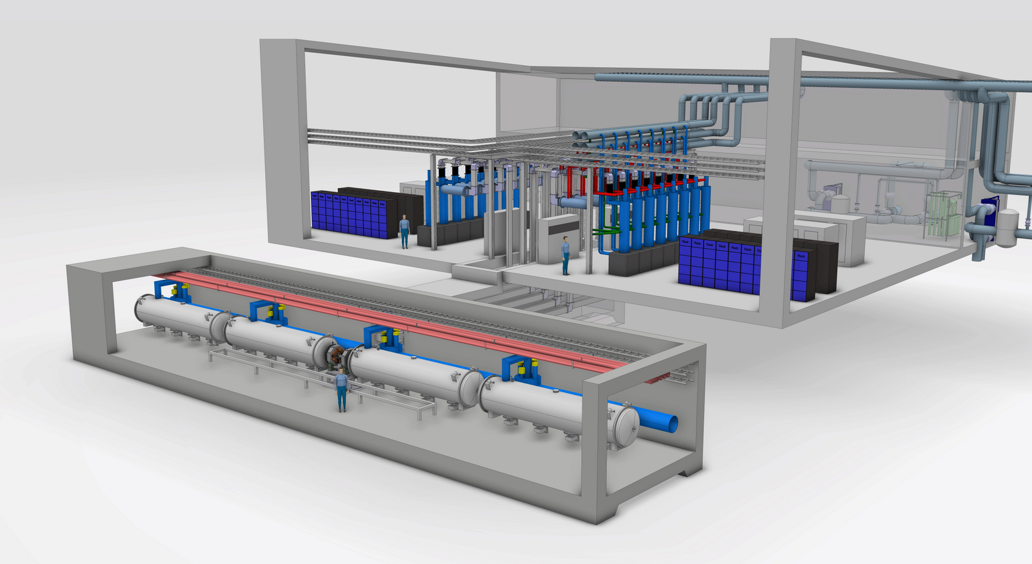
ESS Elliptical Cavities
Universal Cryomodule
  Cryomodules are expensive and difficult to fabricate
  Pick cavity β_{g} and number of cells
    Optimize power transfer
    Optimize length
  Power in couplers is limited to 1.2 MW (peak)
    Medium Beta β_{g} = 0.67
  6 cell cavities
  Cavity length = 0.86 m
  32 cavities packaged in 8 cryomodules
  Maximum peak RF power = 800kW
    High Beta β_{g} = = 0. 86
  5 cell cavities
  Cavity length = 0.92 m
  88 cavities packaged in 22 cryomodules
  Maximum peak RF power = 1.1 MW
One cavity per klystron
Two klystrons per modulator
16 klystrons per stub

Slide 27
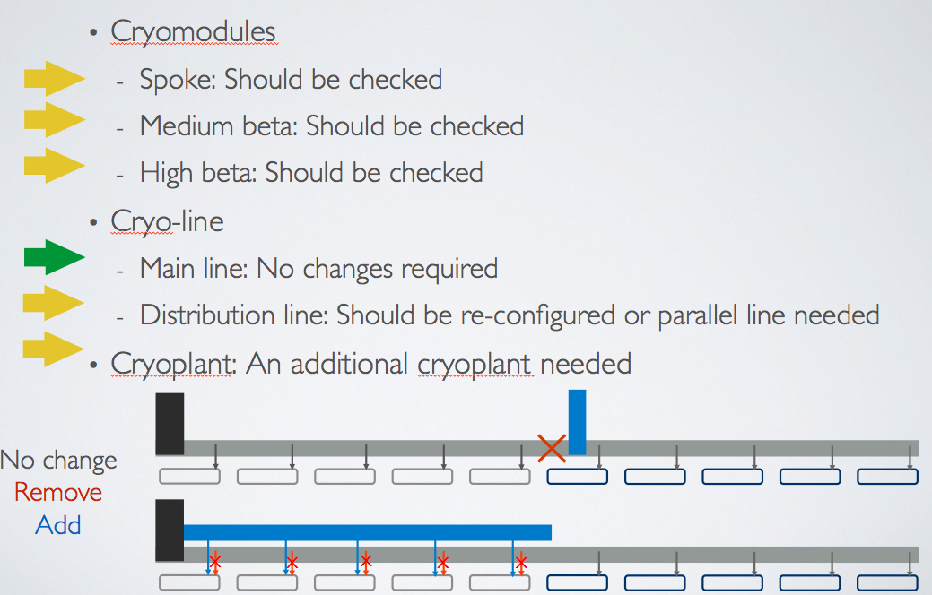
ESS Upgrade for Neutrinos: Cryo

Slide 28
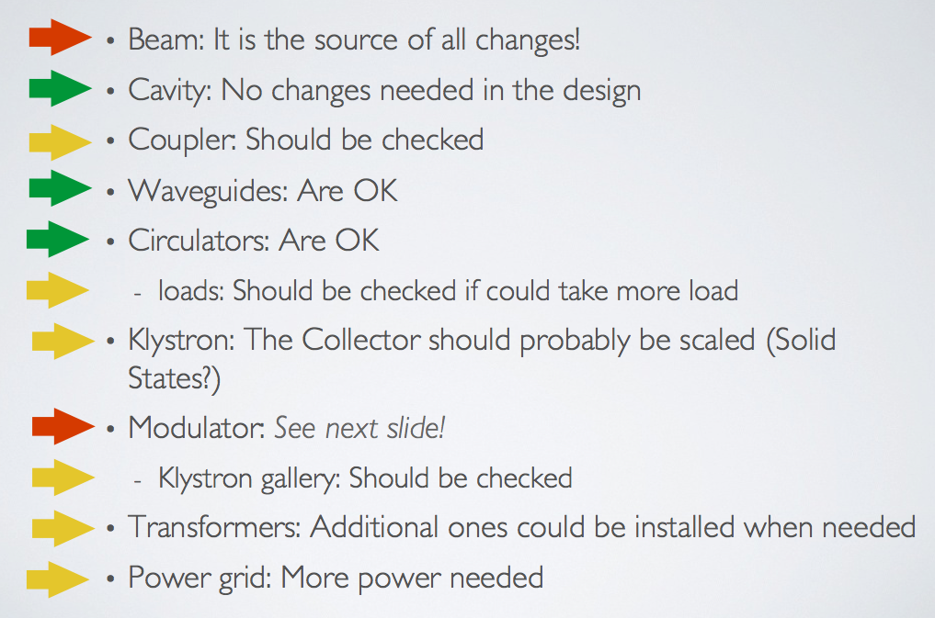
ESS Upgrade for Neutrinos: RF

Slide 29
ESS Upgrade for Neutrinos: Beam Physics
Transport of the H- along the linac
  Matching
  Stripping calculations
  Loss ratios (Total loss of p + H- < 1w/m)
Setting the tolerances for H- transport
Selecting the best position to merge the two beams (emittance growth)
Control system for higher rep. rates
28 Hz (70 Hz for the accumulator)
Longer and less intense linac beam pulses (to avoid unwanted stripping)
  Check cooling of RFQ

Slide 30
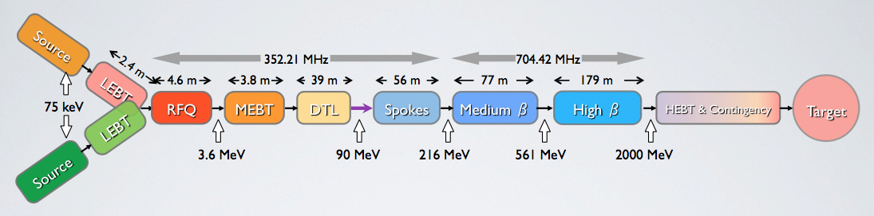
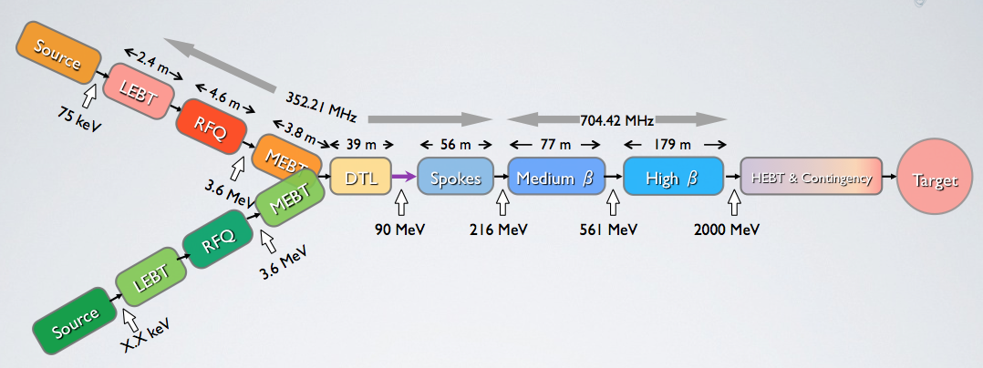
ESS Upgrade for Neutrinos: Merging
Source: An H- source is needed
LEBT: Do we merge the beams here?
RFQ
  The cooling capacity should be checked
  Depending on best merging position a new RFQ might be needed
MEBT: We could also merge the beams here!
DTL: Current calculations indicate that the cooling should be enough

Slide 31
Why an Accumulator for neutrinos
proton driver
28 or 70 Hz
H-
Accumulator
ring
The magnetic horn is pulsed and cannot accept the whole linac pulse of 3 ms
Needs research !
ESS 2-3 GeV, 5 MW
Magnetic
horn capture
(collector)
p
Target
ν, μ
hadrons
decay tunnel
Make 3 ms pulse shorter by accumulating in ring (s)
Accumulator Rings
Linac Beam
Needs study: Do these gaps in the linac pulse perturb the linac beam?
Kicker gap (50-100 ns)

Slide 32

Why more than one ring
ESSnuSB
  1.25 MW on each target, 4 targets
  Reasonable accumulator circumference of 430 m =>1.5 μs pulse length
  Simple space charge formula, coasting beam, self field
  1.1 10¹⁵ p would give SC of -0.67 (round beam, 2.0 GeV, 100 πmm mrad)
    Resonances
  4 rings: Particles in one pulse from accu: 1.1 10¹⁵/4 => 2.75 10¹⁴
  In one ring: For 2.75 10¹⁴ protons in machine SC < – 0.2 (acceptable)
Bf
For example: K. Schindl: Space Charge, CERN, 1999
D. McGinnis, M. Lindroos, R. Miyamoto, “European spallation source afterburner concept”, IPAC

Slide 33
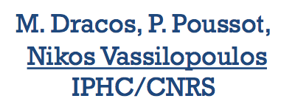
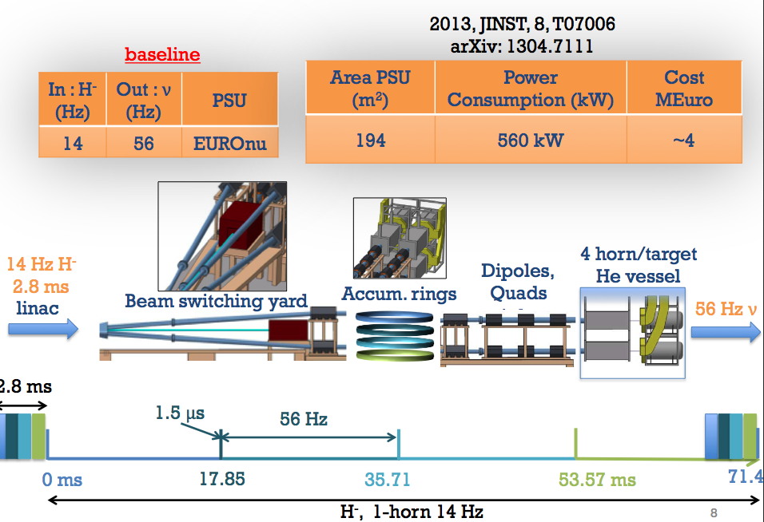
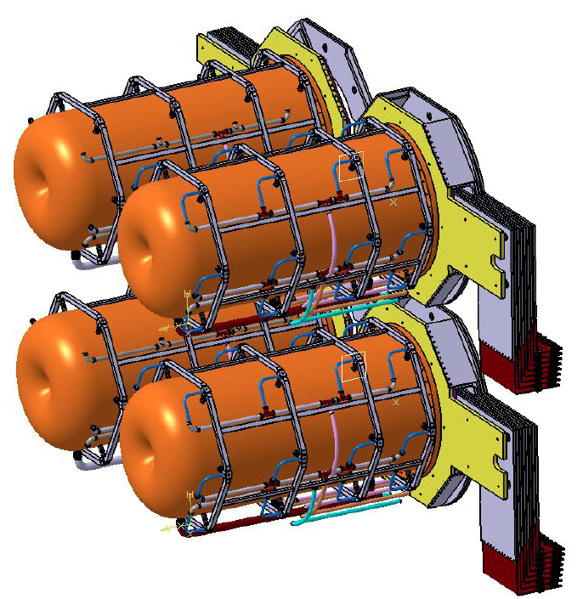
What can we optimize: Several Accumulators
Horn pulsing 56 Hz
With 4 rings we would have the beam too long in accumulator (to be checked!)
https://indico.in2p3.fr/getFile.py/access?contribId=5&resId=0&materialId=slides&confId=8998

Slide 34
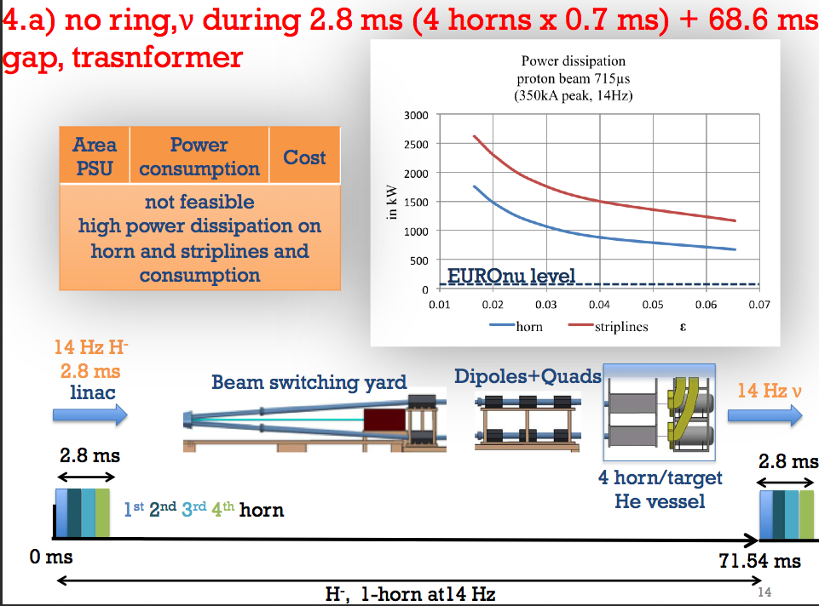
What can we optimize: No Accumulator
Beam direct on target is the best solution however not feasible today, too high power dissipation with today’s horn design & technologies.
R&D, superconducting coils (R. Maccaferri)
Heat deposition in coils
Can e.g. 4 Linac slices of 0.7 ms each help the problem? See later slides.
https://indico.in2p3.fr/getFile.py/access?contribId=5&resId=0&materialId=slides&confId=8998

Slide 35
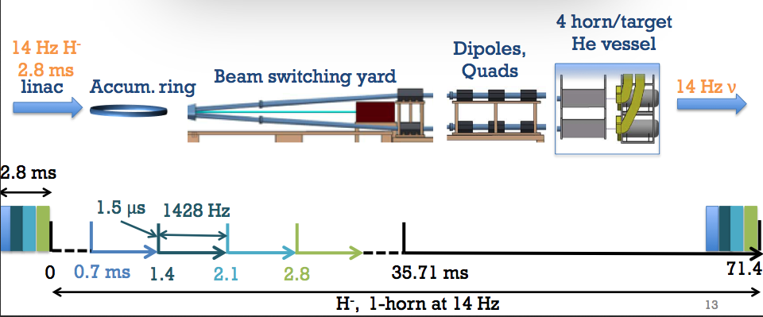
We propose one ring, but spaced Linac pulses
Once the ring is full we extract BUT, we need time for injection and extraction.
We could make “holes” in the Linac beam, “chop” the Linac beam,
but we would need to throw away too many particles.
Proposal:
We make shorter and spaced linac pulses to permit injection/extraction
In particular the injection bumper needs time
Time for injection bumpers needed here: space linac pulses not to loose too much beam by chopping

Slide 36
Linac Pulsing, proposal
neutrino
neutron
71.4 ms, 14 Hz
35.7 ms
28 Hz
Four Accumulators
(Baseline)
2.86 ms
71.4 ms, 14 Hz
14.28 ms
70 Hz
One Accumulator
0.7 ms
2.86 ms
Injection system design of accumulator to be checked (heat deposition and radiation.

Slide 37
70 Hz pulsing
Fill time for superconducting cavities: 0.2 mS
For two 3 mS beam pulses, 6.6% of the beam pulse length
Inefficiency 6.6%
4 pulses at 0.75 mS and one pulse of 3 mS:
    Inefficiency 16.6% (5 x 0.2 mS = 1 mS filling time)
This extra power must be cooled and paid for
Worth it ?
Communication D. Mc Ginnis

Slide 38





Lorentz Stripping
Electric field seen by H-
If strong enough electrons can be ripped off (Scherk, 1979)
The fraction of stripped ions/unit length
Stripping probability
CERN-BE-Note-2010-015:
Magnetic stripping studies for SPL
P. A. Posocco, M. Eshraqi
H⁻
lab

Slide 39
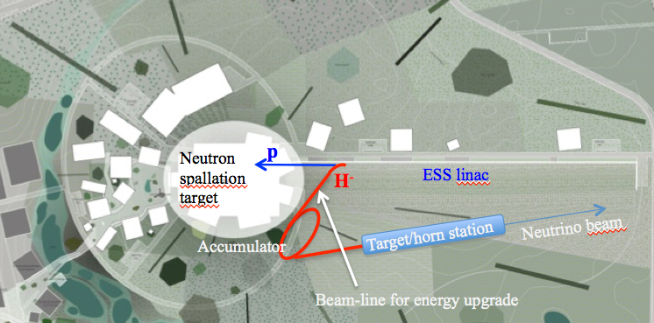
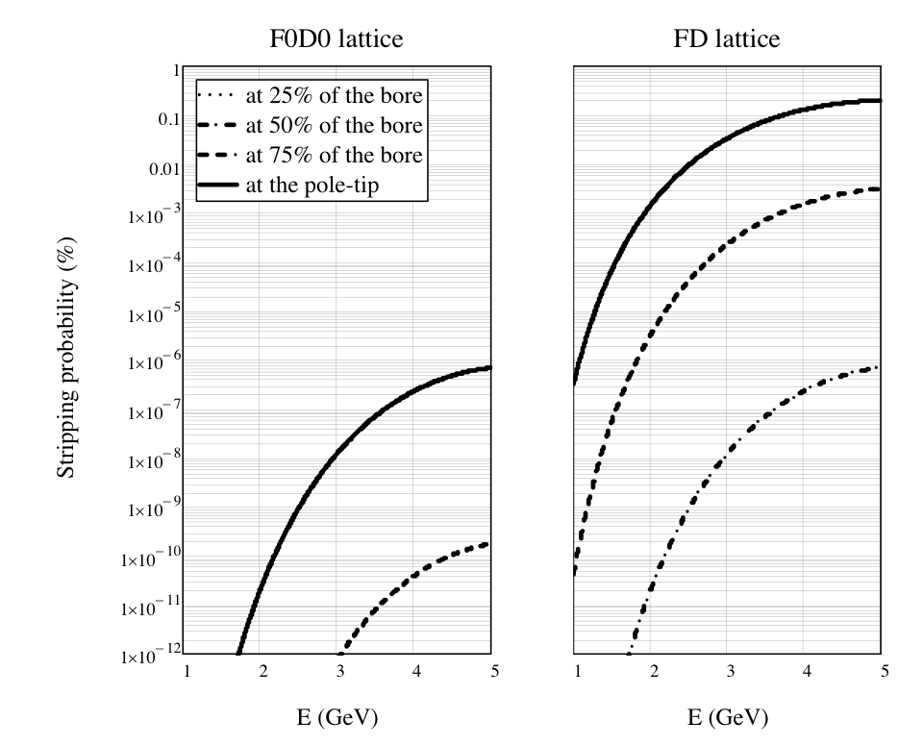


Lorentz Stripping in Linac
At exit of beam
  Calculate necessary length of dipole magnet
  Depends on layout of the Linac HEBT
In quadrupoles for large amplitudes
1GeV H- can be stripped in a few Tesla fields (binding of loosest e- is 0.755 eV)
SPL: 50 mm bore, 450 mm long
We need to check the SPL quad strengths to make statement

Slide 40

Lorentz stripping
Ion rest frame:
E[MV/cm] = 3.197 • p[GeV/c] • B[t]
The ion lifetime:
τ= A/E • exp(C/E)
A=7.96 10⁻¹⁴ [s MV/cm]
C=42.56 [MV/cm]

Slide 41



Lattices (SNS & SPL)
  Small accumulator lattices (shorter pulses on target)
  We can increase the circumference using some insertion on the straight section
  We need first to check the injection
  Check beam stability (collective effects)
    Extensive study
    We have the expertise in ABP/HSC
SPL accu
SNS
A good lattice design is needed !

Slide 42
Injection
Arbitrarily the SPL and the SNS latiices have been used for checks
  For the time being we use the SPL accumulator lattice and the SNS lattice
    SPL: cds.cern.ch/record/1125556/files/CERN-AB-2008-060.pdf (Jakob Jonnerby MAD, Horst Schönauer ACCIM, WINAGILE)
    SNS: Courtesy Yannis Papafilippo, Jakob Jonnerby to set up a working MADX file
  The design of a fully adapted lattice needs more work
Foils could be possible to use (first phase running?)
  Heating
Laser stripping injection is proposed for SNS and PS2
  We investigate and follow work
The “baseline” emittance is increased from 100 to 150 Pi mm mrad

Slide 43
Multi-turn injection for hadrons
Septum magnet
Courtesy W. Bartmann
Varying amplitude bump
Closed orbit bumpers
No kicker
Bump amplitude decreases and inject a new bunch at each turn
Phase-space “painting”

Slide 44
Multi-turn injection for hadrons
Turn 1
On each turn inject a new batch and reduce the bump amplitude
Courtesy W. Bartmann
Example:
CERN PSB injection,
fractional tune Qh = 0.25
  Beam rotates π/2 per turn in phase space
Septum

Slide 45
Multi-turn injection for hadrons
Turn 2

Slide 46
Multi-turn injection for hadrons
Turn 3

Slide 47
Multi-turn injection for hadrons
Turn 8

Slide 48
Multi-turn injection for hadrons
Turn 15
Phase space has been “painted”
In reality filamentation occurs to produce a quasi-uniform beam

Slide 49
Charge exchange H- injection
Multiturn injection is essential to accumulate high intensity
Disadvantages inherent in using an injection septum
  Width of several mm reduces aperture
  Beam losses from circulating beam hitting septum
  Limits number of injected turns to 10-20
Charge-exchange injection provides elegant alternative
  Possible to circumvent Liouville’s theorem, which says that emittance is conserved
  Convert H⁻ to p⁺ using a thin stripping foil, allowing injection into the same phase space area
Courtesy W. Bartmann

Slide 50
H- injection foil stripping
24 m
Courtesy W. Bartmann

Slide 51
Comparison of Foil Heating Simulations for some Project Lattices with the SNS (built machine)
 | TEST CANDIDATE: ESS Linac + AIBA 2008 Lattice | CERN SPL PDAC 2001 1Foil | CERN SPL PDAC 2001 2Foils | SNS
C [m] | 318 | 943 | 943 | 242
T [GeV] | 2 | 2.2 | 2.2 | 1
P beam | 5 GW / 4 | 2 GW | 2 GW | 1 GW
f rep [Hz] | 14 | 50 | 50 | 60
Np | 2.8E14 | 2.3E14 | 2.3E14 | 1.5E14
N turns | 650 | 850 | 850 | 1060
ε _{Norm} (95%) | 100 / 150π*) | 150π | 150π | 200 π
ε _{Linac} (95%) | 0.667 π | 2 π | 2 π | 1.5 π
N_{macro} | 32500 | 41000 |  | 156000
Foil [μg/cm2] | 750 | 750 | 2 x 750 | 400
 | *) 100π too small; 150π needed
Simulations of earlier CERN GW accumulator projects have been done with the ACCSIM Code. The results are compared with the ORBIT results (courtesy M. Plum, J. Holmes) for representative SNS beams.
Horst Schönauer

Slide 52


Two Cases Simulated for the 2008 Aiba Lattice :
‘Multiturn’ vs. ‘Matched’ painting
The classical multi-turn matching, intended to avoid the septum during tens of turns injected,
fails for the hundreds of turns of charge exchange injection, leading to extremely high current
densities and foil temperatures. We propose a different matching in Normalized Phase space
The average Nr of foil hits remains about the same, but the beam areas on the foil increases
Horst Schönauer

Slide 53




SNS Foil: Power Densities W/m3
H- Linac
H- Linac+ p circulating
Courtesy M. Plum (ORNL)
Courtesy M. Plum (ORNL)
Foil Temperature, max. 1164 K
Foil Temperature, max. 1430 K
Horst Schönauer

Slide 54




Aiba Lattice Foil: Power Densities W/m3
H- Linac
H- Linac + p circulating
Foil Temperature max. = 1200 K
Foil Temperature max. =1375 K
Horst Schönauer

Slide 55
Rings Compared: ESS (Aiba Lattice 2008), PDAC (2001), SNS
Case | ESS 150π Multiturn | ESS 150π Matched | PDAC 1Foil | PDAC 2 Foils | SNS 2013
Qx,y | 7.76, 7.67 | 7.61, 7.28 | 11.22, 13.31 | 11.22, 13.31
betx, y | 9.87, 17.95 | 21.94, 28.35 | 4.373, 9.243 | 4.373, 9.243
betLx, y | 2.35,4.25 | 21.7, 28.35 | 1., 2. | 1., 2.
Linac spot FW | 2.5 x 3.4 | 8 x 10 mm | 2.8 x 4 mm | 2.8 x 4 mm | 8x8 mm
Av Nr of Foil hits | 2.4 | 3.2 | 4.7 | 1.6 + 3.8 | 8
Peak Lin. Current | 14444 A/m2 | 2010 A/m2 | 2084 A/m2 | 1034 A/m2 | 1696 A/m2
Peak Circ. Curr. | 20520 A/m2 | 7040 A/m2 | 3331 A/m2 | 2125 A/m2 | 4846 A/m2
dE/dx [MeV cm2/g] Linac H-/ Circ. P | 4.985 / 1.773 | 4.985 / 1.773 | 3.133 / 1.85 | 3.133 / 1.85 | 3.421 / 1.937
T max Linac H-/ Circ. P | 2715 / 1850 K | 1375 / 1200K | 2806 K RAL values | 2112 K RAL values | 1164 / 1430 K
13/03/14
Horst Schönauer

Slide 56
Conclusions:
As a first test candidate, we combined the M. Aiba’s 2008 Ring (C = 318m) with the ESS Linac parameters assuming one ring, four fillings of 0.7ms to be sent to four horns.
Using a Linac-to-circulatlng beam matching different
  from the standard multi-turn rule, foil temperatures in the ballpark of the current SNS values appear feasible.
In order to increase the heated foil area, the final rms emittance was raised 150π. Also profiting from this increase are the max. space-charge tune shifts of <-0.3
Horst Schönauer

Slide 57


Foil temperature evolution (1D model)
Foil temperature evolution during 4 accumulator filling cycles (1)
(elliptic nominal core beam : 1σ = 1 mm : Max T(x,t) > Carbon melting point)
ACC filling time 0.715 ms: foil temp rise
Filling every 71.4 ms (14 Hz): foil cooling
Left plot comparison with the simplified (0D) foil model (continuous line)
T(x,t) [°K] vs t [ms] at 3 foil width locations x [mm]
Michel Martini

Slide 58


Foil temperature evolution (1D model)
Foil temperature evolution during 4 accumulator filling cycles (2)
(elliptic nominal core beam : 1σ = 2 mm : Max T(x,t) < Carbon melting point)
Foil temperature versus time [ms] and foil width [mm]
Front view of the left plot : T(x,t) [°K] vs t [ms] and x [mm]
ACC filling time 0.715 ms: foil temp rise
Filling every 71.4 ms (14 Hz): foil cooling
T(x,t) [°K] vs t [ms] at 3 foil width locations x [mm]
Left plot comparison with the simplified (0D) foil model (continuous line)
Michel Martini

Slide 59
Foil temperature due to the linac beam (1 and 4 rings)
Maximum foil temperature (1 and 4 rings)
Linac beam size: 8x10 mm^2
Linac beam size ➔
"Calculation of the maximum temperature on the carbon stripping foil of the spallation neutron source"
C.J.Liaw et al, (BNL),
Proceedings of the 1999 Particle Accelerator Conference, New York
Jakob Jonnerby

Slide 60

Foils for a first implementation?
Foil damage
Present machines on the high beam power frontier are approaching the limits of foils
Sarah Cousineau, Laser stripping WS, Fermilab,
26-27 Sept-2013

Slide 61
Comparison of machine parameters
…where laser stripping is considered (except for ISIS) – likely not complete
Parameter | Units | ISIS | SNS | HP-PS | FNAL | ESS accumulator
Kinetic energy at inj | [GeV] | 0.8 | 1 | 4 | 8 | 2
Beam power at inj | [MW] | 0.16 | 1.2 - 3 | 0.19 | 0.34 | 5
Repetition rate | [Hz] | 50 | 60 | 1 | 10 | 14
Total beam intensity |  | 2.5e13 | 1.25-3.1e14 | 2.5e14 | 2.7e13 | 2.8e14 (x 4)
# injected turns |  | 150 - 200 | 1100 | 600 | 360 | 650
Macropulse length | ms | 0.2 | 1 | 2 | 4 | 0.73 (x 4)
Microbunch structure | MHz | 202.5 | 402.5 | 352 | 162.5 | 704.42
Motivation for laser stripping |  |  | Loss control, radiation | Loss control, radiation, em growth | Loss control, radiation
Courtesy W. Bartmann

Slide 62
Include laser into injection setup
Wiggler or laser for neutralisation
Laser for excitation
Dedicated design of D3

Slide 63


Laser stripping concept: H⁻ to H⁰
Either Lorentz-stripping in a wiggler magnet…
or Photo-dissociation

Slide 64
Laser characteristics for HP-PS
(H⁰ --> p⁺ stripping)
Parameter |  | n=2 | n=3
Wavelength | nm | 1064 | 1064
Laser/H- angle | deg | 47.50 | 8.39
Angular spread | deg | ±0.10 | ±0.42
Micropulse energy | uJ | 360 | 92
Macropulse length | ms | 2 | 2
Macropulse energy | J | 253 | 65
Peak power (single pass) * 3 (margin) | MW | 21.6 | 5.5
Average power (single pass) | kW | 43.2 | 11.0
Average power (mode-locking) | W | 760 | 193
Average power (Q=100) | W | 432 | 110
Vertical laser beam height (1 σ rms) | mm | 1.5 | 1.5
Linac pulse, 1 σ rms separated by 2.84 ns | ps | 15 | 15
Laser repetition rate (max) | Hz | 1 | 1
Availability | % | 99 | 99
Relevant parameters as input for laser feasibility discussion
Courtesy W. Bartmann

Slide 65
Laser stripping - HW
Chicane and painting bumpers (~4 each)
  Chicane: one of these septum like depending on geometry and specially designed stripping magnet
Stripping foil
  Thin foil: Foil holder with exchange possibility
  Thick Foil: convert unstripped H- and H0 to protons to guide them into dedicated waste beam channel
  Vacuum and radiation compatibility
Waste beam handling
  Internal dump (PSB)
  Short line to external dump
  Electron collector
  Careful design of beam trajectories required due to different angles for H-,H0 in chicane magnets
  Machines with running H- injection suggest tracking studies of waste beams and a high number of diagnostic possibilities
Laser
  Wiggler magnet or laser for H⁻ neutralisation
  Laser for excitation + optical resonator
  All the equipment to run the laser (optical table, fiber,…)
  Vacuum window

Slide 66


Injection area optics
Contradicting requirements for foil and laser → two different optics settings
Foil optics
Laser optics

Slide 67
Items which deserve attention
Laser
  Locking to beam temporal structure
  Optical resonator
  Transport of laser light, radiation hardness
300 J through a vacuum window
Integration of wiggler and laser with variable interaction angle
Magnet design of wiggler and stripping chicane magnet (fringe field)

Slide 68
Summary, laser stripping
Challenges:
  Commercial lasers don’t fully match yet the requirements from accelerators but this community is extremely fast evolving
  Wiggler design/integration
  Fringe field design of stripping chicane magnet
  Vacuum windows withstanding laser power
Long term
  Laser stripping to be operational with similar or better performance than foil stripping … 2020-2025 ???
Laser Stripping is a research opportunity

Slide 69



Intrabeam Stripping
“First Observation of Intrabeam Stripping of Negative Hydrogen in a Superconducting Linear Accelerator”
A. Shishlo, J. Galambos, A. Aleksandrov, V. Lebedev, and M. Plum

Slide 70


Intrabeam Stripping
Empirical cross section
  Valid for β > β_{m} where β_{m is} the velocity below which particles repel
  α_{fs} is the finsstructure constant, 1/137
  a₀ is the Bohr radius, 0.529·10⁻⁸ cm
Particle loss rate
  v is the velocity of the particle, u=v₁-v_{2,} r is the position, f is the distribution function
Intra-beam stripping for new HP linacs (PX, ESS …)
  Important to take into account, goes with square of N (35-62 mA)
  In Figure 3 the integral of the beam loss flattens…
What could be done
  Reduce the beam current
    Consequences ?
  Make the pulse longer and less intense
    Superconducting part ok
    Low energy part: more cooling

Slide 71
Linac Pulsing, option if current too high ? ? ?
neutrino
neutron
71.4 ms, 14 Hz
35.7 ms
28 Hz
Four Accumulators
(Baseline)
2.86 ms
71.4 ms, 14 Hz
14.28 ms
70 Hz
One Accumulator
2.86 ms
0.7 * 2 ms, and half the intensity, for example (if the linac cannot stand the H- intensity)
This will not influence the accumulator design

Slide 72
Summary
The existing Linac has to be upgraded and checked (list of items presented), unless neutron production also can benefit from H-…
Low energy part to be optimized (how many RFQs etc.)
Lorentz stripping probably ok (needs simulations and maybe change of linac optics)
Intrabeam stripping in linac needs simulations
4 Accumulators is not cost effective, 1 is possible paying extra power in Linac, none means heavy R&D

Slide 73
Summary
Foil stripping solutions: necessary fallback ?
Laser stripping important research block: 2025?
SNS or SPL lattices to be adapted, or new design
Linac Microstructure in accumulator?

Slide 74
Thank you for listening
Material & Slides used
B. Kayser, Fermilab,
D. Mc Ginnis and M. Eschraqi ESS,
W. Bartmann, M.Martini, J. Jonnerby and H. Schönauer, CERN.
M. Dracos, CNRS
……

